Slide 1

AGU Fall Meeting 2021
G003 - Geodesy for Climate Research
A high temporal resolution integrated water vapor dataset from more than 10,000 global ground-based GPS stations in 2020
Peng Yuan¹, Geoffrey Blewitt², Corné Kreemer², William C. Hammond², Donald Argus³, Xungang Yin⁴, Roeland Van Malderen⁵, Michael Mayer¹, Weiping Jiang⁶, Joseph Awange⁷, Hansjörg Kutterer¹
1 Karlsruhe Institute of Technology, Geodetic Institute, Karlsruhe, BW, Germany
2 Nevada Bureau of Mines and Geology, University of Nevada, Reno, NV, USA
3 Jet Propulsion Laboratory, California Institute of Technology, Pasadena, CA, USA
4 Riverside Technology Inc, Asheville, North Carolina, USA
5 Royal Meteorological Institute of Belgium, Brussels, Belgium
6 Wuhan University, GNSS Research Center, Wuhan, China
7 Curtin University, School of Earth and Planetary Sciences, Perth, Australia
New Orleans and Online, 13 - 17 December 2021

Slide 2
Motivation
  Water vapor plays an important role in various weather and climate processes and extreme events
  Due to its high spatiotemporal variability, precise quantification of water vapor remains a challenge
  Ground-based Global Positioning System (GPS) provides a unique tool to measure Integrated Water Vapor (IWV), owing to its advantages of high accuracy, high temporal resolution, and all-weather condition availability
  Though tens of thousands of ground-based GPS stations all over the world have been put into operation in recent years, only hundreds of them were used to retrieve IWV in most previous studies. A precise GPS IWV dataset with densified stations around the world is still lacking

Slide 3
Motivation
Nevada Geodetic Laboratory (NGL) GPS data processing
5-min GPS ZTD at 10,000+ stations
Ps/ZHD and Tm
from VMF1 based on operational ECMWF product
at single level, [lat, lon]=[2°, 2.5°], 6-hourly
Ps/ZHD and Tm
from ERA5 reanalysis product
at 37 levels, [lat, lon]=[0.25°, 0.25°], 1-hourly
Converting GPS ZTD into IWV with ZHD and Tm
operational GPS (opGPS) IWV product
enhanced GPS (enGPS) IWV product
Fig. 1. Comparison between the strategies of the operational and enhanced GPS IWV
  The opGPS IWV was calculated with meteorological data from operational ECMWF product
  In this work, we aim at providing an enGPS IWV dataset by using the data from ERA5 reanalysis
  The improvements of the enGPS IWV will be evaluated by using radiosonde and ERA5

Slide 4
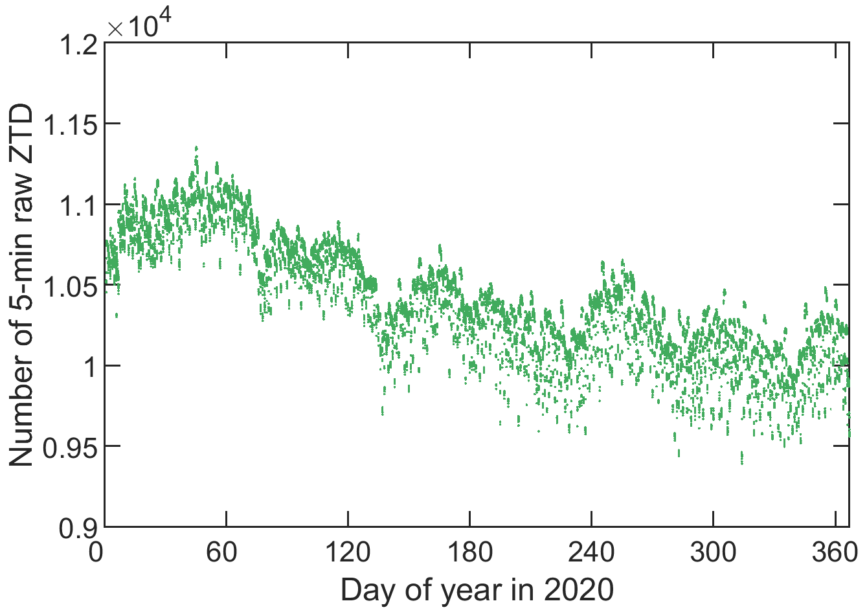
NGL GPS ZTD
  5-min GPS ZTD in 2020
  12,612 stations
  1,103,375,737 raw datapoints in total
  GPS data processing strategy
  GipsyX (Ver. 1.0) PPP solution
  IGS14
  VMF1
  7° elevation angle cutoff
  1st and 2nd order effects of ionospheric delay
  Preprocessing of the enGPS product
  ZTD data screening
  Selection of stations
Fig. 2. Number of raw ZTD per 5-min epoch

Slide 5
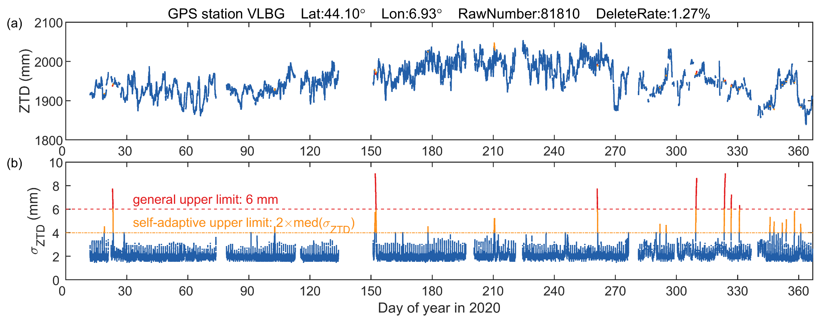
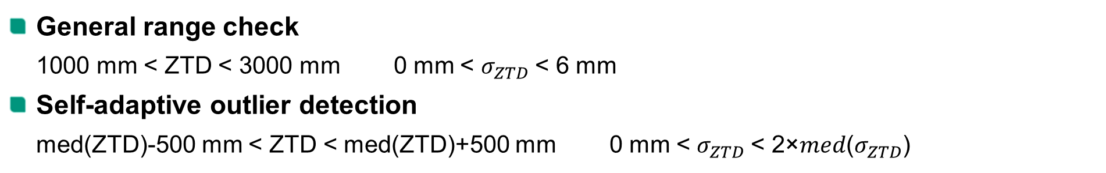
ZTD data screening
  General range check
  1000 mm < ZTD < 3000 mm 0 mm < $σ_{ZTD}$< 6 mm
  Self-adaptive outlier detection
  med(ZTD)-500 mm < ZTD < med(ZTD)+500 mm 0 mm < $σ_{ZTD}$< 2×𝑚𝑒𝑑($σ_{ZTD}$)
Fig. 3. An example of the ZTD data screening at station VLBG

Slide 6
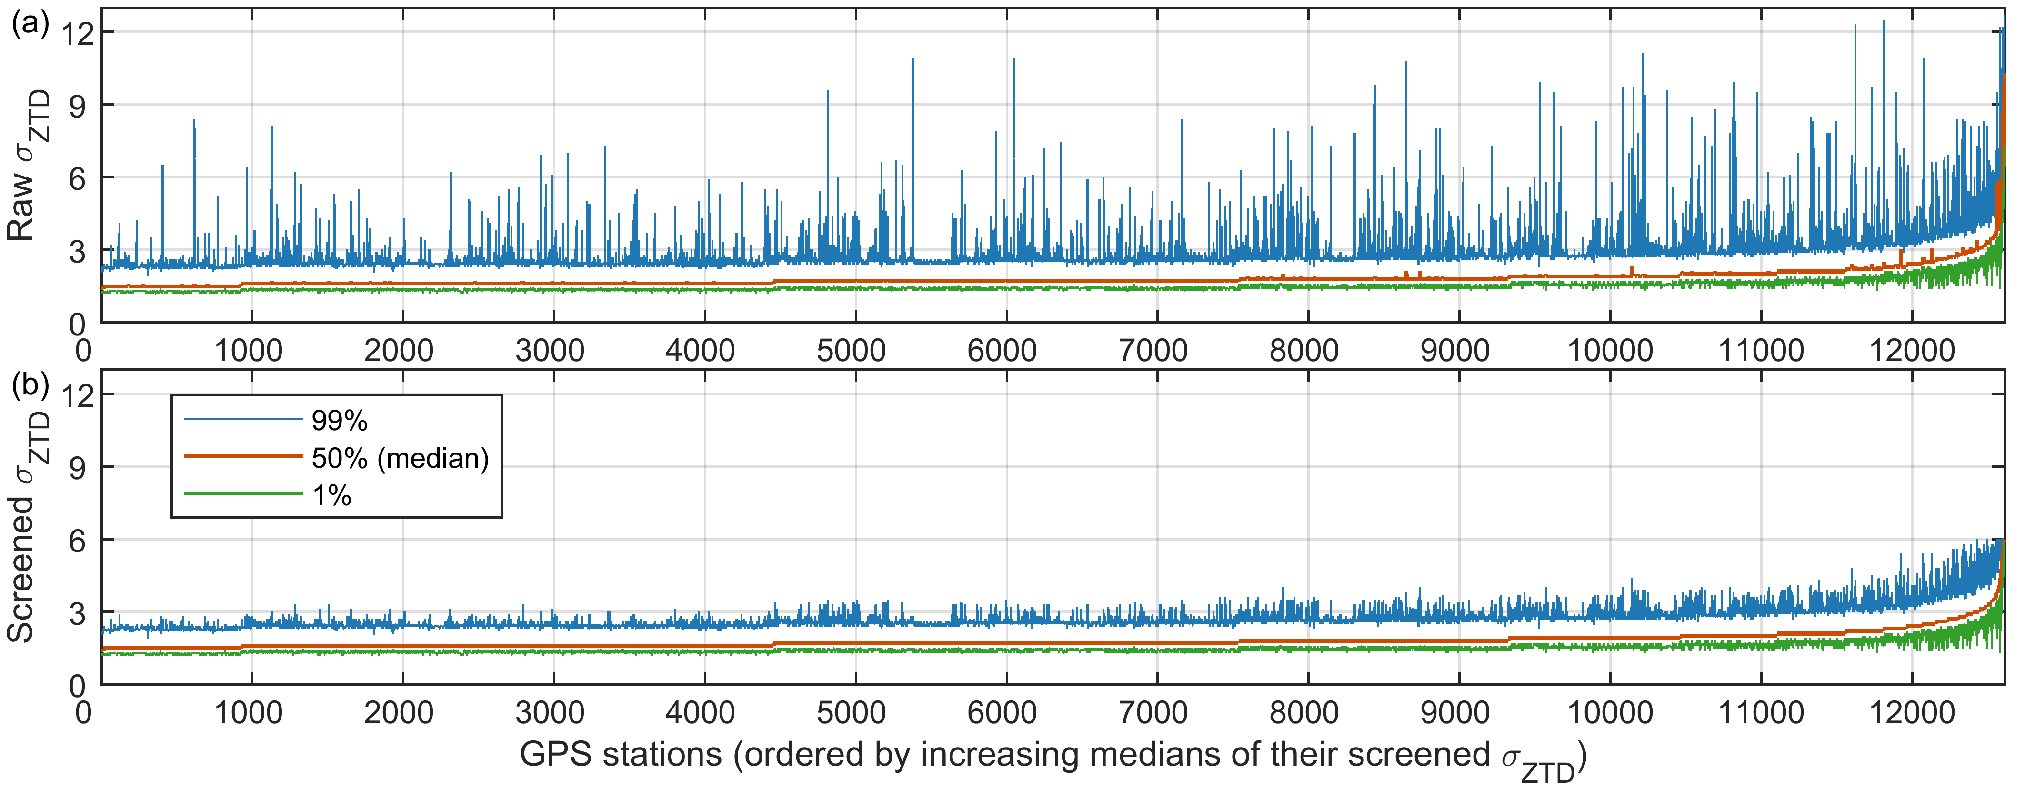
ZTD data screening
  General range check
  1000 mm < ZTD < 3000 mm 0 mm < $σ_{ZTD}$< 6 mm
  Self-adaptive outlier detection
  med(ZTD)-500 mm < ZTD < med(ZTD)+500 mm 0 mm < $σ_{ZTD}$< 2×𝑚𝑒𝑑($σ_{ZTD}$)
Fig. 4. Percentiles of the $σ_{ZTD}$ before (a) and after (b) the data screening

Slide 7
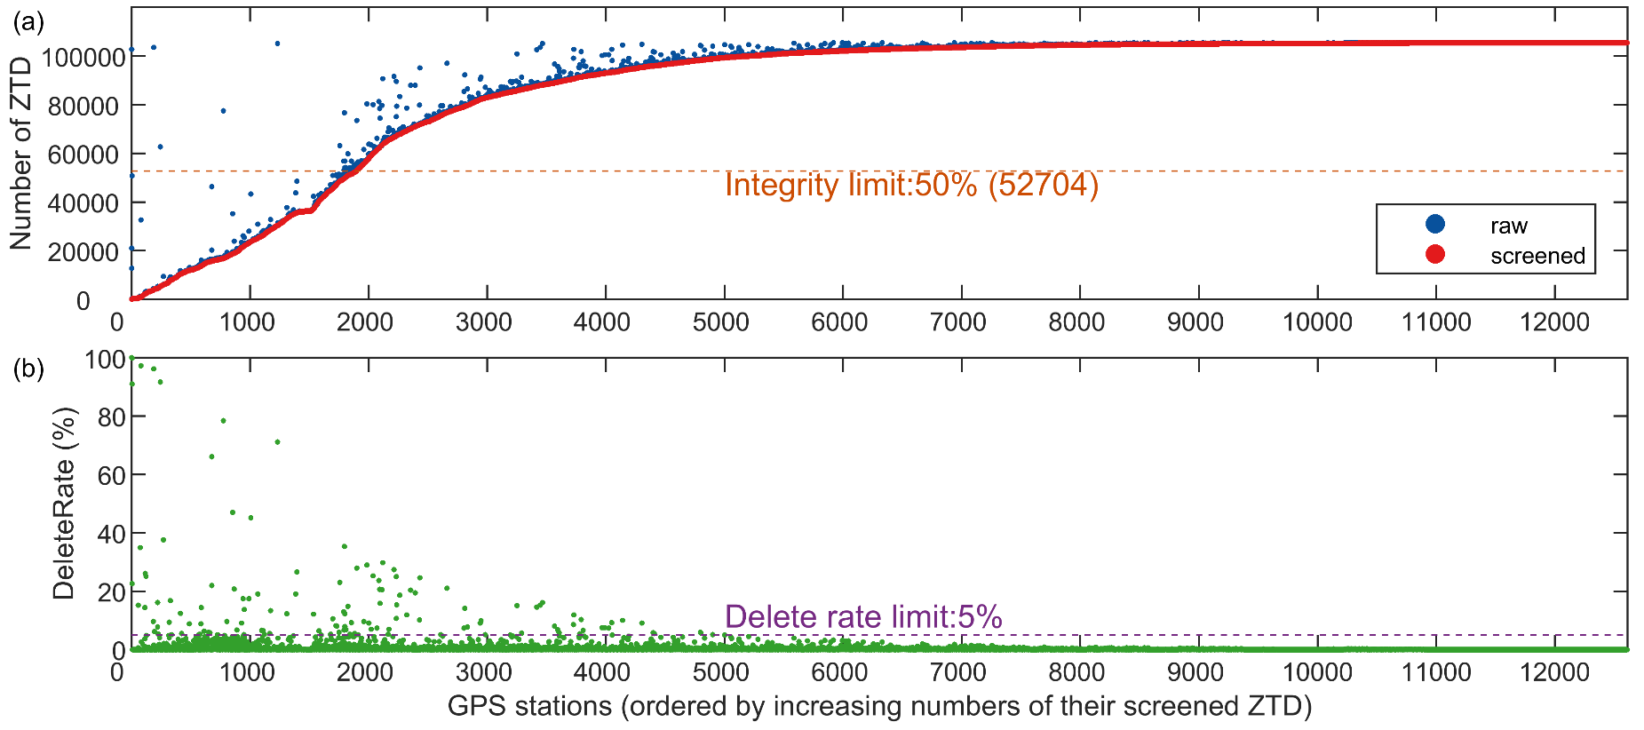


  Selection of stations
  A GPS station is excluded
  if the distance between its actual position and its coordinate in the station list file
  >100 m in East/North, or >10 m in Up, or
  if its 5-min ZTD completing rate <50% (i.e., number of 5-min ZTD <52704 in 2020), or
  if its 5-min ZTD outlier delete rate >5%
$$Integrity=\frac{number of screened observations}{number of all 5−min epochs in 2020}×100\%$$
$$DeleteRate=\frac{number of outliers}{number of raw observations}×100\%$$
Fig. 5. Integrities and delete rates of the ZTD time series

Slide 8
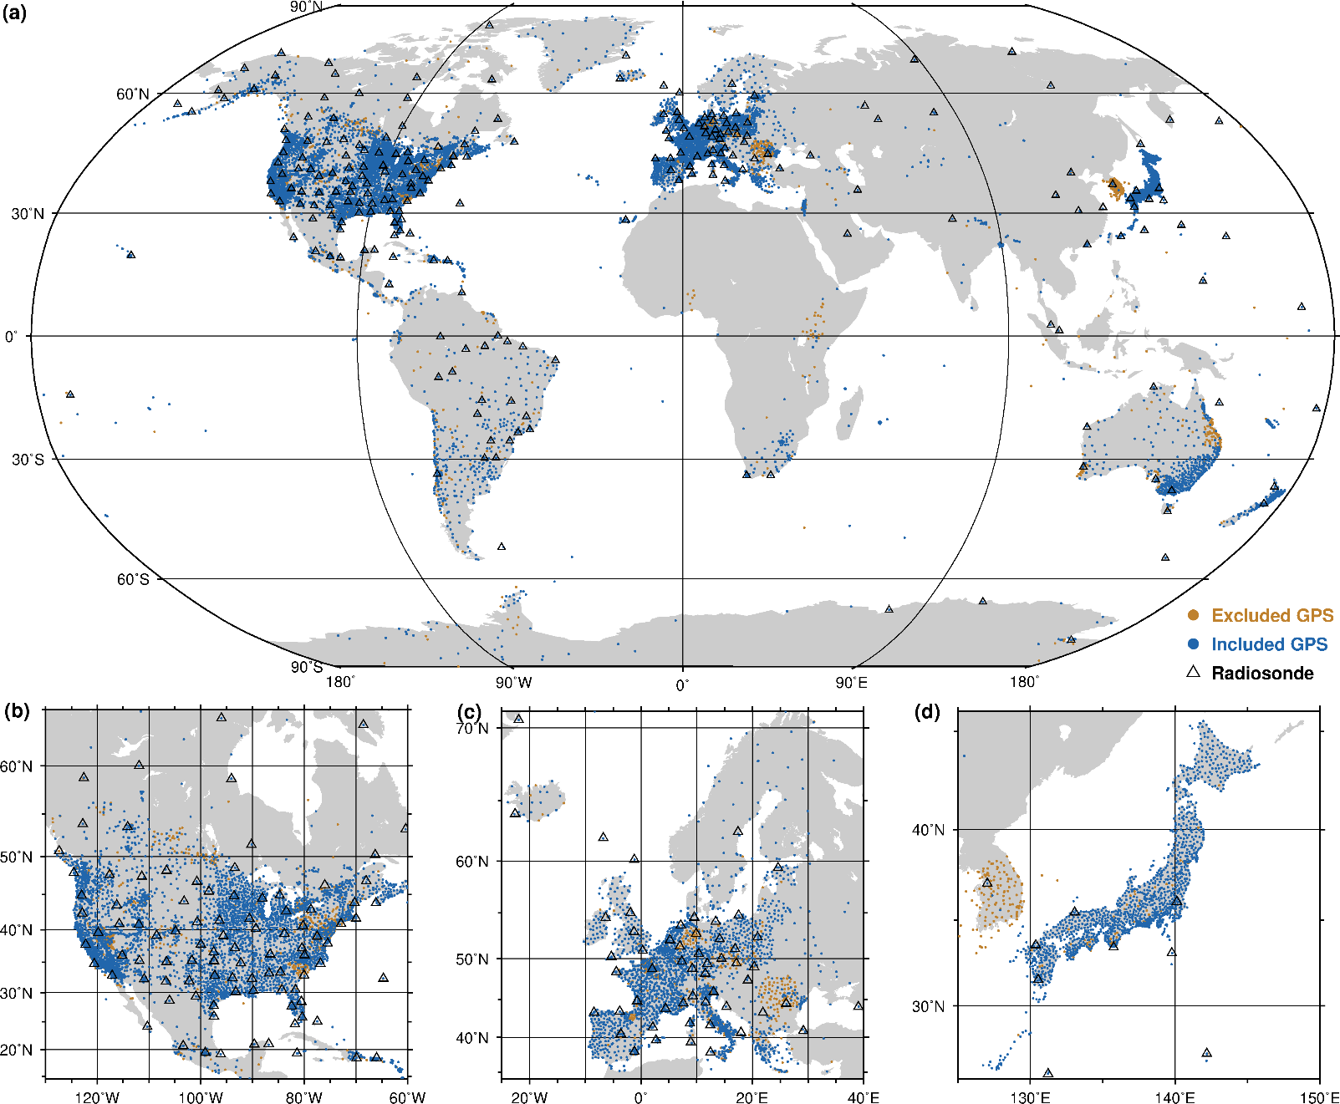
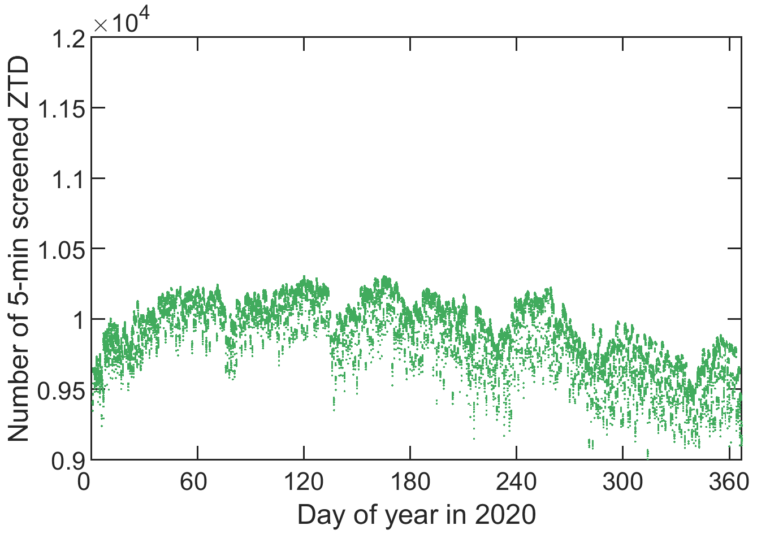
  Screened ZTD for use
 | Num. of stations | Num. of data
Raw | 12,612 | 1,103,375,737
Screened | 10,632 | 1,048,949,554
At last, 95.1% datapoints are used
Fig. 7. Geographical distribution of the 1,980 excluded and 10,632 included GPS stations, and 235 radiosonde stations
Fig. 6. Number of screened ZTD per 5-min epoch

Slide 9
Radiosonde v.s. GPS IWV
  The 5-min GPS IWV time series are aggregated to 1-hourly series and then compared with radiosonde at 00 and 12 UTC
  The radiosonde data are from Integrated Global Radiosonde Archive (IGRA) Version 2
  We selected radiosonde and GPS station pairs
  if the integrality of their time-matched series at 00 and 12 UTC >50%, and
  if their height distance <100 m, and
  if their horizontal distance <50 km
At last, we obtained 917 station pairs with 917 GPS and 235 radiosonde stations
  The radiosonde humidity profiles are integrated from the associated GPS station heights
  No horizontal interpolation was carried out

Slide 10
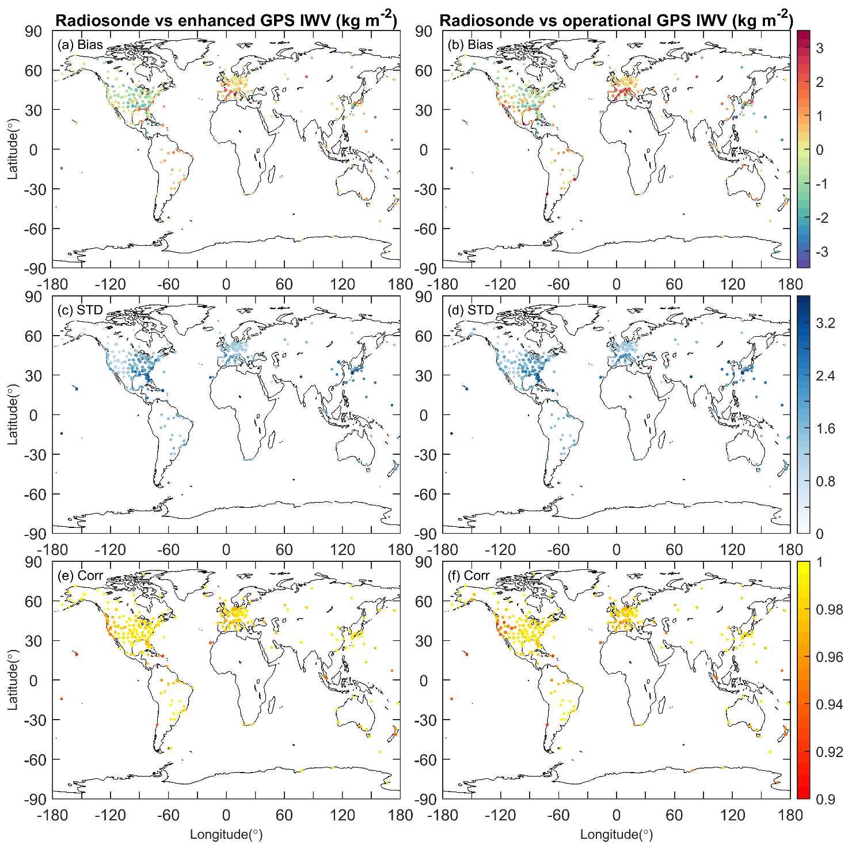
Radiosonde v.s. GPS IWV
  Compared to opGPS, the enGPS has
  Slighter bias in West USA, South Europe
  Better consistency in variability in West USA, South Europe
  Stronger correlation in West USA
Fig. 8. IWV comparisons between the radiosonde and GPS pairs

Slide 11
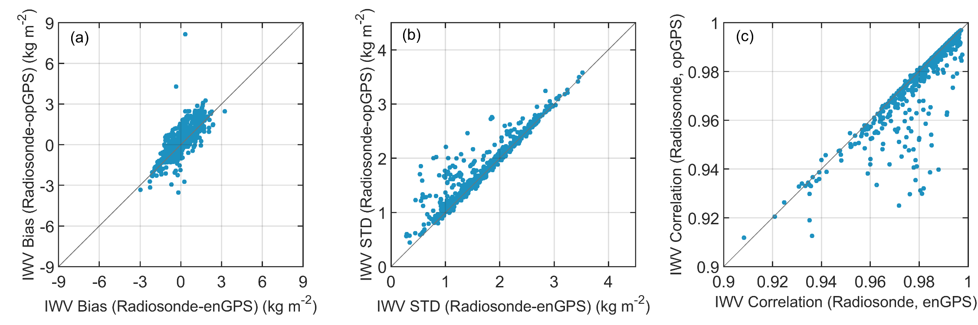
Radiosonde v.s. GPS IWV
Fig. 9. scatterplots of IWV comparison between the 917 radiosonde and GPS pairs
  The improvements of the enGPS IWV with respect to opGPS are validated by the radiosonde

Slide 12
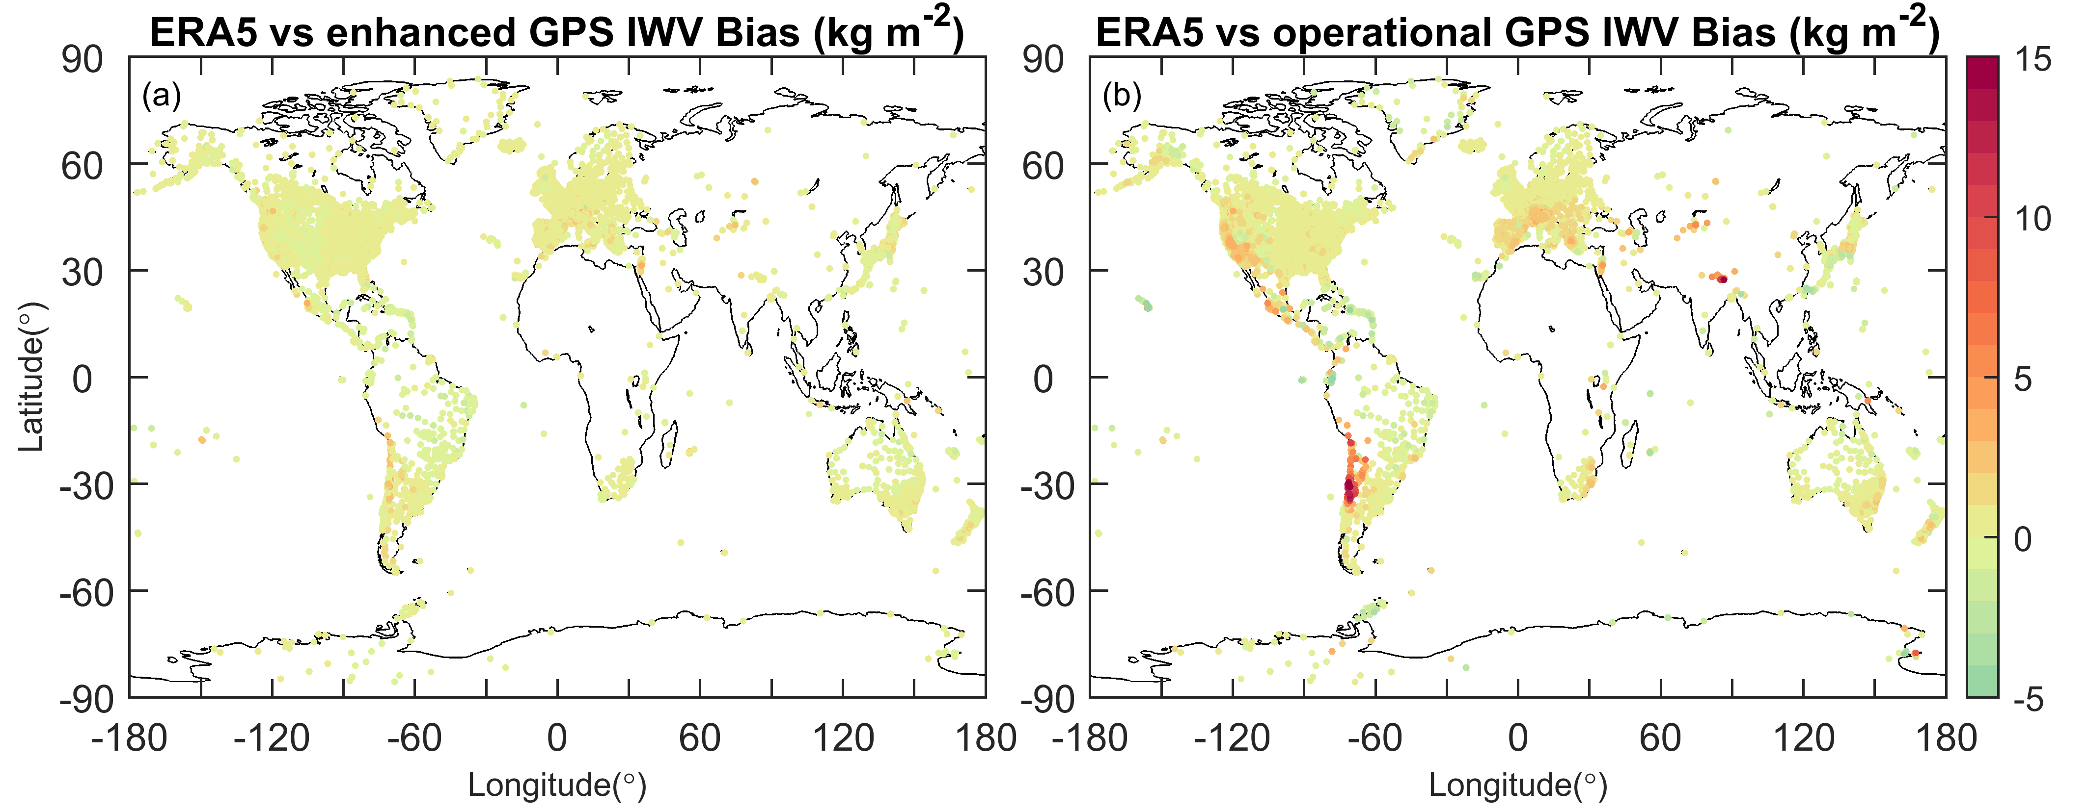
ERA5 v.s. GPS IWV: bias
In addition to the radiosonde, 1-hourly ERA5 IWV is also compared with the 1-hourly enGPS and opGPS IWV as the reanalysis can provide IWV estimates at all the 10,632 GPS stations
Fig. 10. IWV bias between ERA5 and GPS (ERA5-GPS)
Compared to opGPS, the enGPS has a slighter bias in West USA, South Europe, the Andes, the Himalayas, the Tianshan Mnt., and the Antarctic peninsula

Slide 13
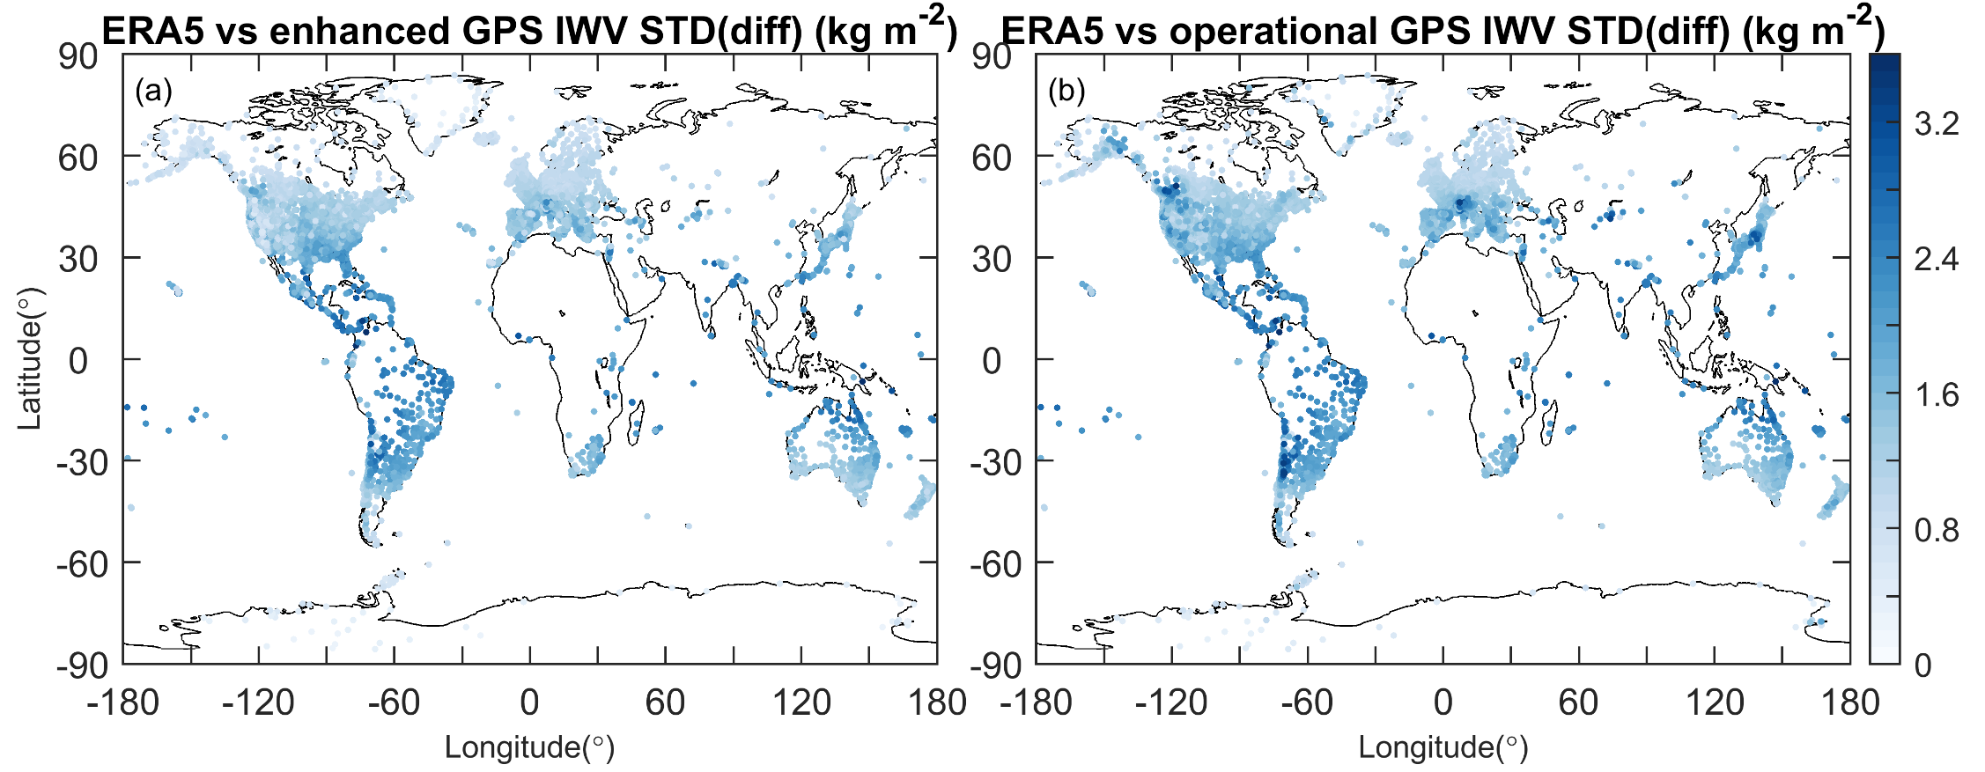
ERA5 v.s. GPS IWV: STD(diff)
Fig. 11. Standard deviations of the IWV differences between ERA5 and GPS
Compared to opGPS, the enGPS has a better consistency in variability in West USA, South Europe, the Andes, the Tianshan Mnt.

Slide 14
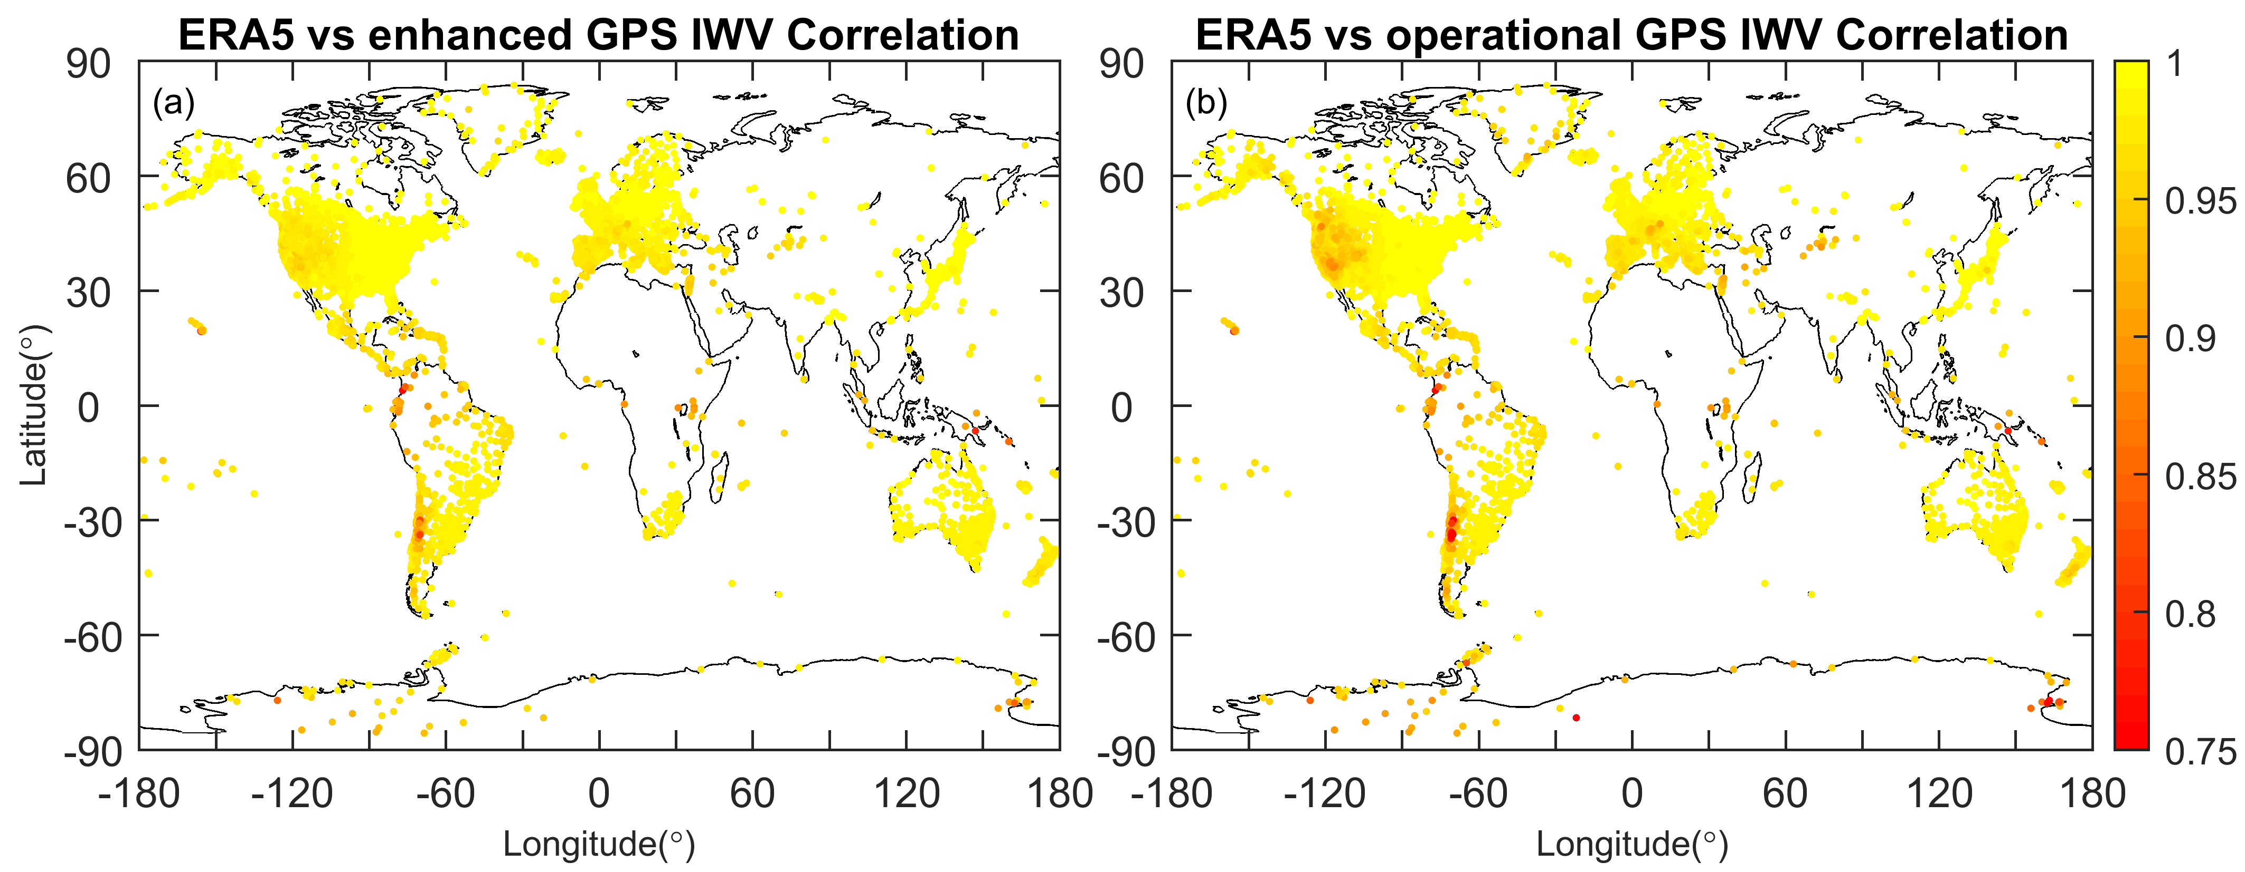
ERA5 v.s. GPS IWV: STD(diff)
Fig. 12. Correlations between the IWV series from ERA5 and GPS
Compared to opGPS, the enGPS has a stronger correlation in West USA, South Europe, the Andes, the Tianshan Mnt.

Slide 15
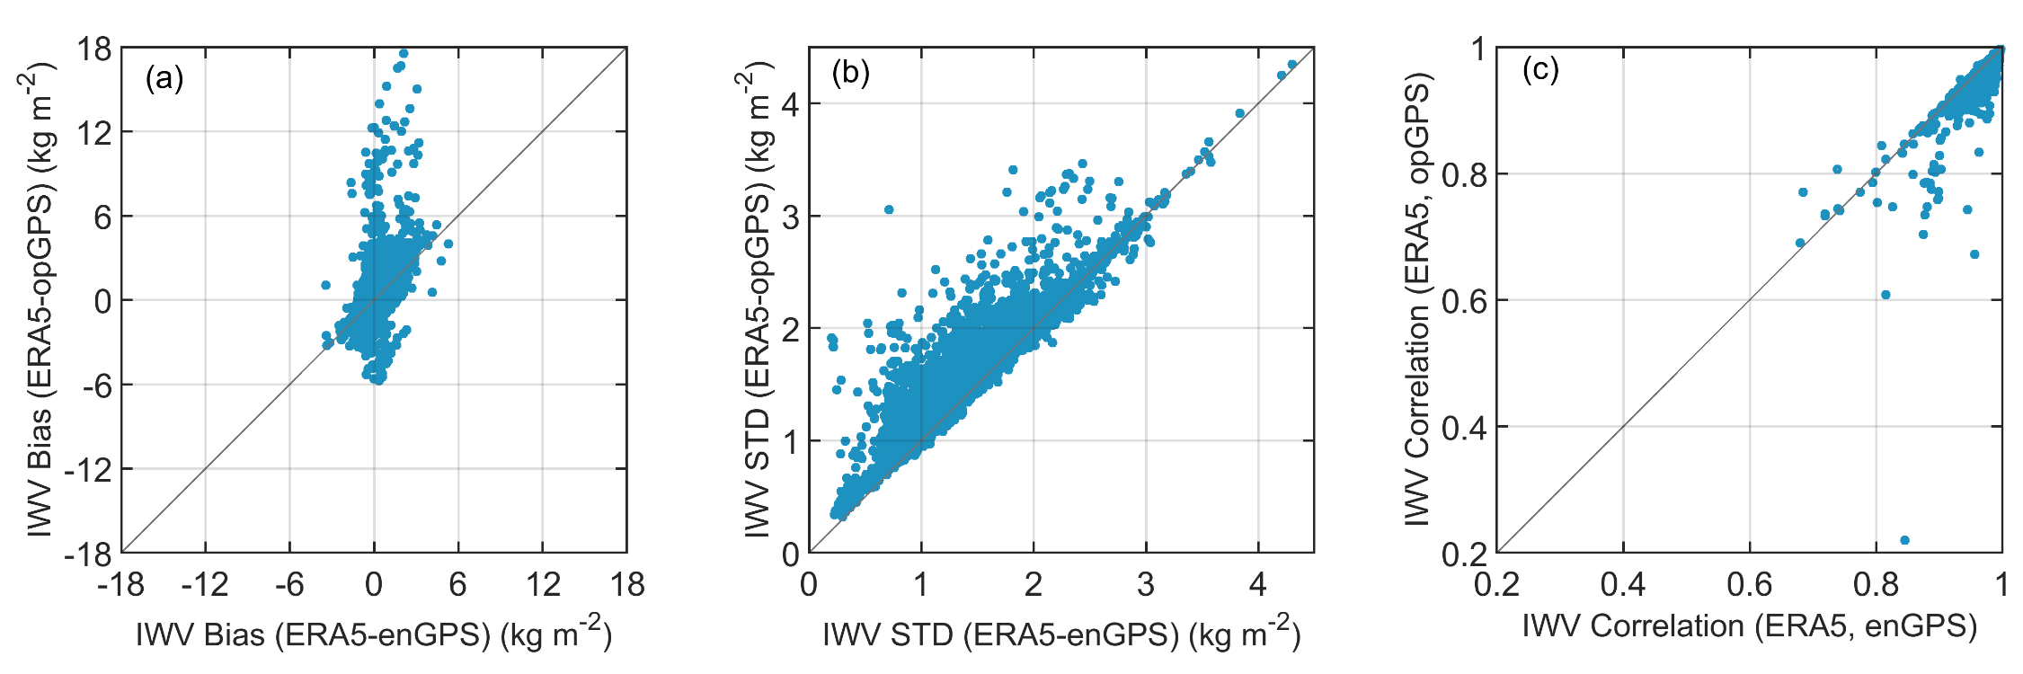
ERA5 v.s. GPS IWV
Fig. 13. scatterplots of IWV comparison between ERA5 and GPS at the 10632 stations
The improvements of the enGPS IWV with respect to opGPS are verified by ERA5

Slide 16
Summary
  This work provides an enhanced version of the NGL 5-min GPS IWV dataset with more than 1 billion measurements at more than 10,000 stations in 2020
  The validation with radiosonde and verification with ERA5 confirmed the improvements of the enhanced GPS IWV with respect to the operational product
  Significant improvements can be seen at the stations located in complex terrain

Slide 17

Thank you for your attention
Contact
Dr. Peng Yuan
Email: peng.yuan@kit.edu
Acknowledgments
We are grateful to NGL (http://geodesy.unr.edu) for providing the GPS data. We thank ECMWF for providing ERA5 data (https://cds.climate.copernicus.eu). Sincere thanks are also given to National Centers for Environmental Information (NCEI) for providing the IGRA2 radiosonde data (https://www.ncei.noaa.gov/access/metadata/landing-page/bin/iso?id=gov.noaa.ncdc:C00975). This work was performed under the German Research Foundation (DFG, project number: 321886779)

