Slide 1
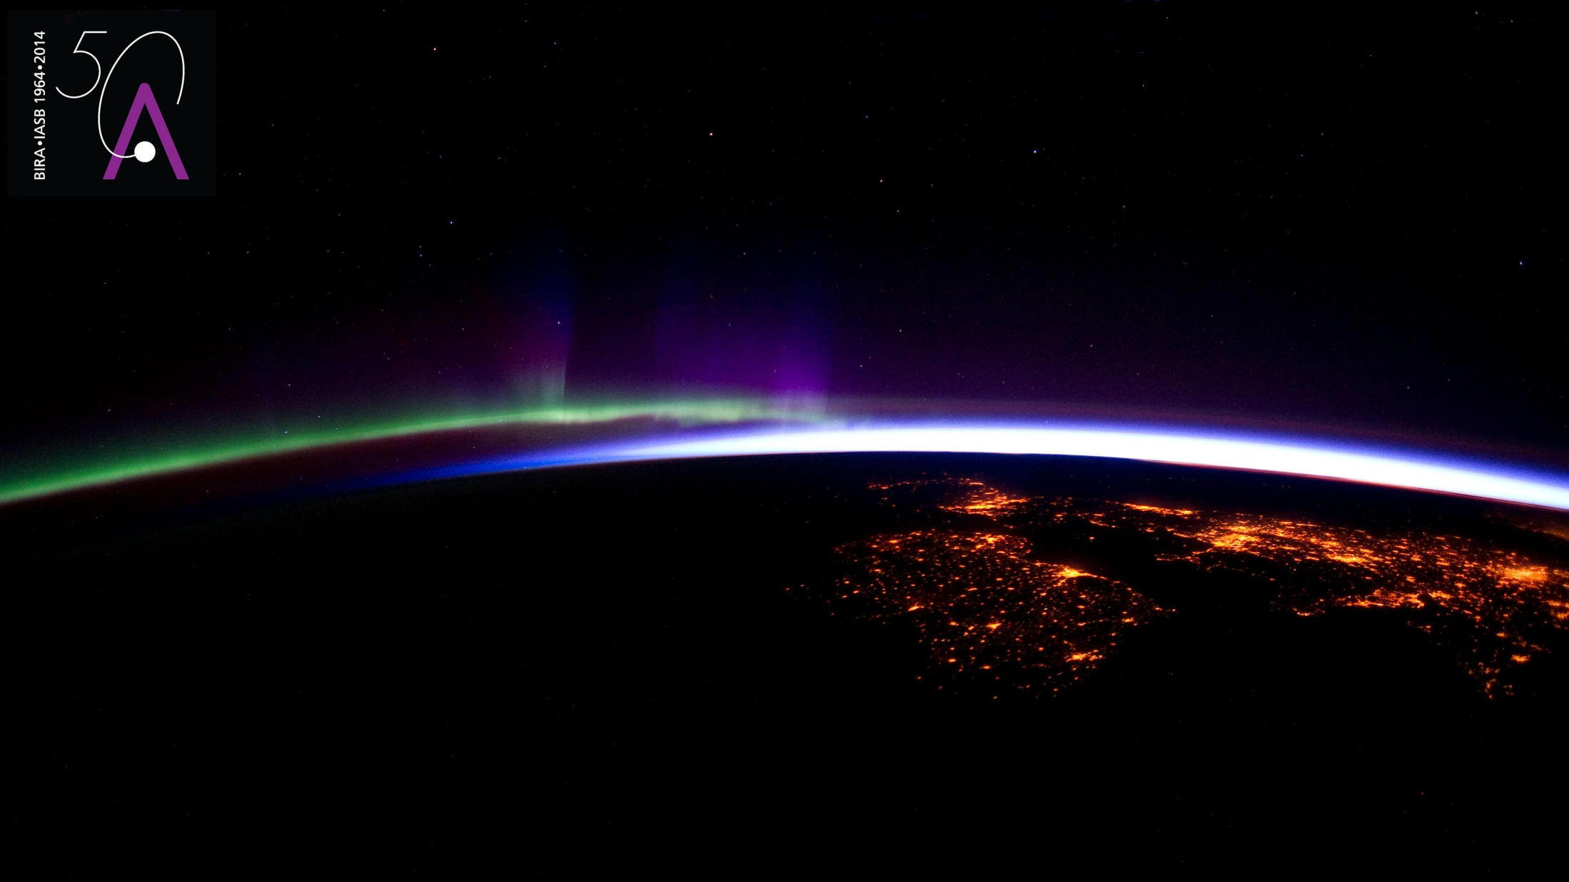


LOTUS : Global Trends in Stratospheric Ozone Between 2000 and 2020
D. Hubert (BIRA-IASB), N. Azouz (LATMOS, UVSQ), S. Godin-Beekmann (LATMOS, UVSQ), I. Petropavlovskikh (NOAA-GML, CIRES),
G. Ancellet (LATMOS, UVSQ), C. Arosio (U Bremen), W. Ball (TU Delft), R. Damadeo (NASA-LaRC), S. Davis (NOAA-CSL),
D. Degenstein (U Saskatchewan), S.M. Frith (SSAI), L. Froidevaux (NASA-JPL), D.E. Kollonige (NASA-GSFC, SSAI),
J.-C. Lambert (BIRA-IASB), T. Leblanc (NASA-TMF), E. Maillard Barras (MeteoSwiss), R. Querel (NIWA), H.G. Smit (FZJ), V. Sofieva (FMI), R. Stauffer (NASA-GSFC), W. Steinbrecht (DWD), A.M. Thompson (NASA-GSFC), K. Tourpali (AUTH), R. Van Malderen (RMI), C. Vigouroux (BIRA-IASB), J. Wild (UMD, NOAA-CPC), D. Zawada (U Saskatchewan) and many more data providers
ATMOS 2021
22-26 November 2021, virtual conference

Slide 2
LOTUS update : extended & updated ozone profile data records
Extended & improved zonal mean satellite data
SBUV-MOD, SBUV-COH,
GOZCARDS, SWOOSH,
SAGE-CCI-OMPS, SAGE-OSIRIS-OMPS, SAGE-SCIA-OMPS
Consideration latitude-longitude resolved satellite data
SWOOSH, MEGRIDOP, SBUV-MOD
Extended & homogenized ground-based observations (NDACC, GAW, SHADOZ)
ozonesondes, lidar, microwave spectrometer,
FTIR, Umkehr
SPARC/IO3C/GAW Report (2019)
https://www.sparc-climate.org/activities/ozone-trends

Slide 3
LOTUS update : extended & updated regression model
Code version 0.8.0
maintained by University of Saskatchewan
freely available at https://arg.usask.ca/docs/LOTUS_regression/index.html
LOTUS regression model
Predictors : extended to Dec 2020
AOD : replaced GISS by GloSSAC v2
Predictors : added seasonal dependence (Fourier terms)
$$y\left(t\right)=A.{QBO}_{1}\left(t\right)+B.{QBO}_{2}\left(t\right)+C.ENSO\left(t\right)+D.AOD\left(t\right)+E.Solar\left(t\right)$$
$$+F.{Linear}_{pre}\left(t\right)+G.{Linear}_{post}\left(t\right)+H.C_{1}\left(t\right)+I.C_{2}\left(t\right)+J.C_{3}\left(t\right)+ε$$

Slide 4
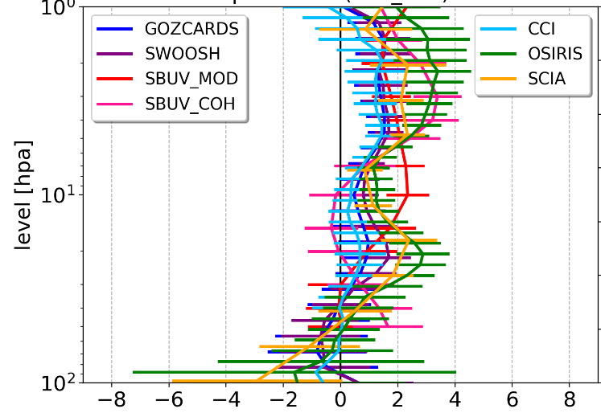
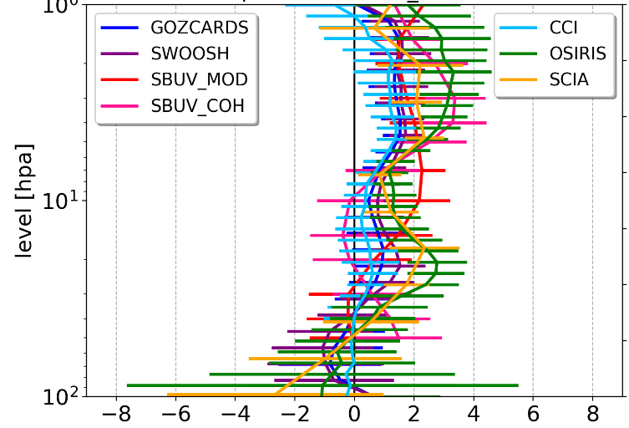
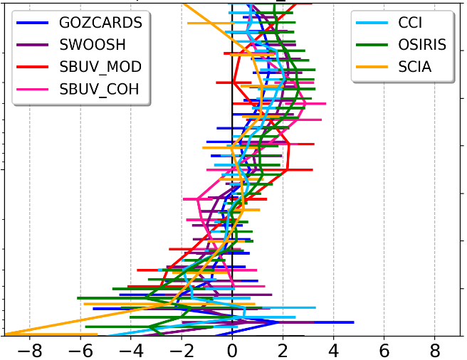
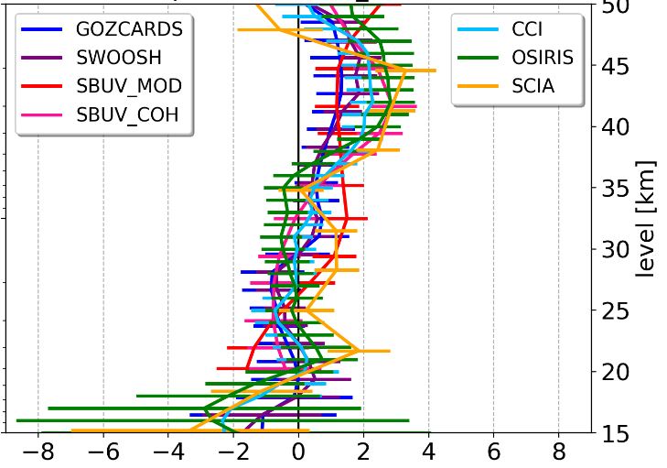
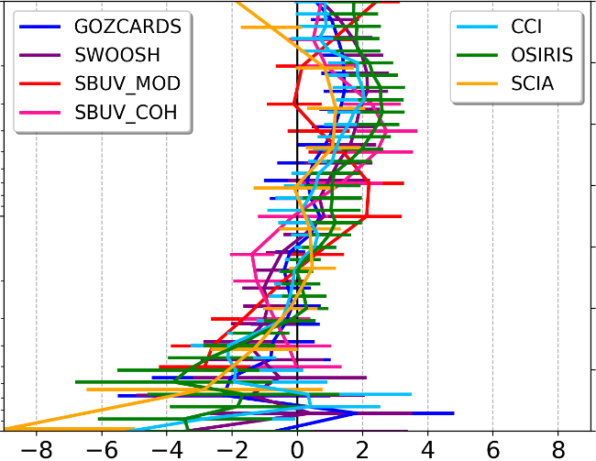
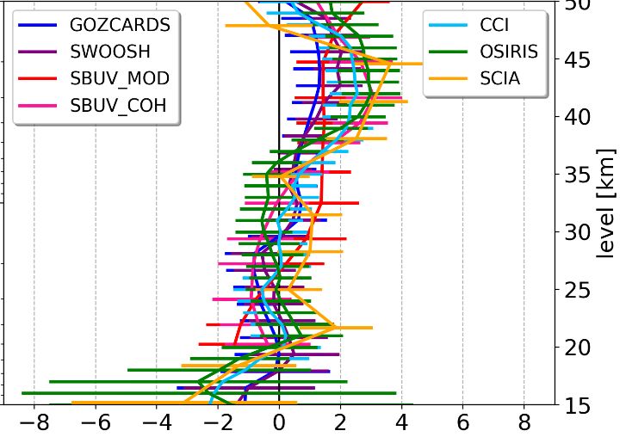
Influence of including seasonal variation
60S – 30S
20S – 20N
30N – 60N
Trend 2000 – 2020 (%/dec)
No seasonal dependence
Seasonal dependence → smaller trend uncertainty

Slide 5
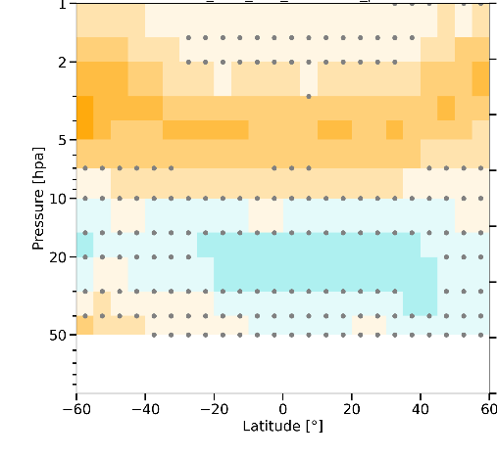
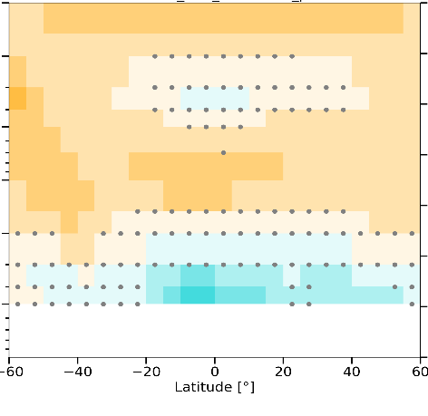
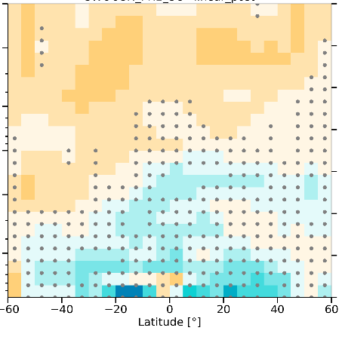
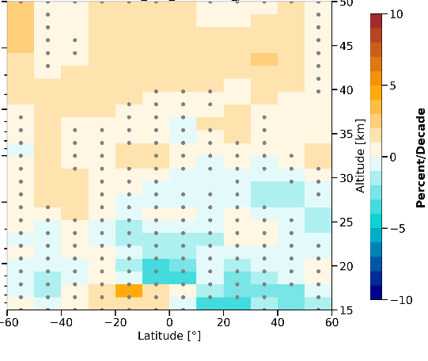
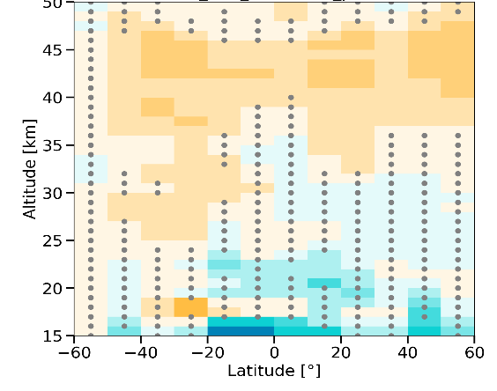
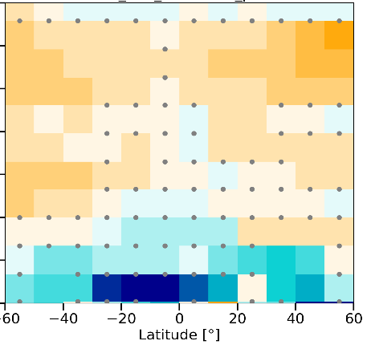
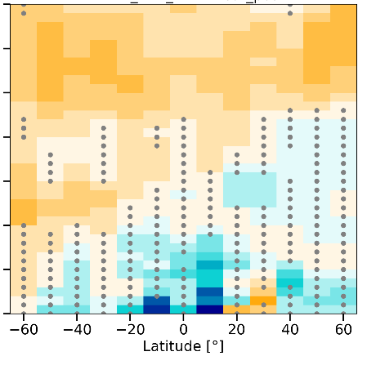
Satellite ozone trends 2000–2020
SBUV-COH
SBUV-MOD
SWOOSH
GOZCARDS
SAGE-CCI-OMPS
SAGE-SCIA-OMPS
SAGE-OSIRIS-OMPS
Upper stratospheric trends generally agree for the different satellite records
Lower stratospheric trends are more uncertain with generally non-significant negative trends
No large differences from 2000-2016 trends published in LOTUS report (2019).

Slide 6
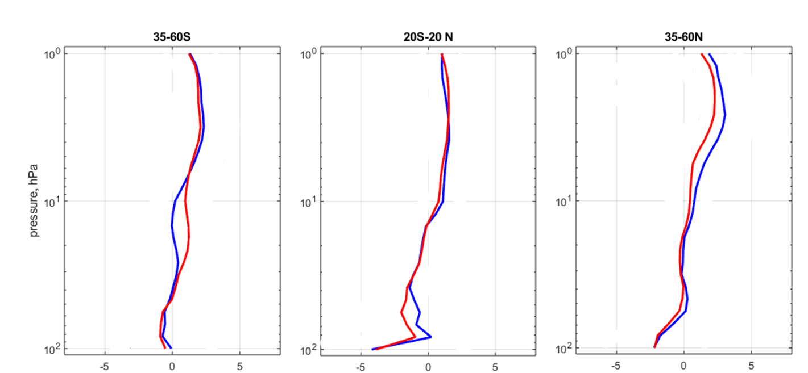
Combined satellite trend (uncertainty) at mid and low latitudes
2000-2016
2000-2020
O3 trend (%/decade)

Slide 7
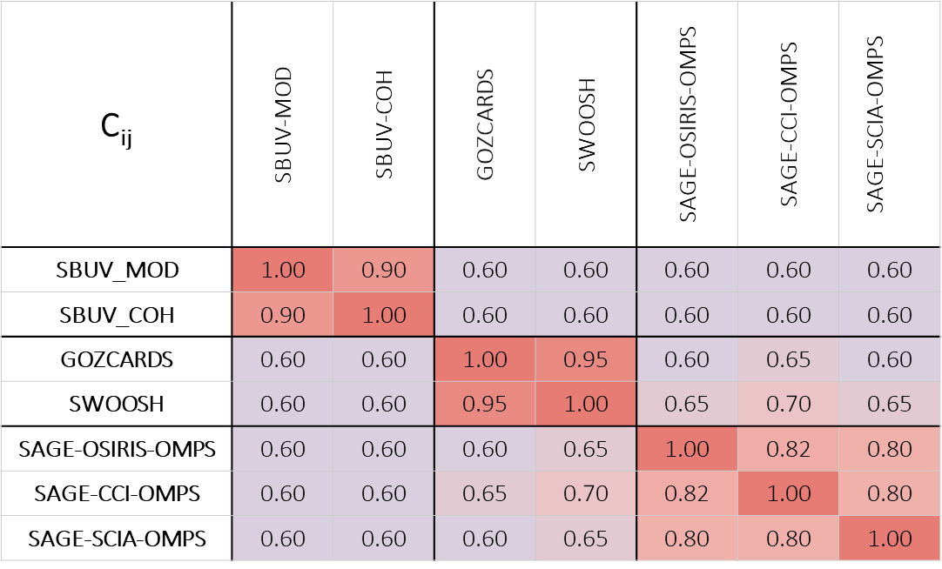
Uncertainty combined trend : correlations & effective number of independent estimates
2018
6 CDRs → N_{eff} = 1.37
2021
7 CDRs → N_{eff} = 1.39

Slide 8
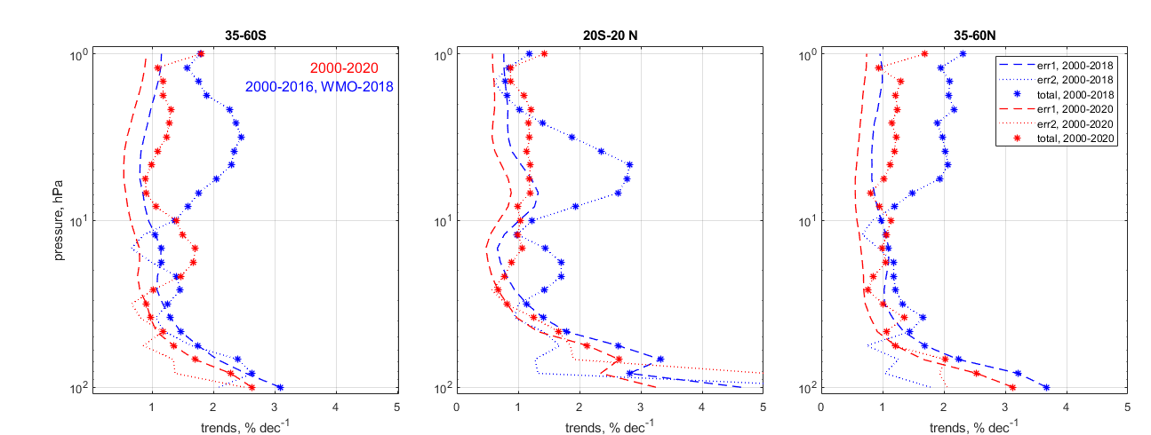
Uncertainty combined trend
∗ ∗ ∗ ∗
reduction in Var(x)
reduction in σ
Trend uncertainty (%/dec)

Slide 9
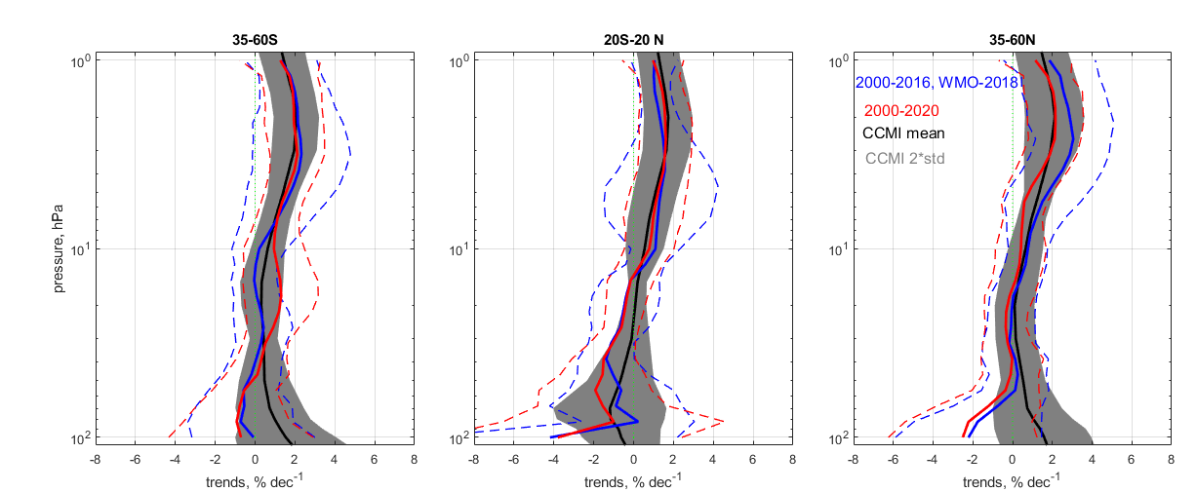
Agreement satellite & CCMI trends
SAT 2000-2016
SAT 2000-2020
CCMI 2000-2020
Trend (%/dec)
Multi-model mean and 2σ from CCMI-1 REF-C2 simulations
Good agreement with CCMI trends in middle and upper stratosphere
Larger CCMI trends in SH and NH lower stratosphere but these differences are not significant

Slide 10
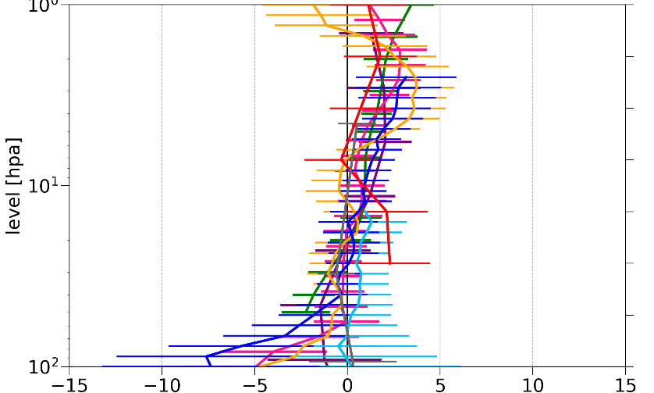
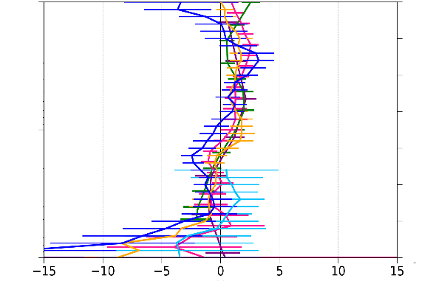
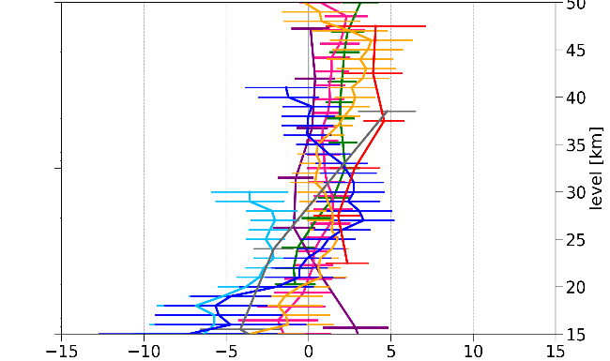
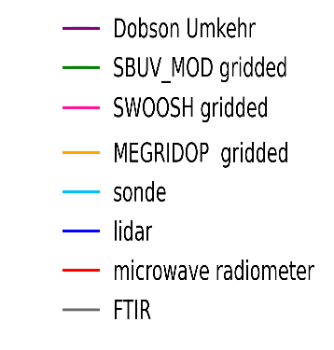
Improved agreement ground-based and gridded satellite
ALPINE stations
Mauna Loa
Lauder
44°N – 49°N
6°E – 11°E
19.5°N 155.8°W
45°S 169.7E
Trend 2000-2020 (%/dec)
Alpine stations Multi-site averages (Umkehr: Arosa, OHP; sonde: OHP, Hohenpeissenberg , Payerne; Lidar: OHP, Hohenpeissenberg; FTIR: Zugspitze, Jungfraujoch; Microwave : Payerne). FTIR trends from C. Vigouroux (personal communication, 2021).
Gridded satellite data Closest grid cell (SBUV-MOD & SWOOSH: 10° lat x 30° lon; MEGRIDOP: 10° lat x 20° lon)
Agreement clearly improved w.r.t. earlier assessment
Good agreement between ground-based and gridded satellite data for Alpine and Mauna Loa station.
Larger discrepancies at Lauder. Further investigations ongoing.

Slide 11
Conclusions 2000-2020 ozone profile trends
Estimates from zonal mean satellite CDRs
upper stratosphere
  Positive trends of 1-4% dec⁻¹ depending on record and latitude; similar to LOTUS (2019)
  Combined trends in broad latitude bands: ~2% dec⁻¹ in SH, Tropics and NH.
  Somewhat smaller in NH compared to LOTUS (2019). Smaller error bars: trends now significant in all regions.
  Good agreement with CCMI trends.
lower stratosphere
  Non-significant negative trends in the Tropics and NH below 20 km.
  Larger (non significant) discrepancies between CCMI and observations in NH and SH.
Comparison between trends from gridded satellite data and ground-based observations
Good agreement at the NDACC alpine stations (NH) and Mauna Loa (Tropics)
Larger discrepancy at Lauder (SH)

