Slide 1
Update of the Homogenization of the Long-Term Global Ozonesonde Records
R. Van Malderen, D. Poyraz, H.G.J. Smit , G. Romanens, R. Stübi, G. Ancellet, S. Godin-Beekmann, N. Prats, C. Torres, W. Steinbrecht, M. Allaart, A. Piters, A. Díaz, J. L. Hernandez, R. Kivi, R. Querel, M. Tully, P. von der Gathen, B. Klikova, M. Motl, P. Skrivankova, B. Kois, N. Lyall, M. Gill, N. Jepsen, P. Oelsner, V. Rizi, M. Iarlori, D. W. Tarasick, B. J. Johnson, A. M. Thompson, R. M. Stauffer

Slide 2
Current “homogenization” activities within O3S
harmonizing Standard Operating Procedures by new WMO-GAW report No. 268 in https://library.wmo.int/
poster SAT2_20 by Kollonige et al. (“ASOPOS 2.0: Ozonesonde Measurement Principles and Best Operational Practises”)
continuation of O3S-DQA (Ozone Sonde Data Quality Assessment) activity in https://www.wccos-josie.org/O3S-DQA
Harmonization and Evaluation of Ground-based Instruments for Free Tropospheric Ozone Measurements within the TOAR-II Focus Working Group “HEGIFTOM”
TCO dropoff
talk FRI1_2 by Stauffer et al. (“An updated Examination of the Post-2013 Ozonesonde TCO Dropoff”)

Slide 3
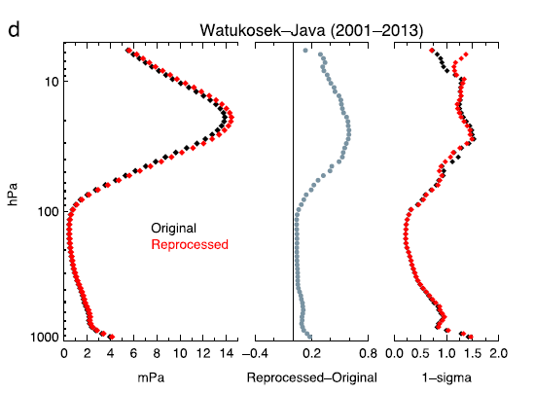
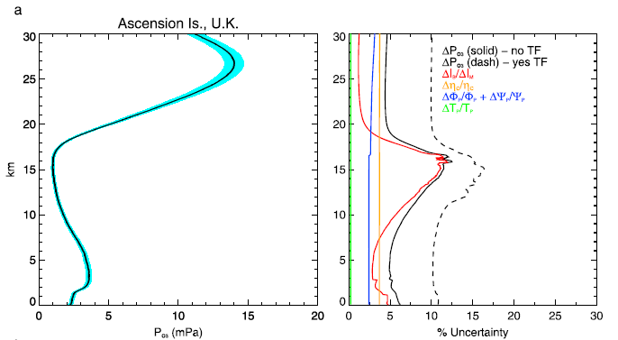
O3S-DQA: principles
correcting for changes in …
ECC ozonesonde type (SPC, EN-SCI)
sensing solution strength/volume
“pump” temperature measurements
pre-flight procedures (background current, pump flow rate)
post-processing (pump efficiency correction tables, total ozone normalization, etc.)
estimation of uncertainties for every ozone partial pressure measurement
➔ reduce uncertainty from 10-20% to 5-10%
WMO-GAW report No. 268 (Annex-C & D in https://library.wmo.int)
Witte et al., JGR, 2017
Witte et al., JGR, 2018

Slide 4
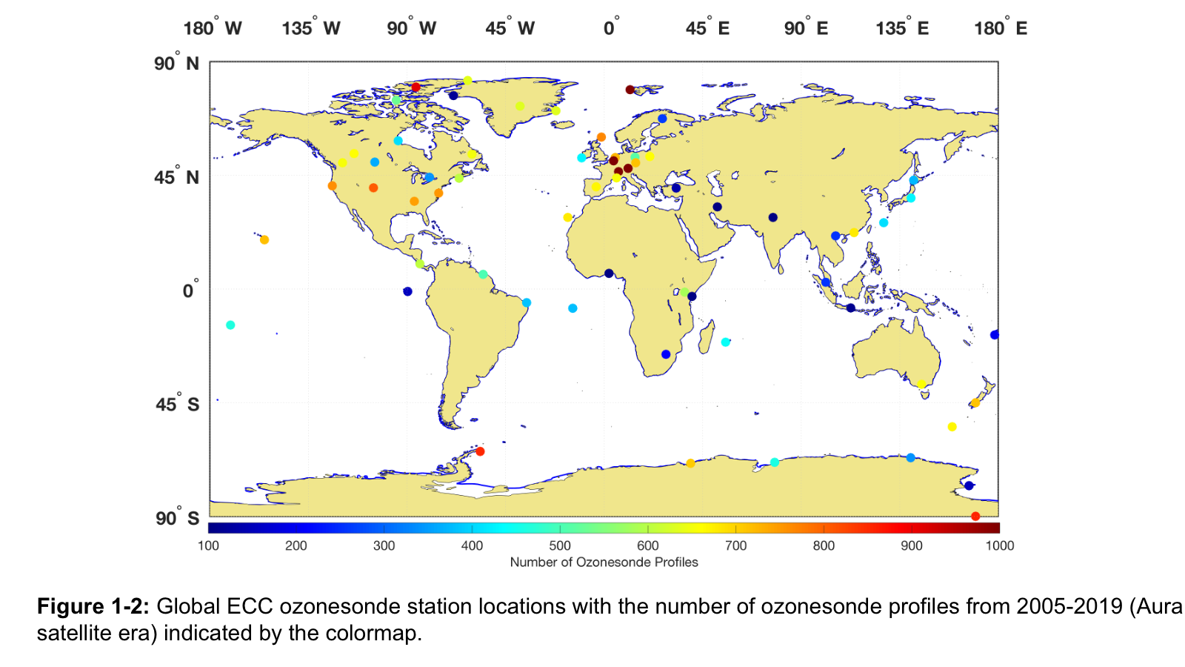
O3S-DQA: status
Canadian network (10 sites) Tarasick et al., AMT, 2016
SHADOZ network (10 sites) Witte et al., JGR, 2017, 2018, Thompson et al., JGR, 2017
NOAA network (9 sites) Sterling et al., AMT, 2018
Individual sites (11): Uccle & De Bilt (Van Malderen et al. , AMT, 2016), Wallops Island (Witte et al., JGR, 2019), Mc Murdo, Payerne, OHP, Izaña, Madrid, Sodankylä, Lauder, Hohenpeissenberg
➔ 40 homogenized sites
Fig. taken from the new WMO-GAW Report No. 268, courtesy of A. Thompson

Slide 5
O3S-DQA: latest results & examples
data available at ftp-server, upon request, and already used for trends assessment
poster THU3_3 by Steinbrecht et al. (“Ozone Trends in the Lower Stratosphere from Ozone Sondes”)
recently homogenized by station PIs: Hohenpeissenberg, Payerne, Izaña, OHP
poster SAT2_25 by Ancellet et al. (“Homogenisation of the Observation de Haute Provence ECC ozonesonde data record: comparison with lidar and satellite observation ”)
recently homogenized by processing task team @RMI, with open source code https://github.com/denizpoyraz/o3s-dqa-homogenization: Sodankylä, Lauder, Madrid
poster SAT2_17 by Kivi et al. (“Long Term Ozonesonde Observations at Sodankylä”)
poster SAT2_26 by Querel et al. (“Update on Lauder ozonesonde homogenization”)

Slide 6
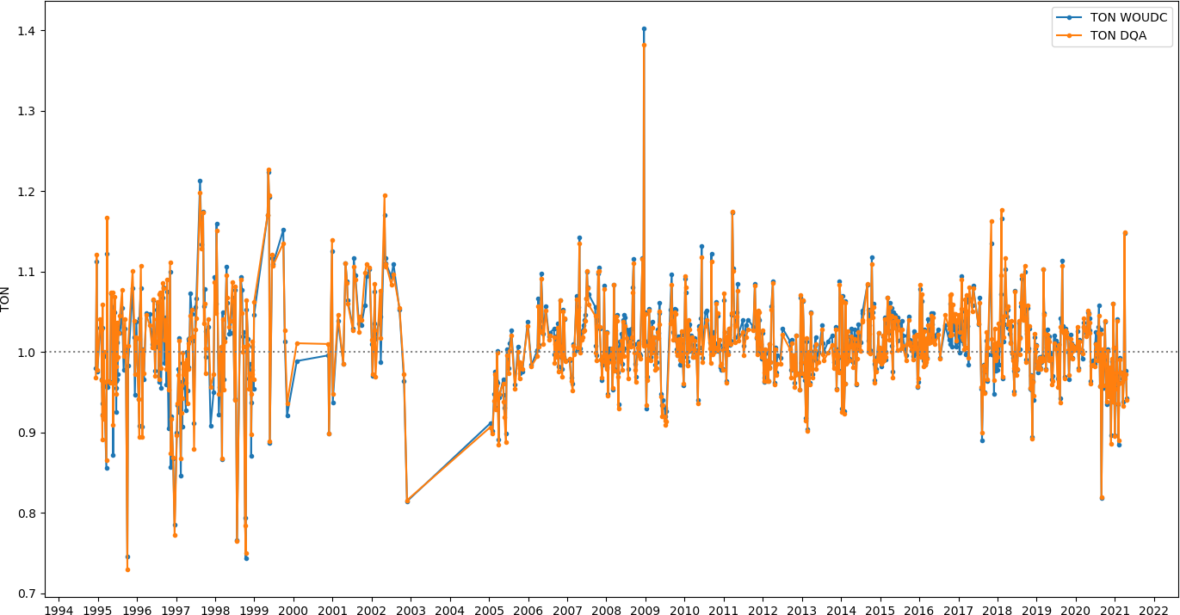
O3S-DQA: Madrid example
Total ozone normalization factors w.r.t. co-located Brewer
original
homogenized (DQA)
minor total ozone content changes in the ozonesonde profiles.

Slide 7
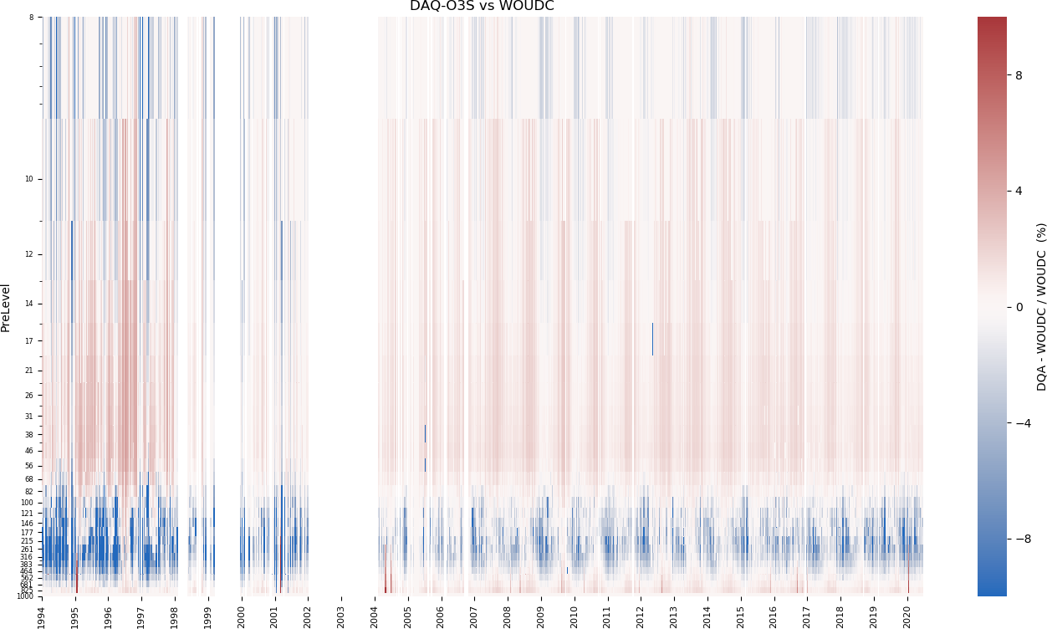
O3S-DQA: Madrid example
O3S-DQA vs. WOUDC
relative ozone concentrations of homogenized (DQA) vs. original:
O₃ higher in DQA
O₃ lower in DQA
modest changes
redistribution of total ozone over profile compared to original dataset

Slide 8
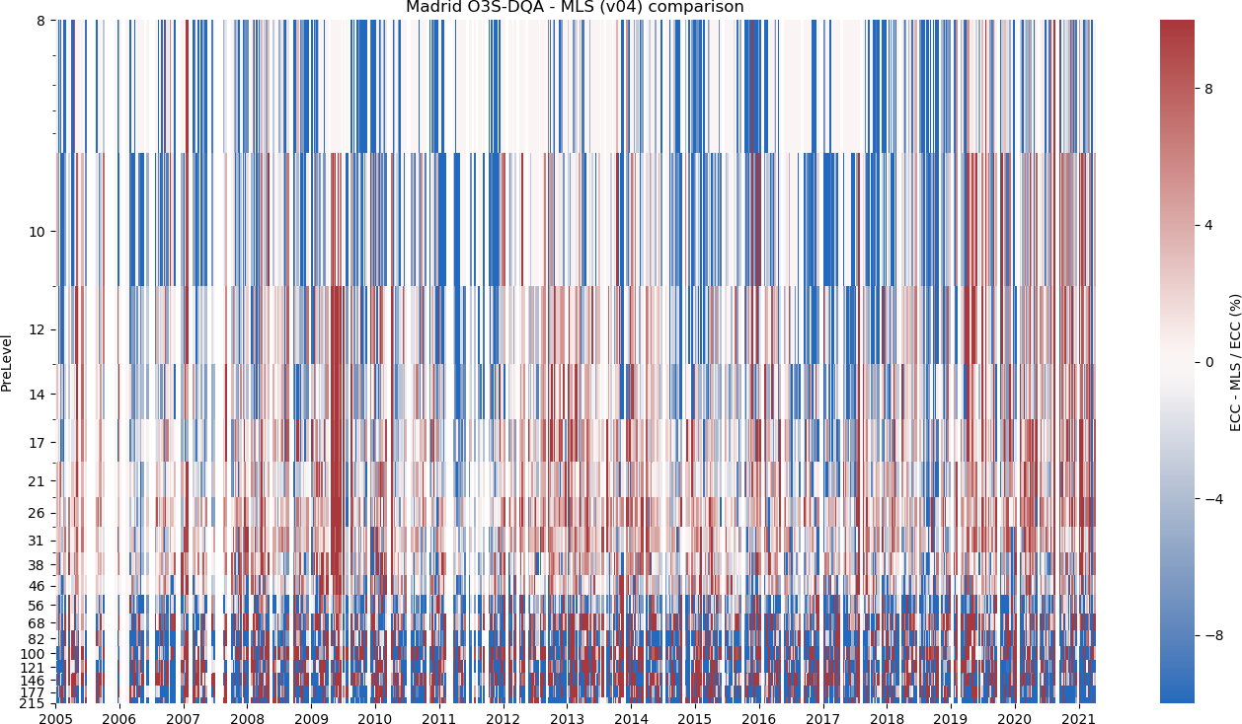
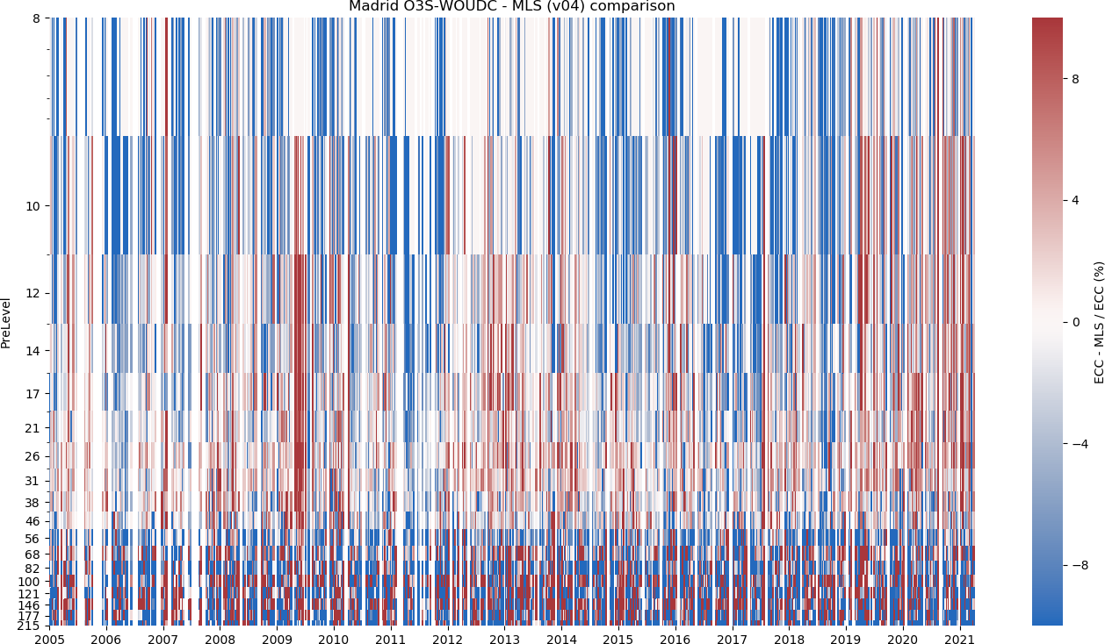
O3S-DQA: Madrid example
homogenized vs. MLS
original vs. MLS
small differences in 200-8 hPa range
homogenized dataset more positively biased w.r.t. MLS

Slide 9
O3S-DQA: conclusions and outlook
around 15 sites still remaining to be homogenized (EU + AUS + Japan + Antarctic sites)
lack of metadata to convert to the raw data is an issue for these sites
homogenization and dropoff investigations go hand in hand
Homogenization is a pre-requisite and essential for trend analysis, but the data reprocessing is a difficult, slow process and an almost never ending story…
talk FRI1_1 by Vömel et al. (“The importance of correcting the time response of the ECC Ozonesonde”)
poster SAT2_23 by Smit et al. (“New Insights From the Jülich Ozone Sonde Intercomparison Experiments: Calibration Functions Traceable to one Ozone Reference Instrument”)

