Slide 1

Session 6.2 ICCC Geodesy for Climate Research
Assessments of integrated water vapor from atmospheric reanalyses against ground-based GPS over Europe
Peng Yuan¹, Roeland Van Malderen², Xungang Yin³, Hannes Vogelmann⁴, Joseph Awange⁵, Hansjörg Kutterer¹
1 Karlsruhe Institute of Technology, Geodetic Institute, Karlsruhe, Germany
2 Royal Meteorological Institute of Belgium, Brussels, Belgium
3 Riverside Technology Inc, Asheville, North Carolina, USA
4 Karlsruhe Institute of Technology, IMK-IFU, Garmisch-Partenkirchen, Germany
5 Curtin University, School of Earth and Planetary Sciences, Perth, Australia
IAG Scientific Assembly, Beijing, China (online), June 28–July 2, 2021

Slide 2
Motivation
  Water vapor is a crucial component in the Earth’s atmosphere with high spatio-temporal variability
  Water vapor is associated with extreme weather/climate events, and long-term climate change
  Atmospheric reanalysis is a commonly-used source of water vapor but its performance needs to be assessed, especially for the newly-released ERA5
  Ground-based GPS is a unique tool for the assessment of Integrated Water Vapor (IWV) derived from reanalysis as it is not included in the assimilation

Slide 3
GPS data
  Study region
  Europe, 108 CGPS stations
  Data period
  1994.01.01-2018.12.31
  Data sources
  Hourly GPS ZTD from NGL
  Pre-processing of IWV
  Outlier detection
  homogenization
  GPS IWV retrieval
Fig. Calculation of Ps, Tm, and IWV at the GPS station from ERA5
Fig. Map of the 108 GPS stations

Slide 4
Atmospheric reanalyses
Table. Feature comparison of the pressure level products of six reanalyses
Reanalysis | CFSR | ERA5 | ERAI | JRA55 | MERRA2 | NCEP2
Source | NCEP | ECMWF | ECMWF | JMA | NASA GMAO | NCEP
References | Saha et al., 2010, 2014 | Hersbach et al. 2020 | Dee et al., 2011 | Kobayashi et al., 2015 | Gelaro et al., 2017 | Kanamitsu et al., 2002
Assimilation | 3DVAR | 4DVAR | 4DVAR | 4DVAR | 3DVAR | 3DVAR
Time range | 1979-present | 1979-present | 1979-Aug. 2019 | 1958-present | 1980-present | 1979-present
Temporal res. (hour) | 6 | 1 | 6 | 6 | 3 | 6
Horizontal res. (lat.*lon.) | 0.5°×0.5° | 0.25°×0.25° | 0.75°×0.75° | 1.25°×1.25° | 0.5°×0.625° | 2.5°×2.5°
Pressure levels | 37 | 37 | 37 | 37 | 42 | 17
Comment |  | Successor of ERAI |  | RH only at 27 levels (≥100 hPa)

Slide 5

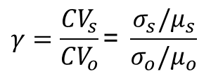

Consistency metrics (when $μ_{s}≠0$ and $μ_{o}≠0$)
  Modified Kling-Gupta efficiency (KGE’, Kling et al., 2012)
$${KGE}^{′}=1−\sqrt{{(γ−1)}^{2}+{(β−1)}^{2}+{(r−1)}^{2}}$$
  Variability consistency indicator
$$γ=\frac{{CV}_{s}}{{CV}_{o}}\text{=} \frac{σ_{s}/μ_{s}}{σ_{o}/μ_{o}}$$
  Bias indicator
$$β=\frac{μ_{s}}{μ_{o}}$$
  Correlation indicator
$r=corr\left(X_{s},X_{o}\right)=$ $\frac{{Cov}_{so}}{{σ_{s}σ}_{o}}$
  Ideal case: $γ=1$, $β=1$, $r=1$, and thus ${KGE}^{′}=1$
Notes:
to avoid the influence of the bias metric on the variability metric

Slide 6



Consistency metrics (when $μ_{s}=0$ and $μ_{o}=0$)
  Kling-Gupta efficiency (KGE, Gupta et al., 2009)
$$KGE=1−\sqrt{{(α−1)}^{2}+{(r−1)}^{2}}$$
  Variability consistency indicator
$$α=\frac{σ_{s}}{σ_{o}}$$
  Correlation indicator
$r=corr\left(X_{s},X_{o}\right)=$ $\frac{{Cov}_{so}}{{σ_{s}σ}_{o}}$
  Ideal case: $α=1$, $r=1$, and thus $KGE=1$
Notes:
Zipper et al., 2018

Slide 7
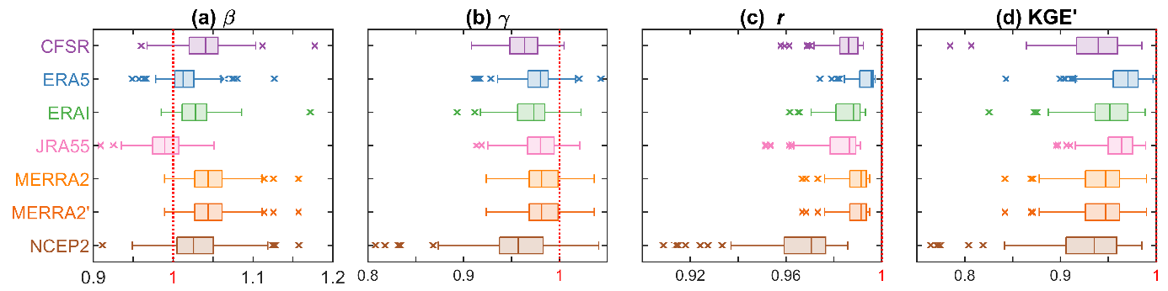
Consistency in daily time series
Fig. Boxplot of the KGE’ parameters for the daily IWV time series from the reanalyses against GPS for the 108 GPS stations
  Most of the KGE’ scores are larger than 0.9, indicating that they are capable to reproduce daily IWV
  ERA5 performs the best whereas NCEP2 performs the worst
  JRA55 has a slight negative bias whereas the other reanalyses are characterized with positive biases
Notes:
Fig. 5. Boxplot of the KGE’ parameters for the daily IWV time series from the reanalyses against GPS for the 108 GPS stations.

Slide 8
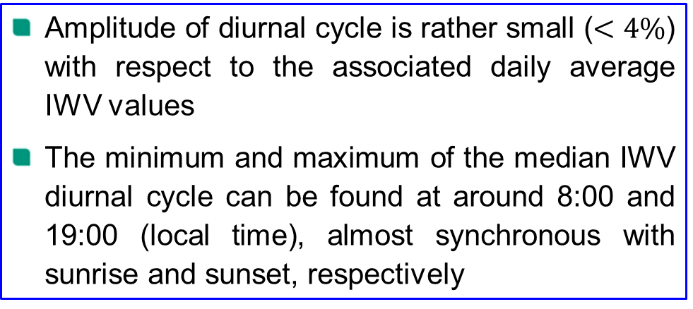
Consistency in hourly diurnal cycle
Fig. The median (curves) and interquartile range (shaded areas) of relative diurnal cycle of IWV for the 108 GPS stations.
  Amplitude of diurnal cycle is rather small ($<4\%$) with respect to the associated daily average IWV values
  The minimum and maximum of the median IWV diurnal cycle can be found at around 8:00 and 19:00 (local time), almost synchronous with sunrise and sunset, respectively
Notes:
Fig. 7. (top) Relative diurnal cycle of GPS IWV in MAM, JJA, SON, DJF, and years, respectively. The deep gray line indicates the medium values of the diurnal cycle of GPS IWV for the 108 stations, and the light gray area indicates the range between the first and the third quartiles. The rest subplot are for the reanalyses, respectively. The KGE parameters for the medium values of the diurnal cycle of IWV from the reanalyses with regard to GPS are also given.

Slide 9
Consistency in hourly diurnal cycle
Fig. Boxplot of the KGE parameters for the relative diurnal cycle of IWV from the reanalyses against GPS for the 108 GPS stations
  NCEP2 ranks the last due to its worst correlation against GPS
  MERRA2 ranks the second worst due to its exaggerated amplitudes of diurnal cycle
  The median KGE scores for the rest four reanalyses are around 0.71–0.75, indicating that diurnal cycle of IWV from reanalyses are still subject to significant uncertainties
Notes:
Fig. 8. Boxplot of the KGE parameters for the relative diurnal cycle of IWV from the reanalyses against GPS for the 108 GPS stations.

Slide 10
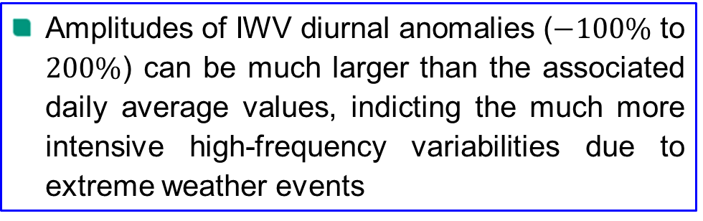
Consistency in hourly diurnal anomalies
Fig. Scatterplot of the hourly relative anomalies from the daily mean IWV in percentage for the 108 GPS stations
  Amplitudes of IWV diurnal anomalies ($−100\%$ to $200\%$) can be much larger than the associated daily average values, indicting the much more intensive high-frequency variabilities due to extreme weather events
Notes:
Fig. 10. Scatter plot of the hourly relative anomalies from the daily mean IWV in percentage for the 108 GPS stations.

Slide 11
Consistency in hourly diurnal anomalies
Fig. Boxplot of the KGE paramters for the hourly relative anomalies of IWV from the six reanalyses against GPS for the 108 GPS stations. Note that the mean values of anomalies are always equal to zero so that no bias was considered
  ERA5 performs the best in reproduce the diurnal anomalies, confirming the benefit of its improved spatio-temporal resolution (0.25°×0.25°, 1-hourly) and indicating that it can be used for the diagnosis of extreme weather events
  MERRA2 ranks the second best which could be due to its temporal resolution (3-hourly) better than the other four reanalyses (6-hourly)
Notes:
Fig. 11. Box plot of the KGE paramters for the hourly relative anomalies from the diurnal mean IWV from the reanalyses with regard to GPS for the 108 GPS stations.
ERA5 performs the best with the majority of the KGE values larger than 0.8, confirming the benefit of its improved spatio-temporal resolution and indicating that it can be used for extreme weather events
MERRA2 ranks the second best which could be due to its temporal resolution better than the other four reanalyses

Slide 12
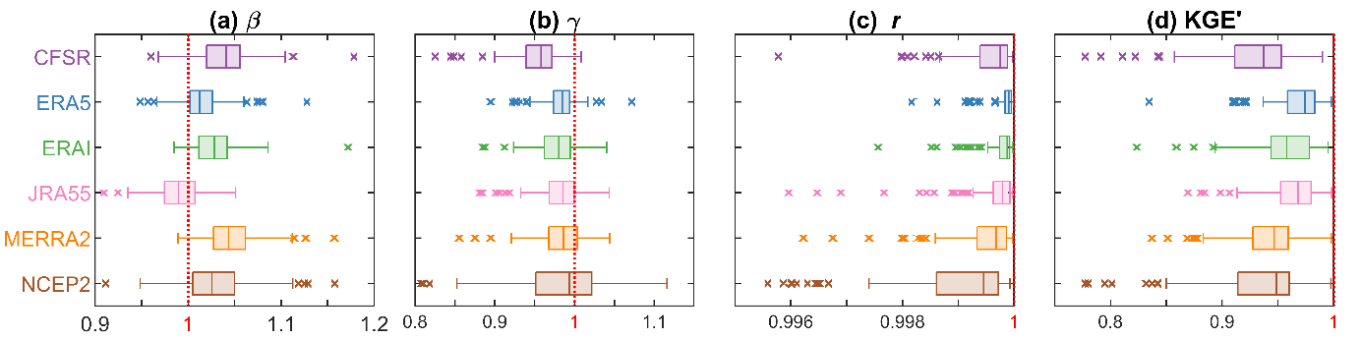
Consistency in monthly annual cycle
Fig. 13. Boxplot of the KGE’ parameters for the monthly annual cycles of IWV from the six reanalyses with respect to GPS for the 108 GPS stations
  The KGE’ scores are close to 1 (mostly >0.9), indicating that they are potential datasets for the study of water cycle
  ERA5 performs the best whereas CFSR performs the worst
  MERRA2 is the second worst mainly due to its significant positive bias
Notes:
Fig. 13. Box plot of the KGE’ paramters for the monthly cycles of IWV from the varied reanalyses with respect to GPS for the 108 GPS stations.

Slide 13
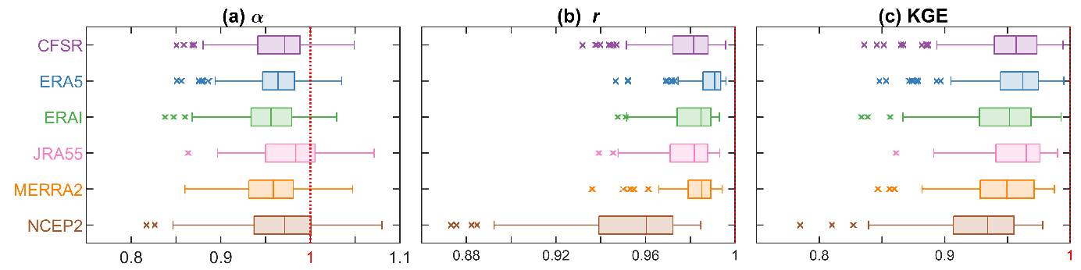
Consistency in monthly annual anomalies
Fig. Boxplot of the KGE parameters for the monthly relative anomalies of IWV from the six reanalyses against GPS for the 108 GPS stations. Note that the mean values of anomalies are always equal to zero so that no bias was considered
  The majority of the KGE scores are larger than 0.9, indicating that they are eligible for the study of climate extreme events
  NCEP2 ranks the last mainly due to its worst correlation against GPS
Notes:
Fig. 16. Box plot of the KGE parameters for the monthly relative anomalies of IWV from the varied reanalyses with respect to GPS for the 108 GPS stations.

Slide 14
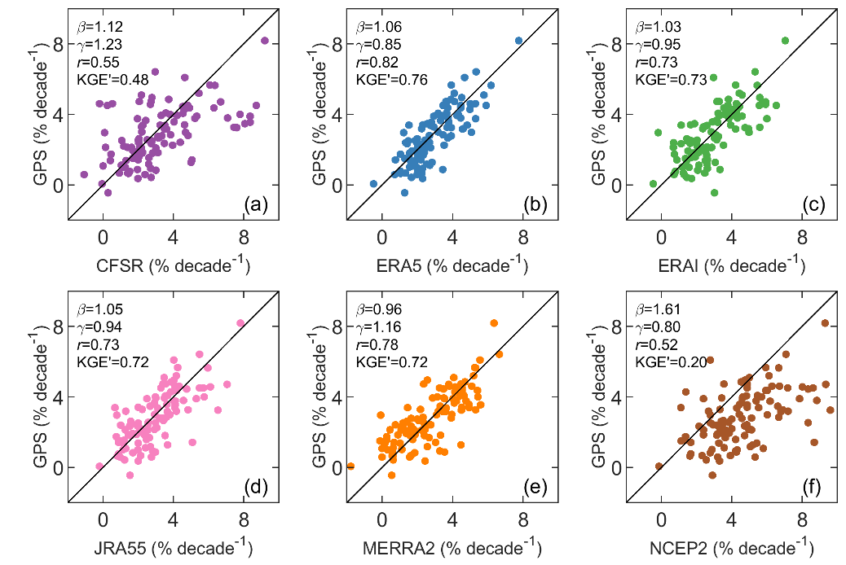
Consistency in trends
Fig. Comparison of the IWV trends (% decade⁻¹) from the six reanalyses against GPS, respectively
  The KGE’=0.76 for ERA5, indicating it is a very promising dataset for the study of climate change
  NCPE2 performs the worst
Notes:
Fig. 18. Comparison of the IWV trends (% decade⁻¹) from varied reanalyses with regard to GPS, respectively.

Slide 15

Thank you for your attention
Contact
Dr. Peng Yuan
Email: peng.yuan@kit.edu
Department of Geodetic Earth System Science, Geodetic Institute
Karlsruhe Institute of Technology, Karlsruhe, Germany
Acknowledgments
We are grateful to NGL (http://geodesy.unr.edu/) for providing the GPS data. Thanks were also given to ECMWF for providing ERA5 and ERAI data, NCEP for providing CFSR and NCEP2 data, JMA for providing JRA55 data, and NASA GAMO for providing MERRA2 data. The CFSR, NCEP2, JRA55 and MERRA2 data were obtained from the research data archive of NCAR (https://rda.ucar.edu/). This work was performed under the German Research Foundation (DFG, project number: 321886779)

Slide 16
Consistency in daily time series
1000-0.1 hPa
1000-100 hPa
Fig. Boxplot of the KGE’ parameters for the daily IWV time series from the reanalyses against GPS for the 108 GPS stations
  Most of the KGE’ scores are larger than 0.9, indicating that they are capable to reproduce daily IWV
  ERA5 performs the best whereas NCEP2 performs the worst
  JRA55 has a slight negative bias whereas the other reanalyses are characterized with positive biases
  The fact that JRA55’s RH are unavailable at the levels above 100 hPa might not be the reason for its slight negative bias
Notes:
Fig. 5. Boxplot of the KGE’ parameters for the daily IWV time series from the reanalyses against GPS for the 108 GPS stations.

Slide 17
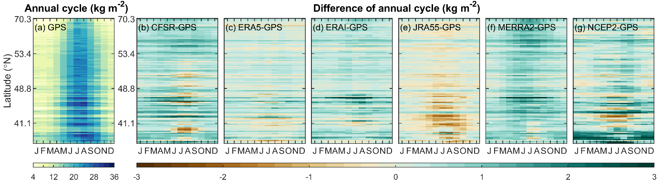
Consistency in monthly annual cycle
Fig. (a) Monthly annual cycle of GPS IWV for the 108 GPS stations. The stations are shown with descending latitudes.
(b-g) are the differences of annual cycle from the six reanalyses against the GPS, respectively.
  Most annual cycles peak in July and August and reach their minima in January and February
Notes:
Fig. 12. (a) Monthly annual cycle of GPS IWV for the 108 GPS stations. The stations are shown with descending latitudes.
(b-g) are the differences of annual cycle from the six reanalyses against the GPS, respectively.

