Slide 1
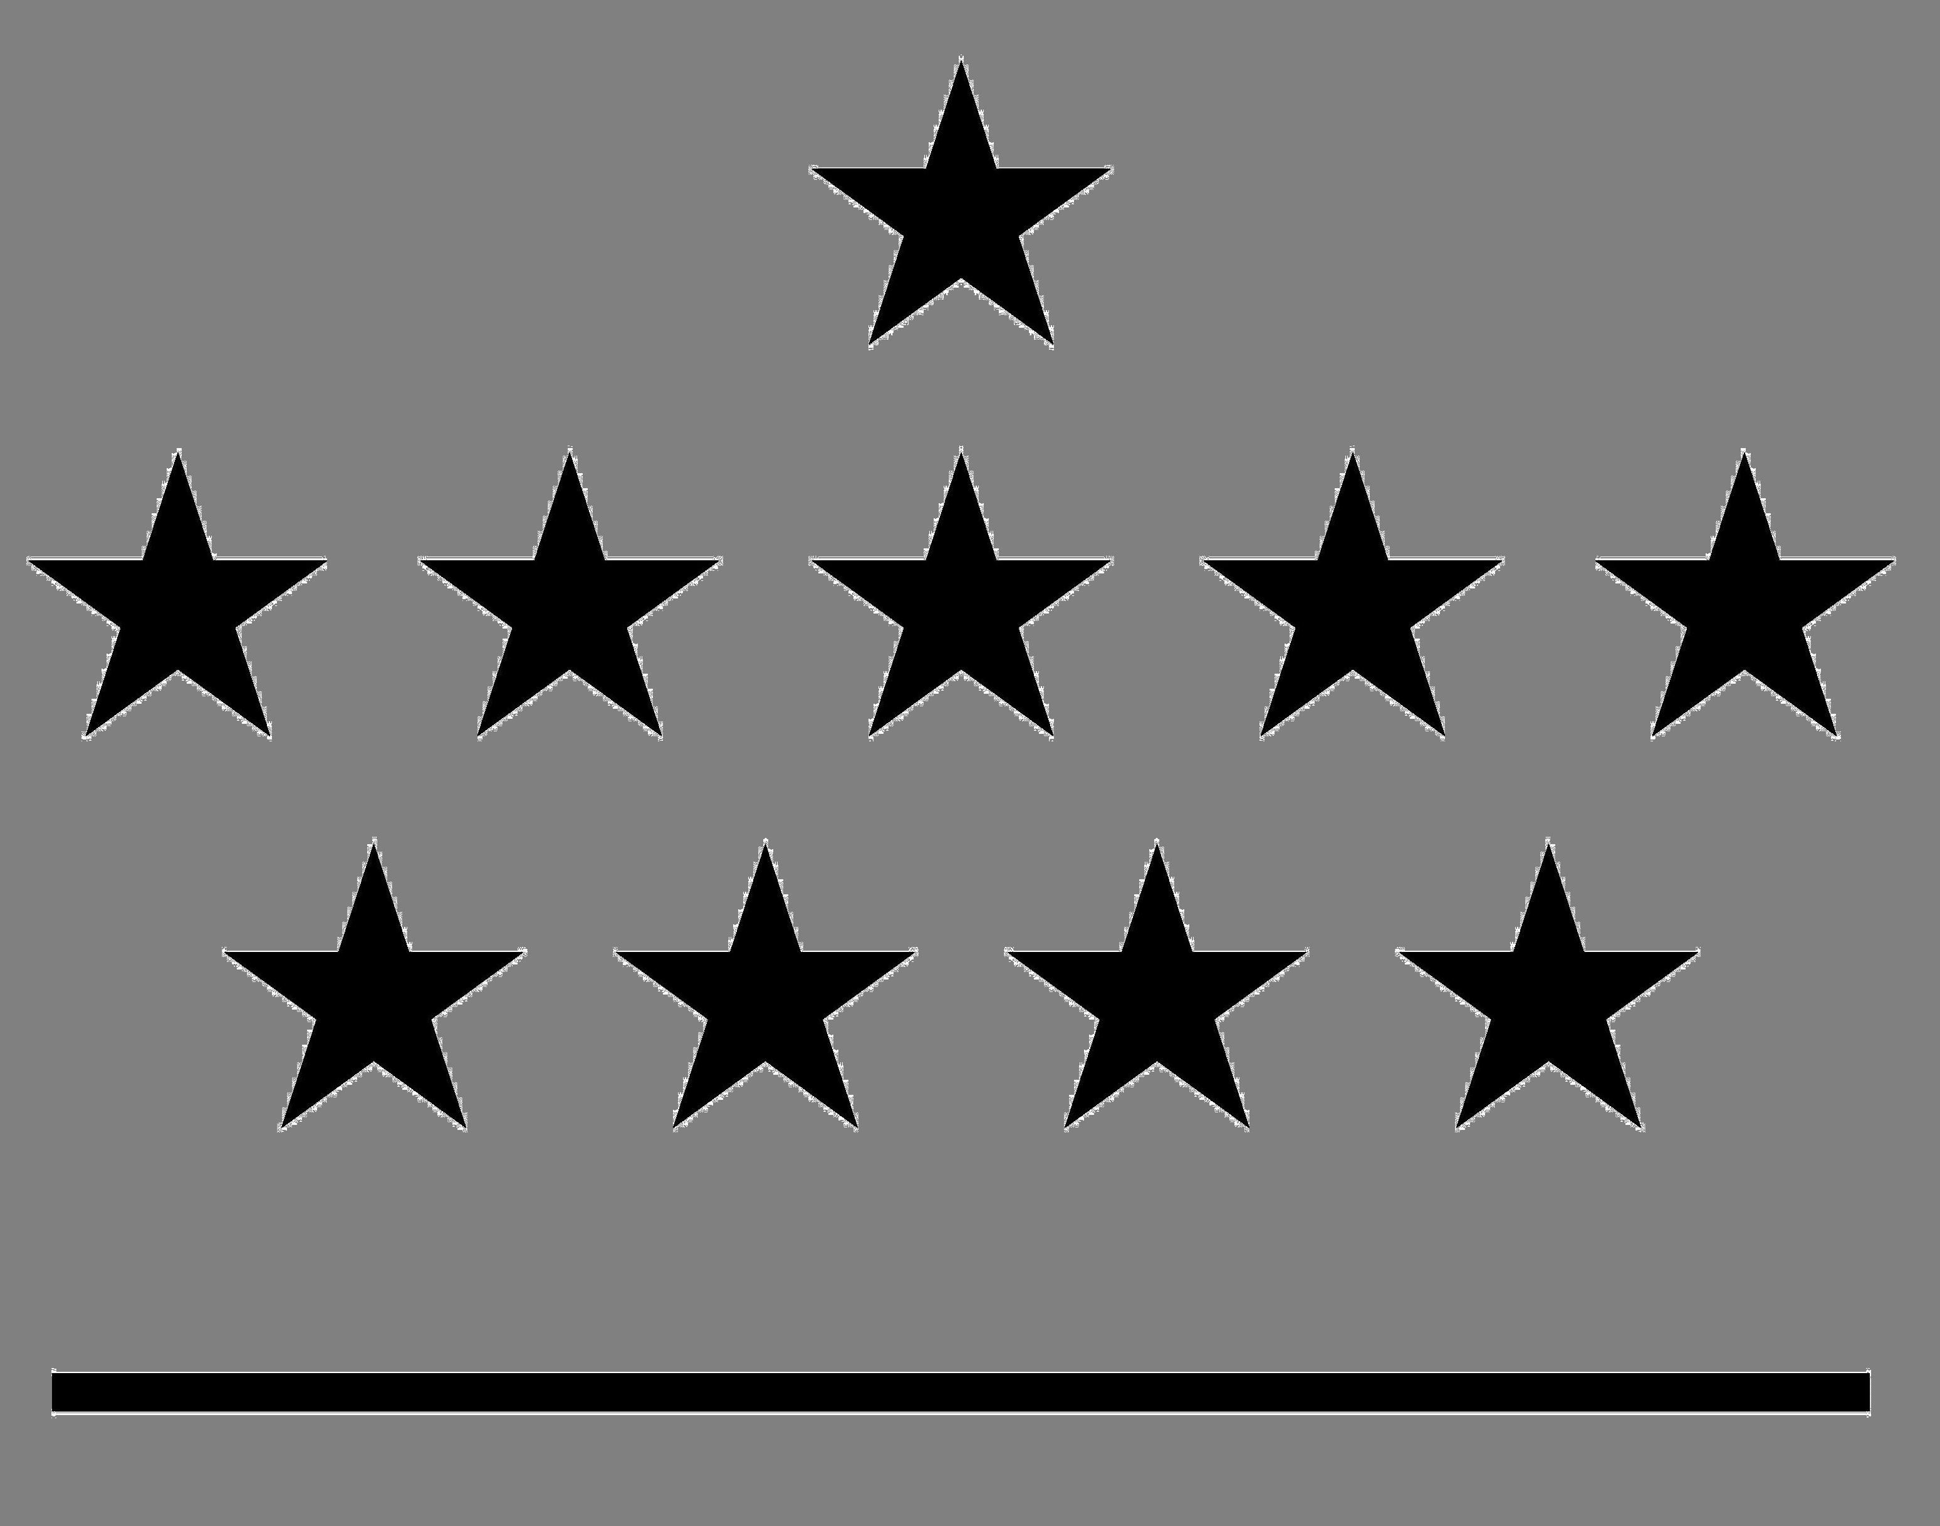



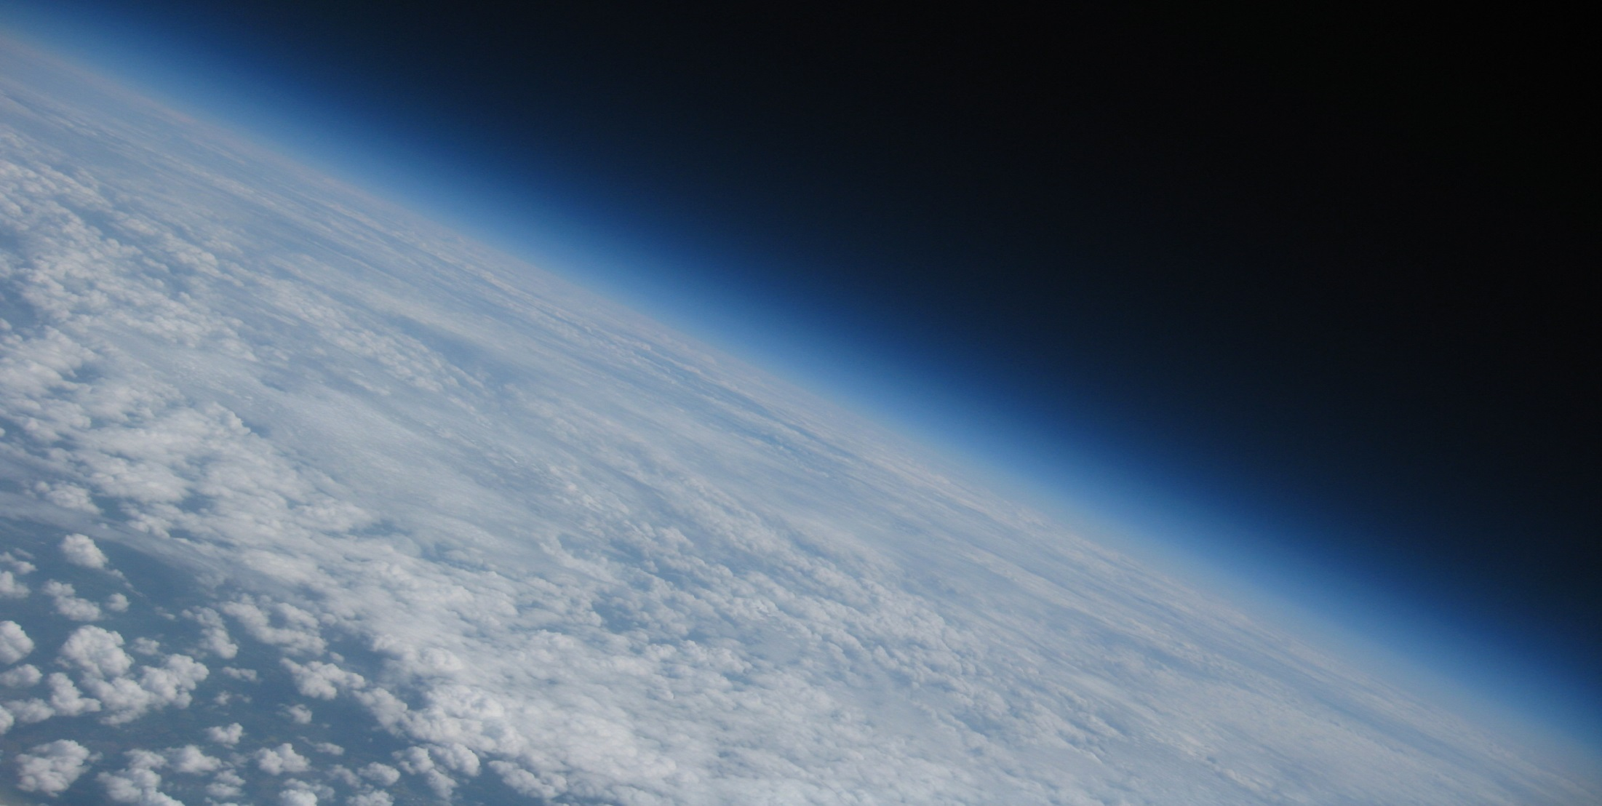
Royal Meteorological
Institute of Belgium
Royal Observatory of Belgium
Royal Belgian Institute
for Space Aeronomy
Max Planck Institute
for Chemistry
Solar-Terrestrial Centre of Excellence
1
2
3
4
5
Time variability of IWV datasets retrieved from IGS repro1, GOMESCIA satellite measurements and reanalyses
R. Van Malderen^{1,5}, E. Pottiaux^{2,5}, H. Brenot^{3,5}, S. Beirle⁴, T. Wagner ⁴, H. De Backer¹, and C. Bruyninx^{2,5}
GNSS4SWEC workshop, Reykjavik, 8-10/03/2016

Slide 2





ROB
Outline
Introduction
Diurnal IWV variation
Seasonal cycle
Frequency distribution
Conclusions & Perspectives
GNSS4SWEC workshop
Reykjavik, Iceland 8-10 March 2016

Slide 3
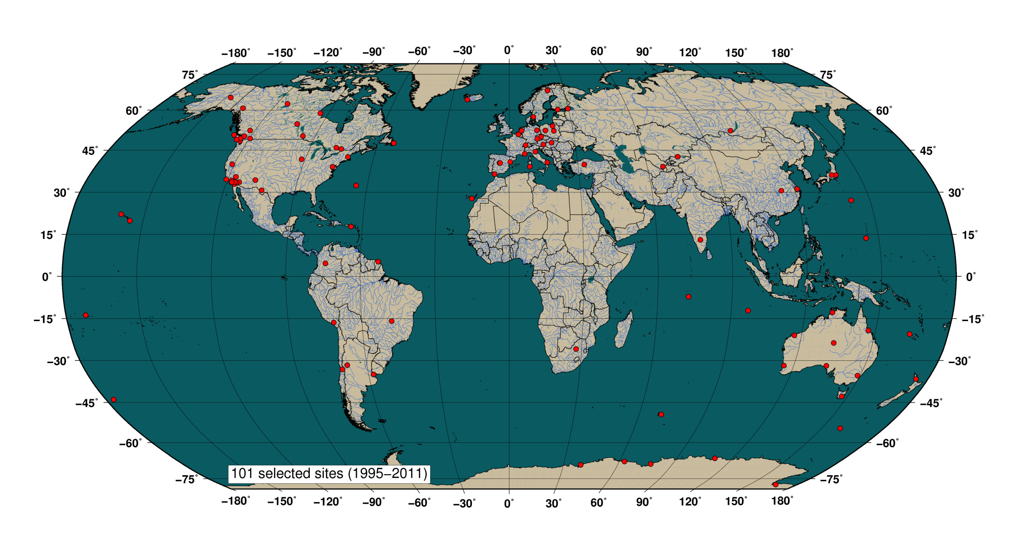
Introduction
Diurnal variation
Seasonal cycle
Frequency distribution
ROB
101 IGS stations selected (homogenous data processing from January 1995 to April 2011).
ERA-interim/NCEPNCAR
GOME/SCHIAMACHY/GOME-2 satellite overpass measurements (1996-…).
GNSS4SWEC workshop
Reykjavik, Iceland 8-10 March 2016

Slide 4
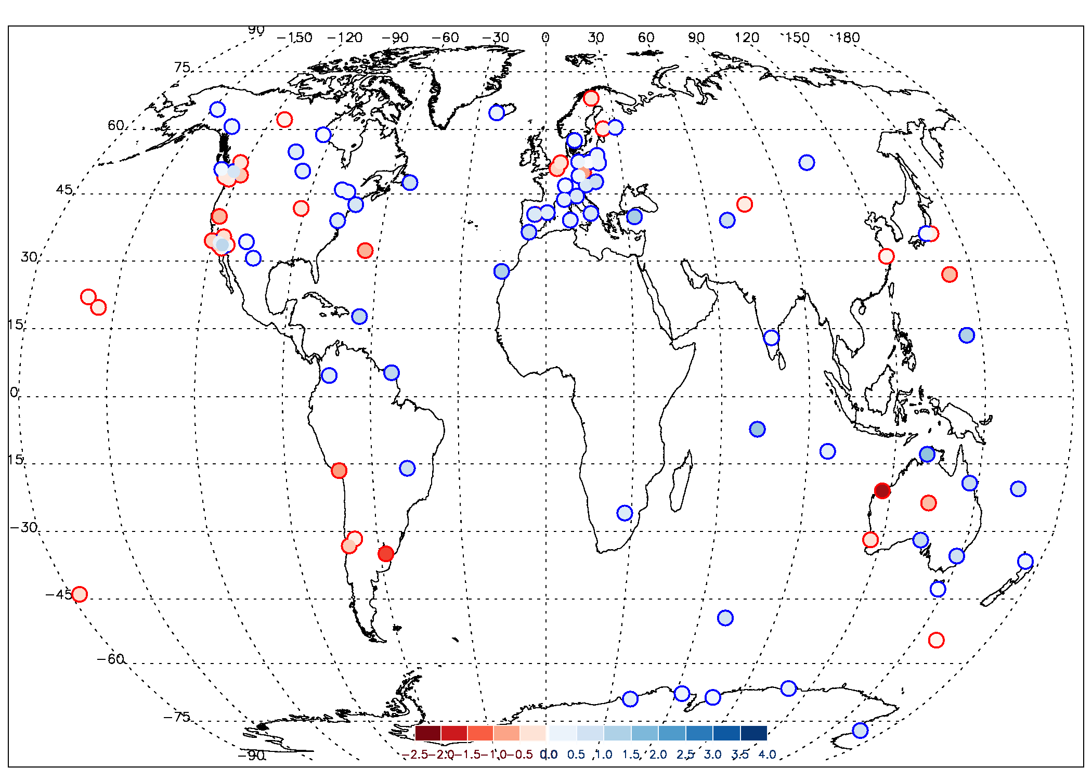
Introduction
Diurnal variation
Seasonal cycle
Frequency distribution
ROB
IWV trends [mm/dec] (January 1997-March 2011)
IGS, T_{m} ERAinterim

Slide 5
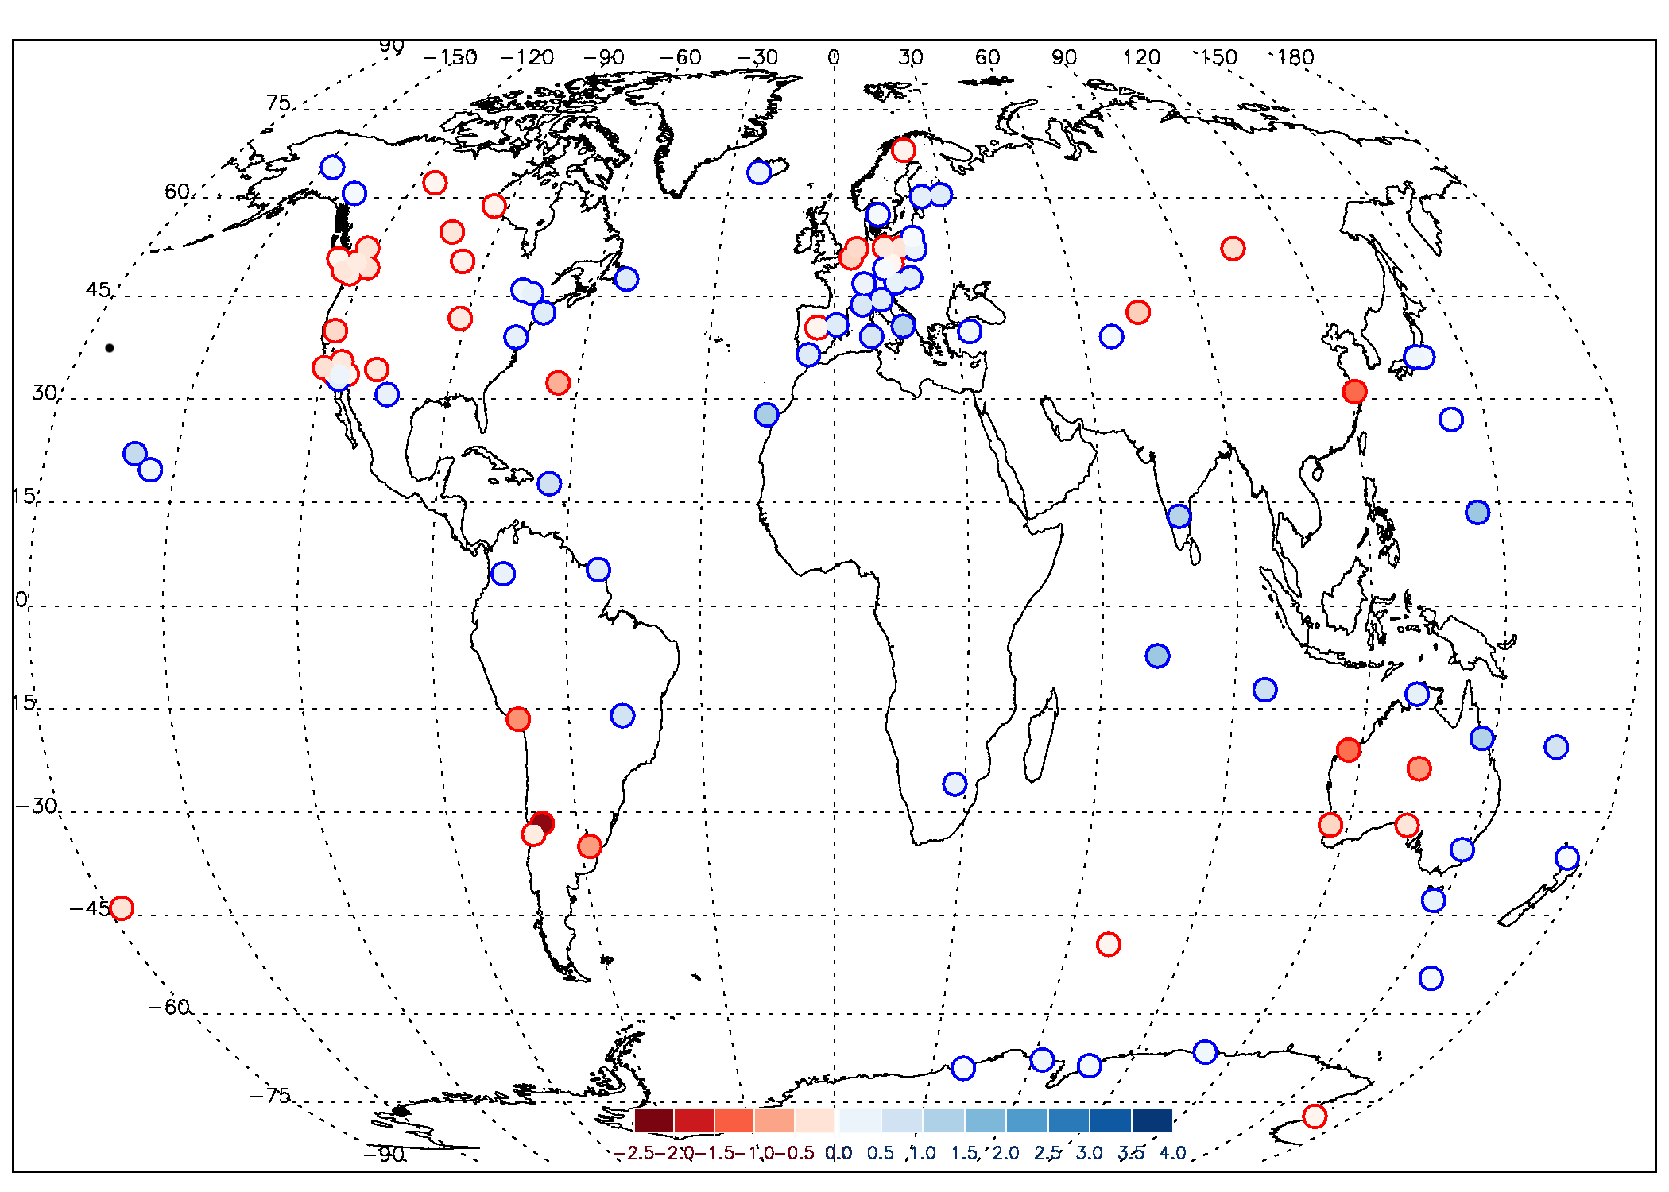
Introduction
Diurnal variation
Seasonal cycle
Frequency distribution
ROB
IWV trends [mm/dec] (January 1997-March 2011)
ERAinterim

Slide 6
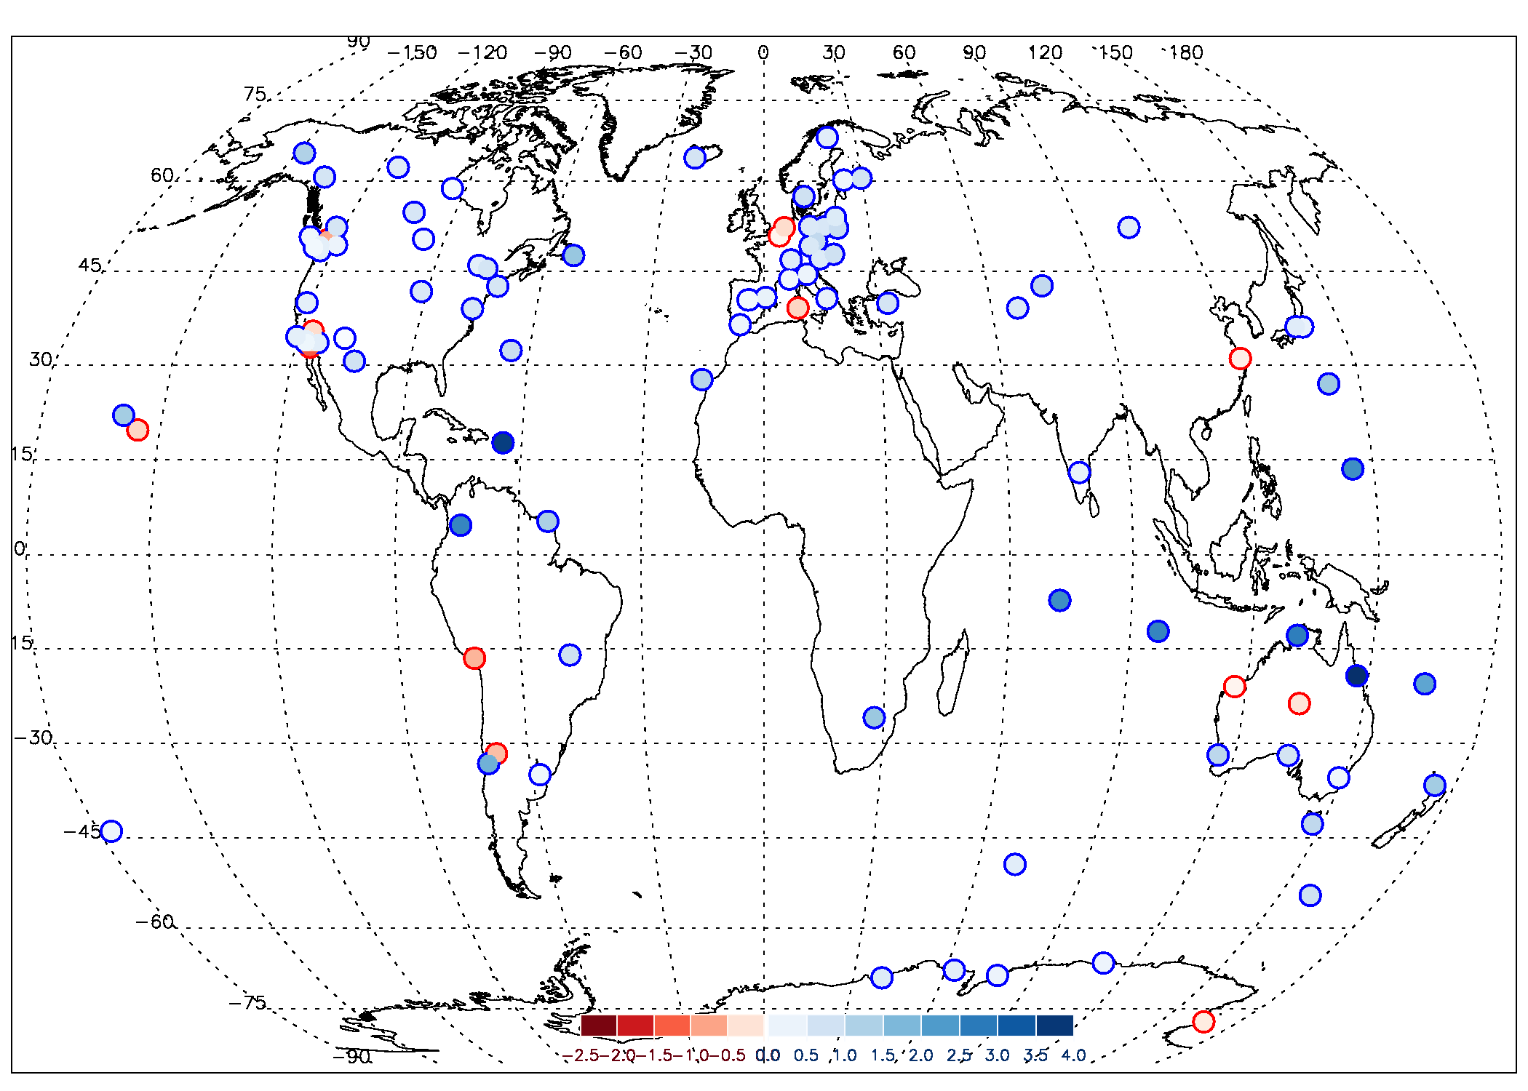
Introduction
Diurnal variation
Seasonal cycle
Frequency distribution
ROB
IWV trends [mm/dec] (January 1997-March 2011)
GOMESCIA

Slide 7
Introduction
Diurnal variation
Seasonal cycle
Frequency distribution
ROB
IWV trends [mm/dec] (January 1997-March 2011)
IGS, T_{m} ERAinterim

Slide 8
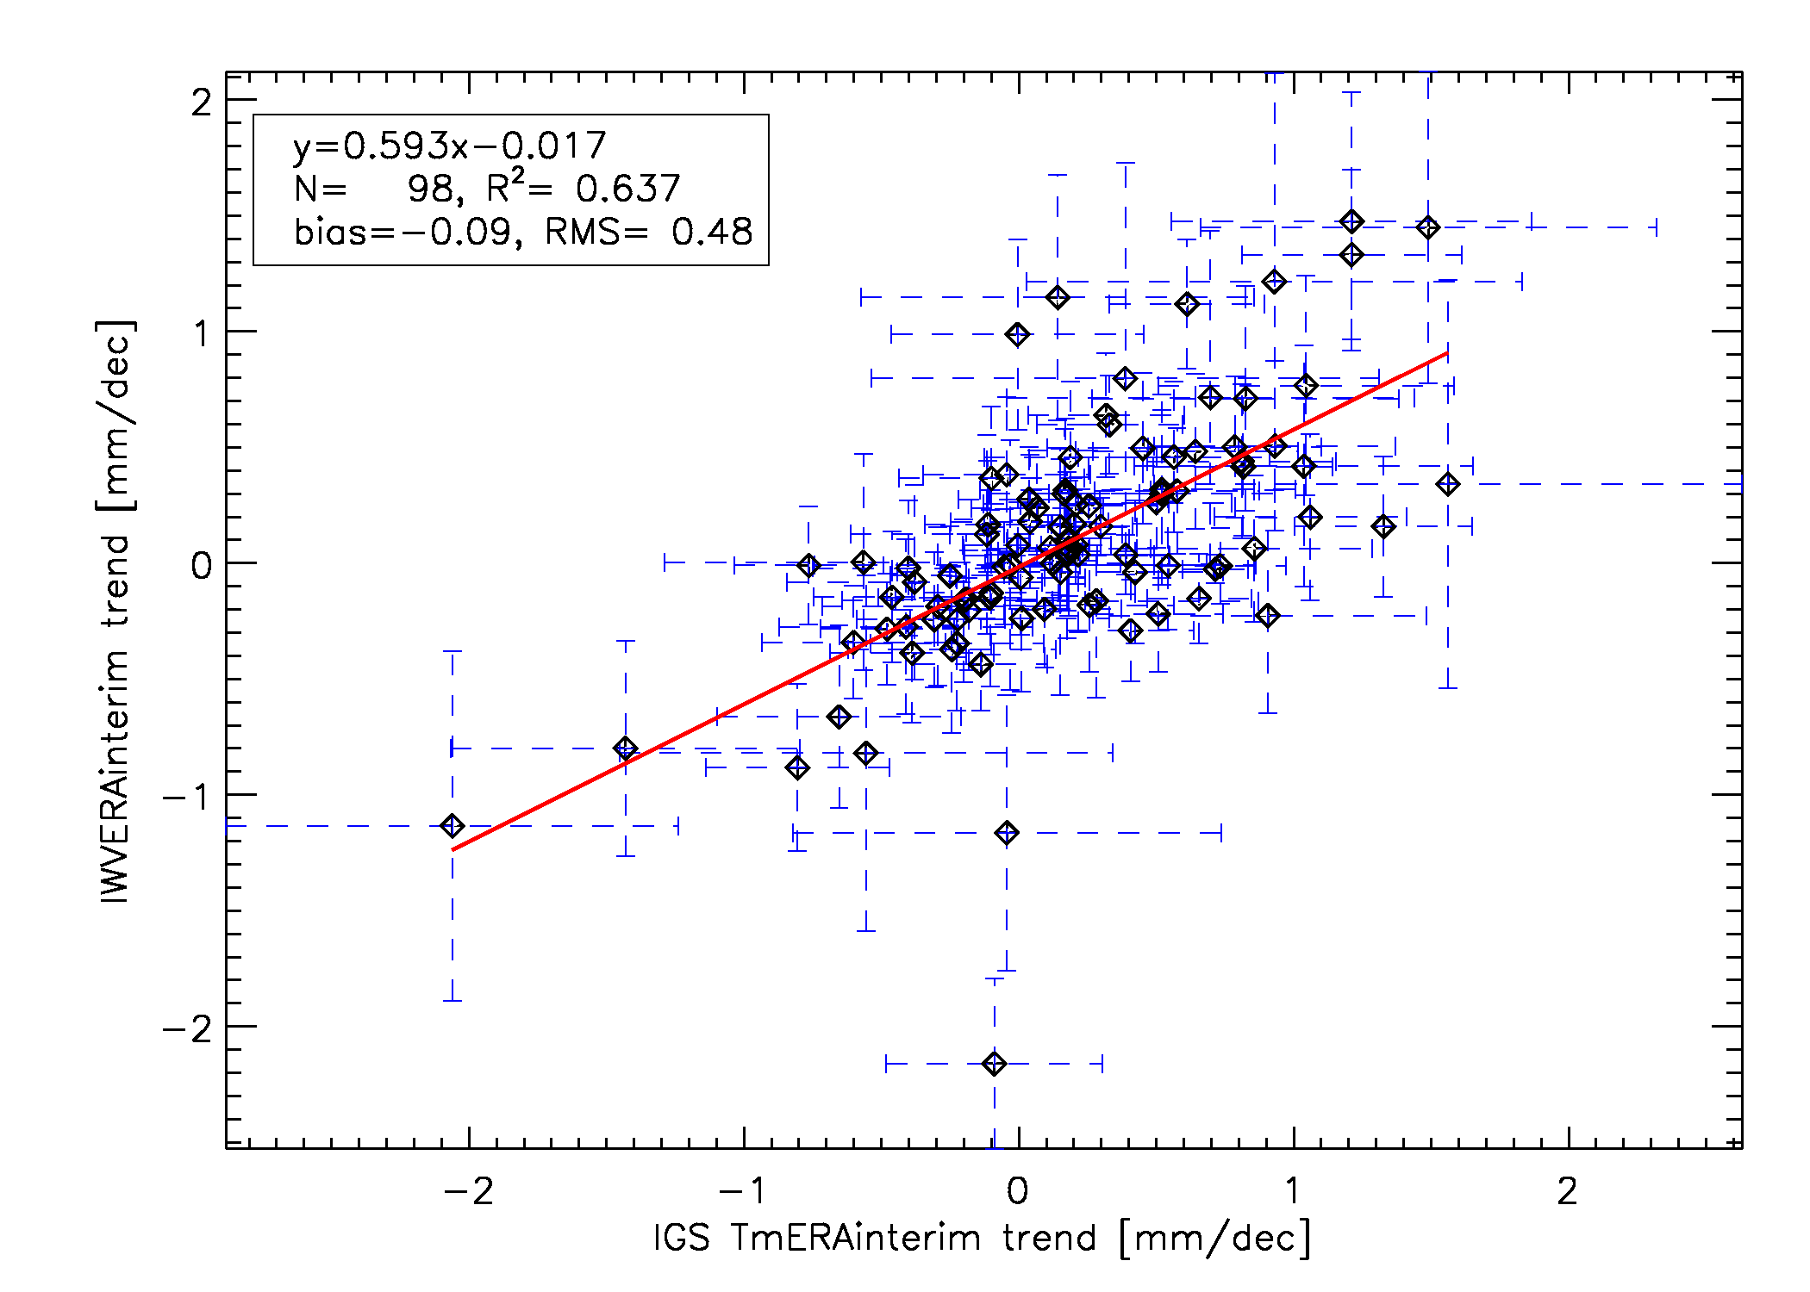
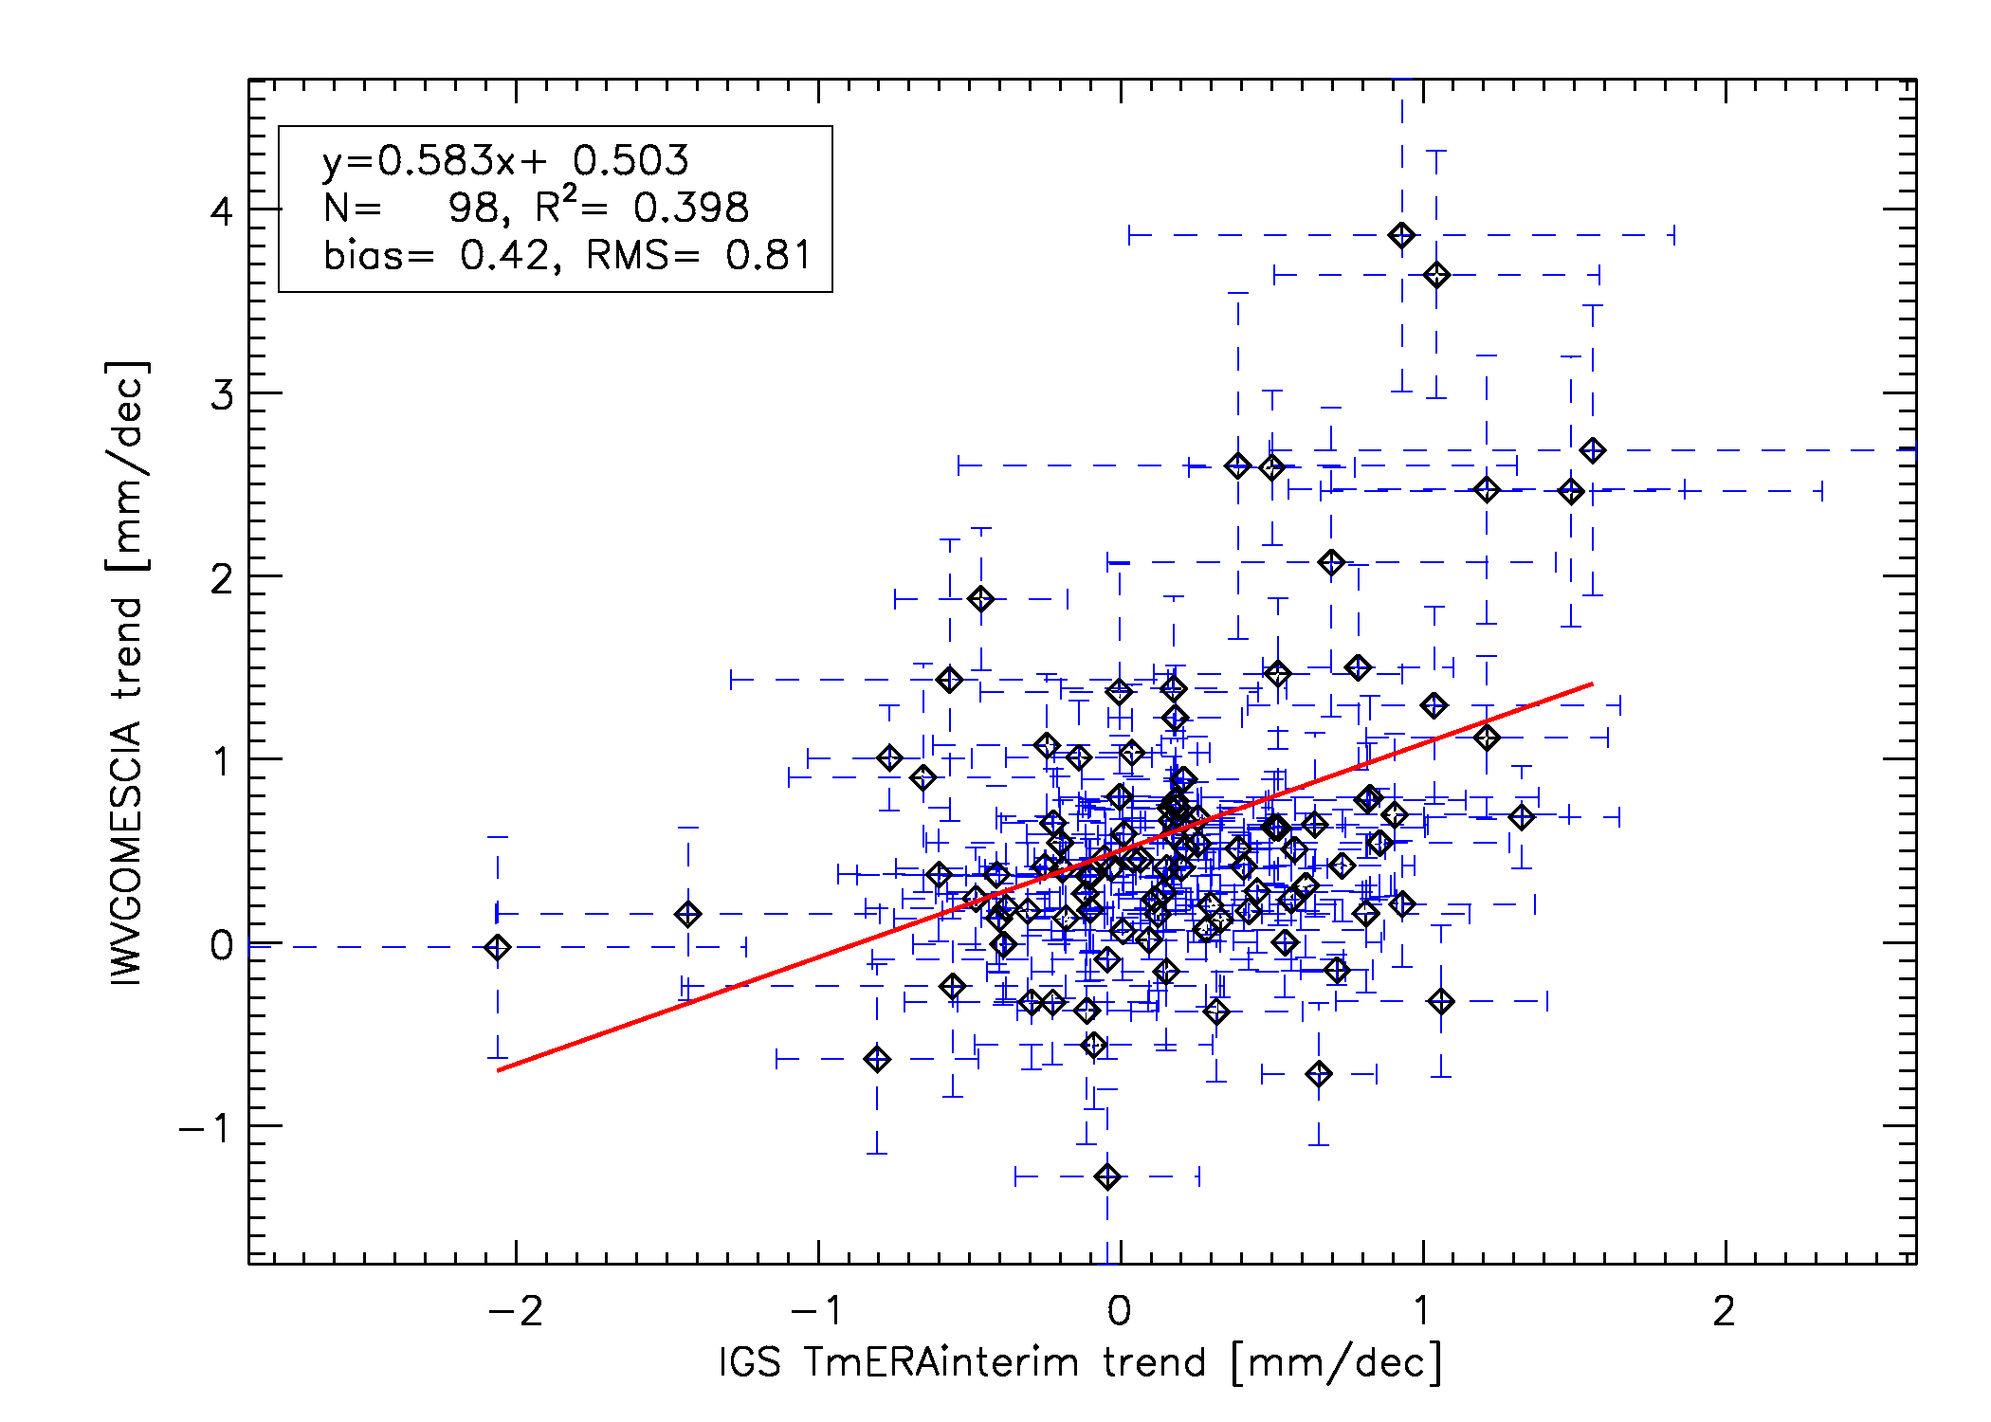
Introduction
Diurnal variation
Seasonal cycle
Frequency distribution
ROB
Trend correlations: between data sources
IGS vs. ERA-interim
IGS vs. GOMESCIA
Fair agreement between IGS and ERAinterim IWV trends.
Poorer agreement between IGS and GOMESCIA trends (stronger moistening in GOMESCIA): differences in observation times? Impact of weather observation bias (partly clear sky) of GOMESCIA? Data homogeneity issues?
GNSS4SWEC workshop
Reykjavik, Iceland 8-10 March 2016

Slide 9
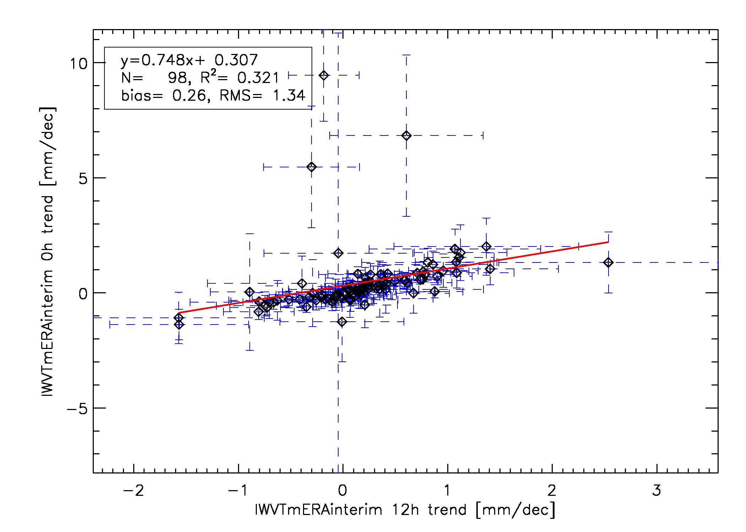
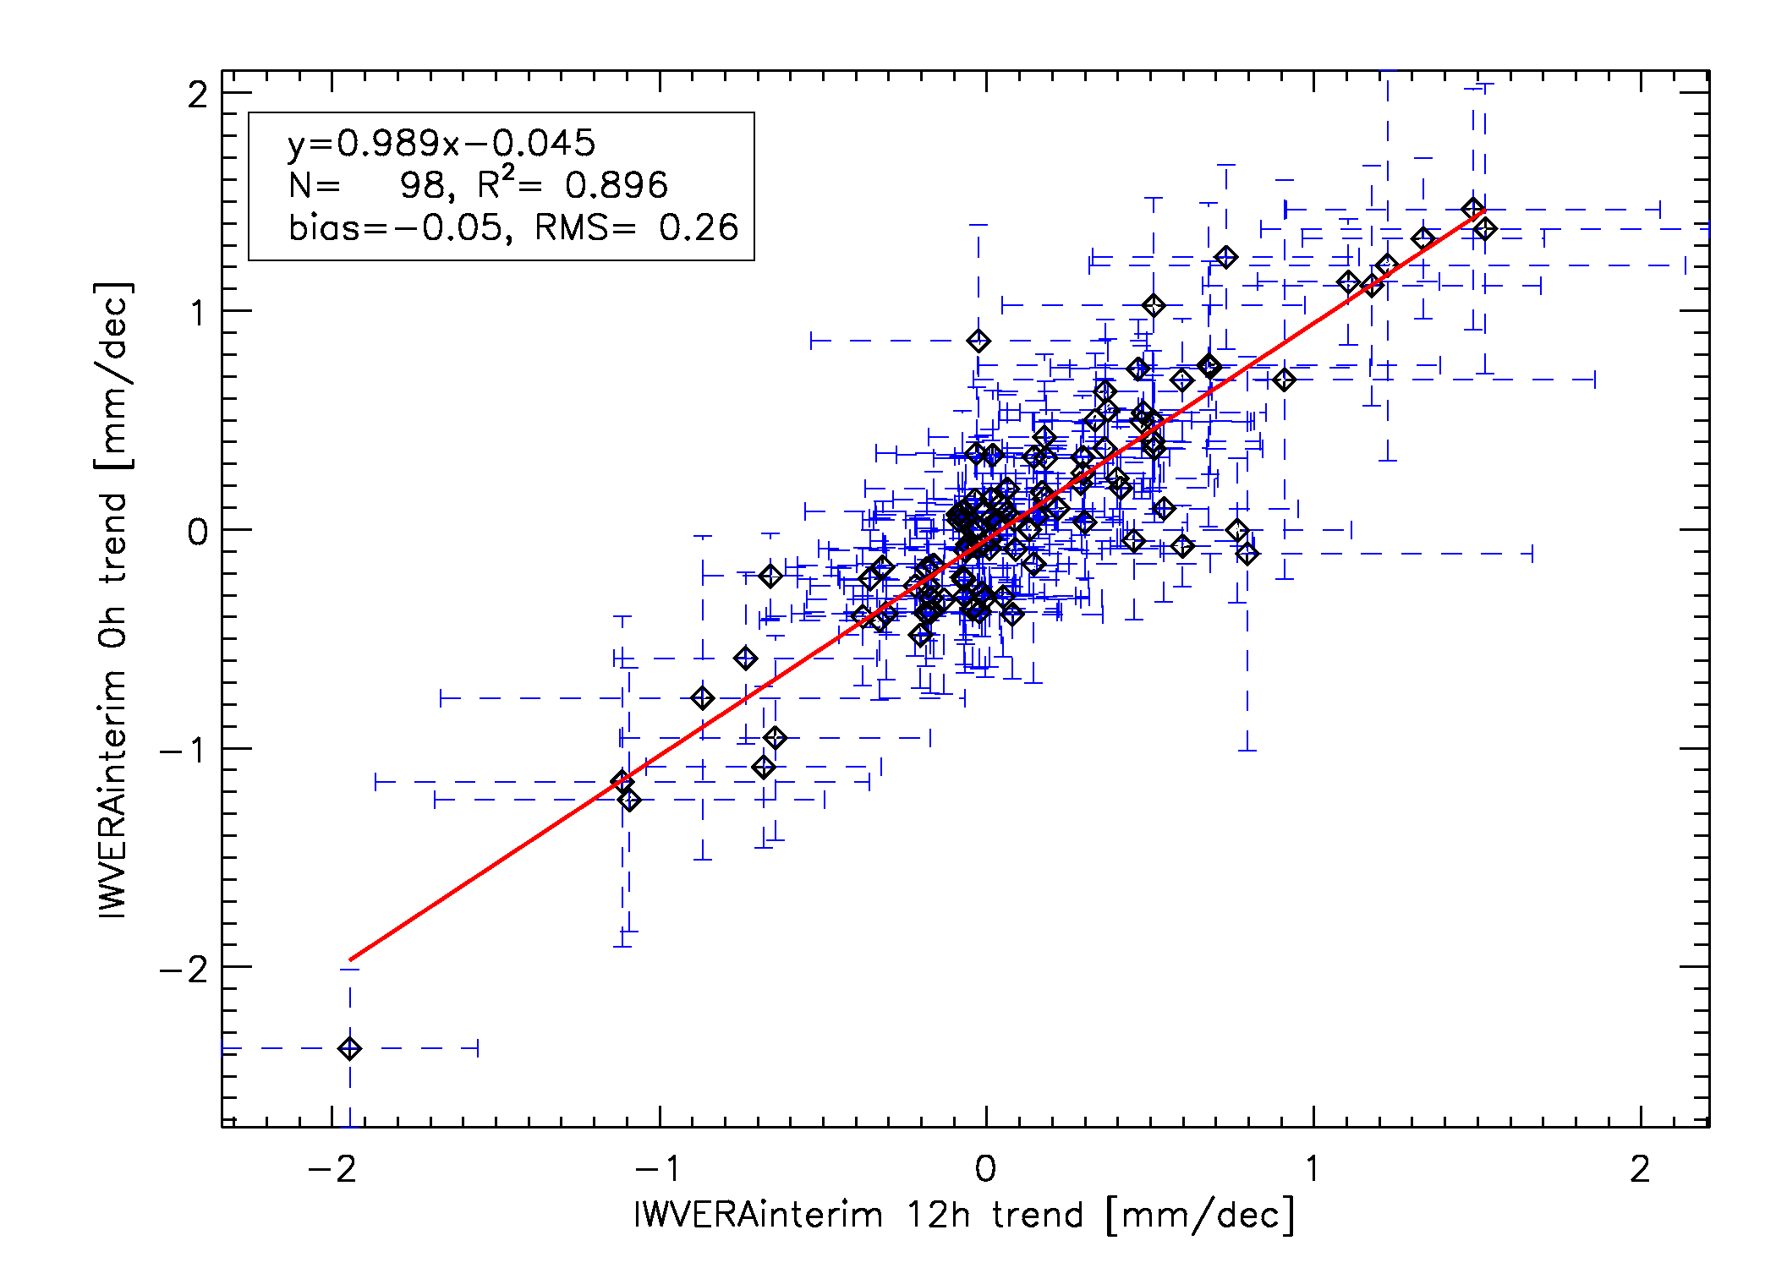
Introduction
Diurnal variation
Seasonal cycle
Frequency distribution
ROB
Trend correlations: between 0h and 12h
IGS
ERA-interim
Very good agreement between IWV ERAinterim trends at 0h and 12h.
A handful of IGS sites show unrealistic trends at 0h. Some additional filtering is needed here, to remove e.g. the ZTD day boundary jumps (→ IGS repro 2!).
GNSS4SWEC workshop
Reykjavik, Iceland 8-10 March 2016

Slide 10
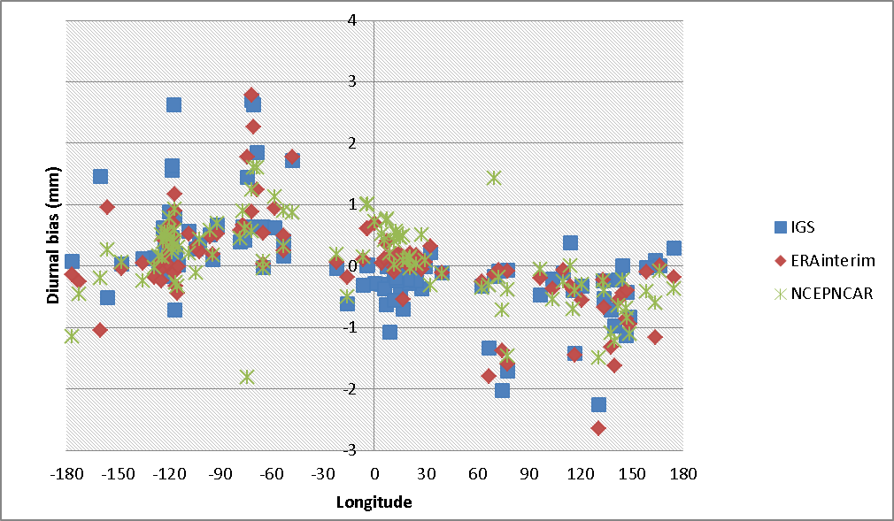
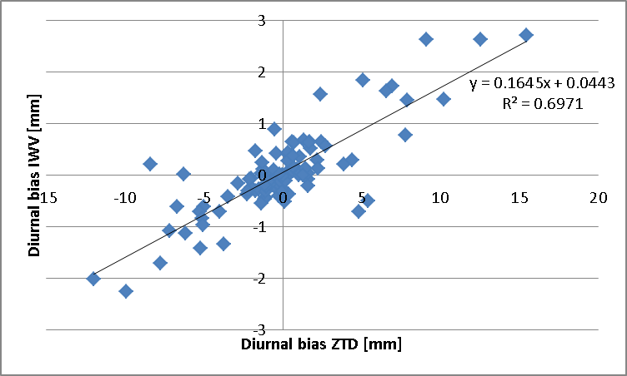
Introduction
Diurnal variation
Seasonal cycle
Frequency distribution
ROB
Diurnal variation (→ 0h UTC – 12 h UTC)
Of course, we found some longitudinal variations (value → more than noise)
In general, IGS IWV shows largest diurnal bias (impact of day boundary jumps?).
NCEPNCAR has smaller diurnal bias than ERA-interim.
The diurnal IWV bias of IGS dataset can attributed largely to the diurnal ZTD bias.
➔ Impact from the ZTD→IWV → conversion is small.

Slide 11
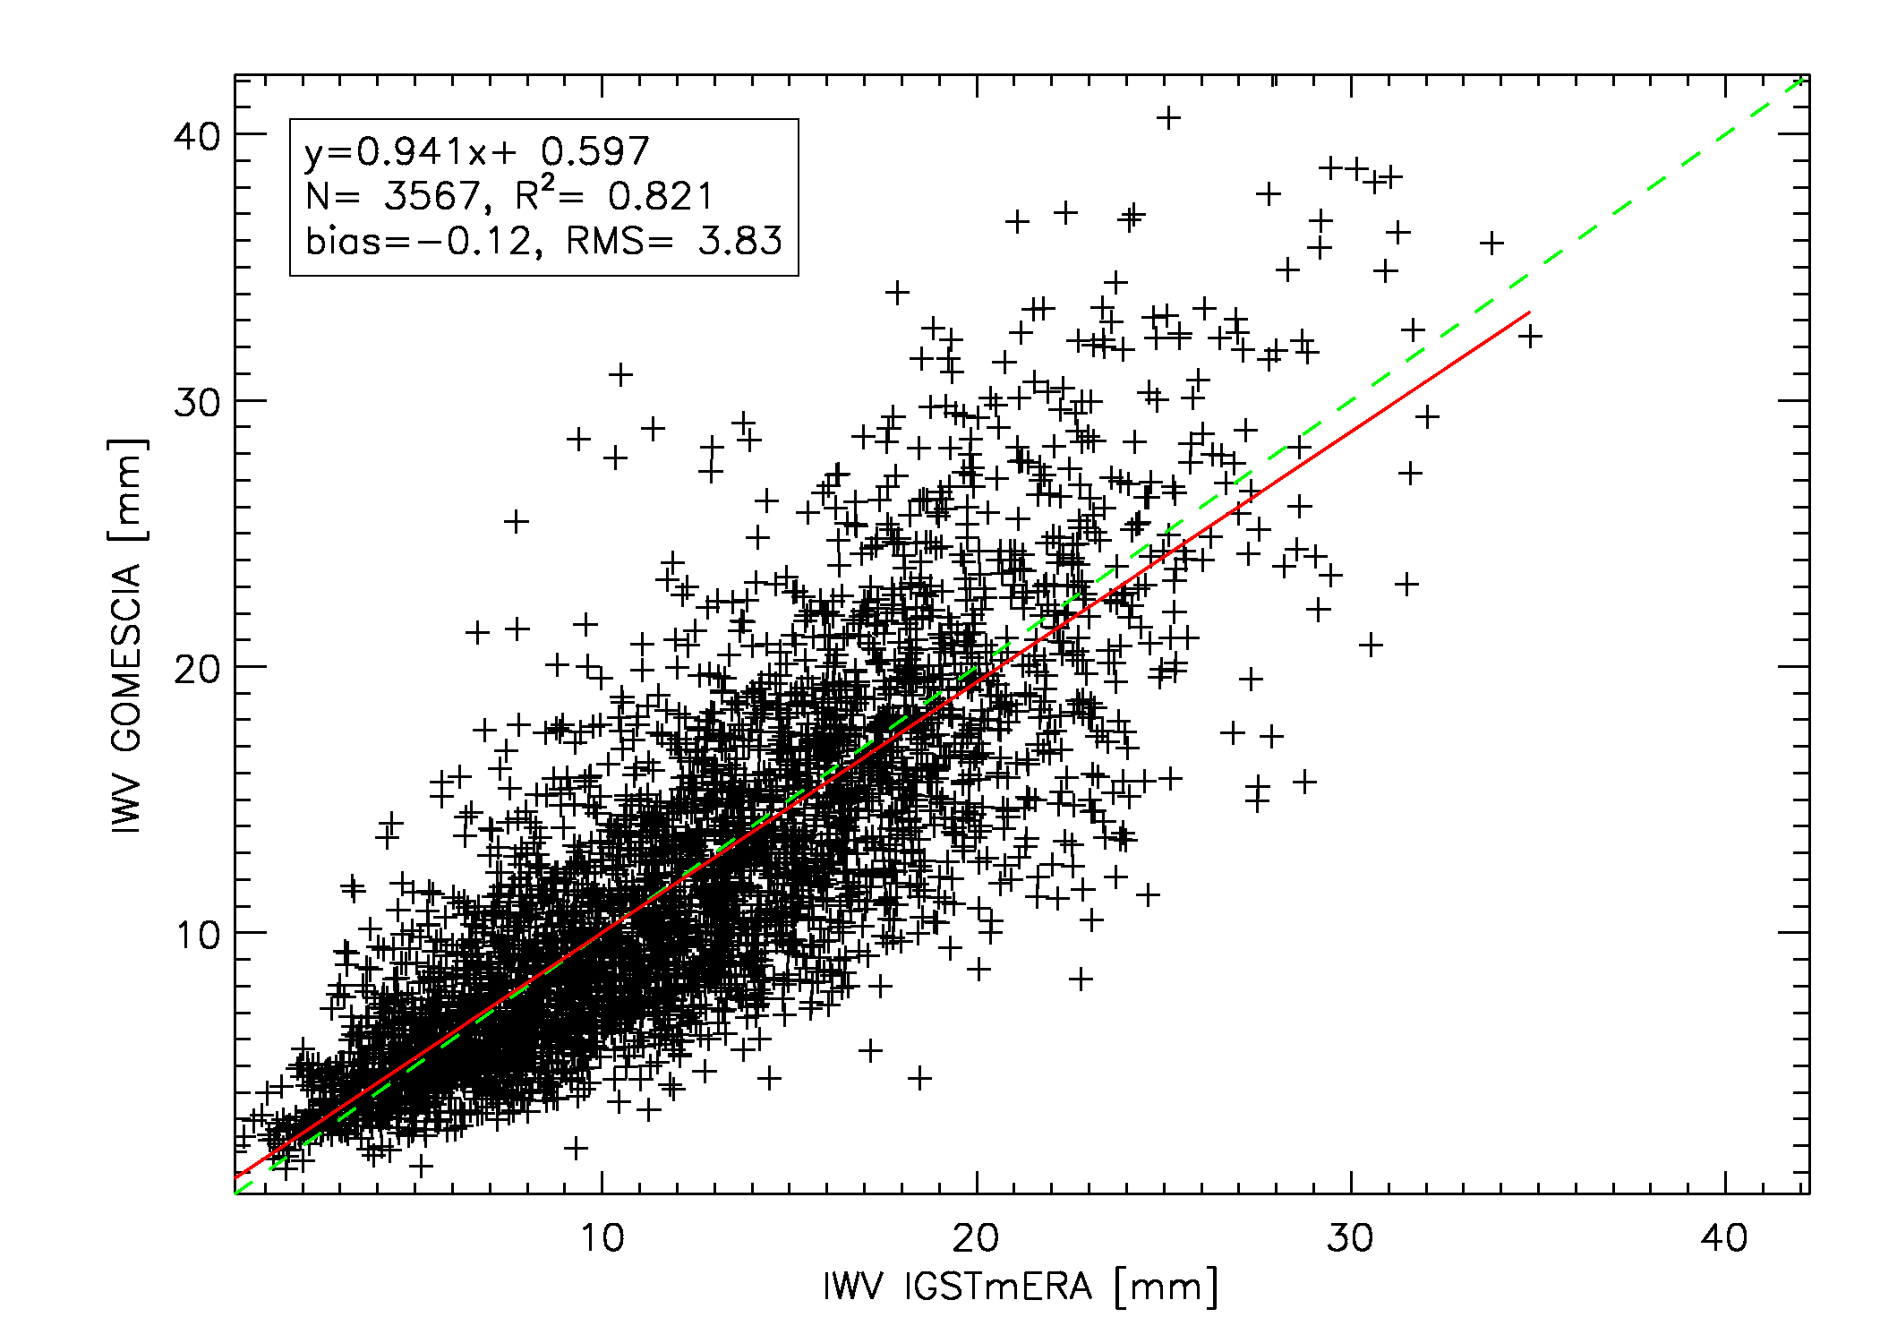
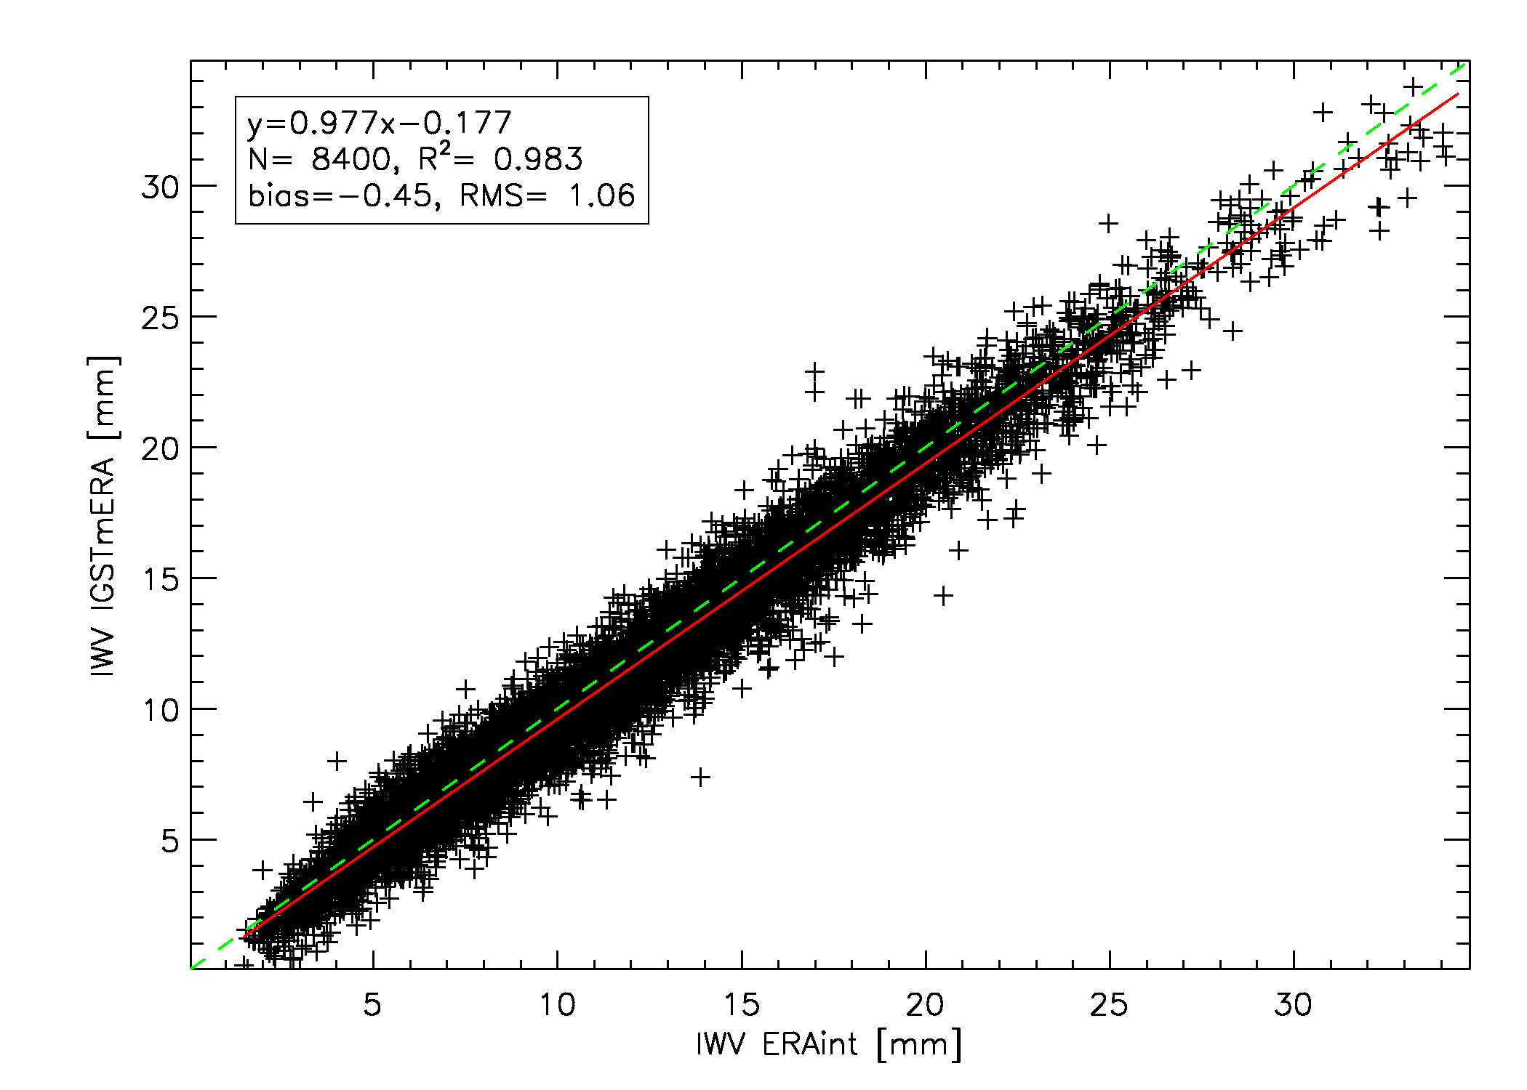
Introduction
Diurnal variation
Seasonal cycle
Frequency distribution
ROB
Diurnal variation
The diurnal variation seems to have no impact on the agreement between GOMESCIA (fixed satellite overpass times) and other IWV datasets (0h, 12h).
REYK, satellite crossing time: 12h45 UTC
GNSS4SWEC workshop
Reykjavik, Iceland 8-10 March 2016

Slide 12
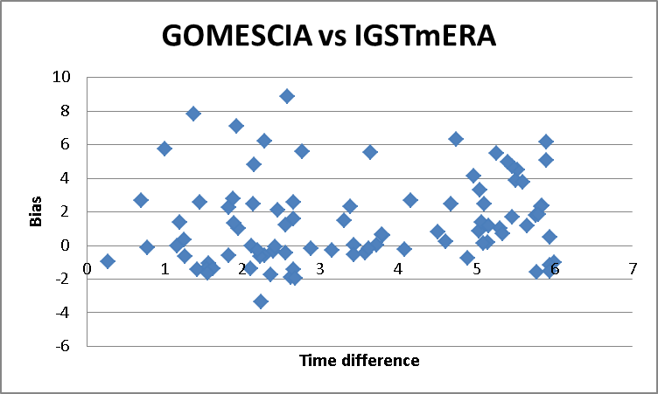
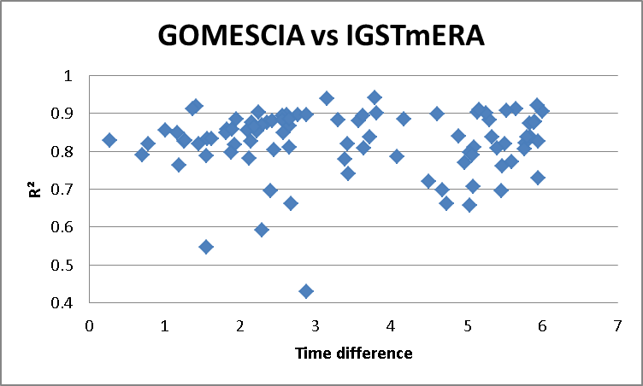
Introduction
Diurnal variation
Seasonal cycle
Frequency distribution
ROB
Diurnal variation
The diurnal variation seems to have no impact on the agreement between GOMESCIA (fixed satellite overpass times) and other IWV datasets (0h, 12h).
GNSS4SWEC workshop
Reykjavik, Iceland 8-10 March 2016

Slide 13
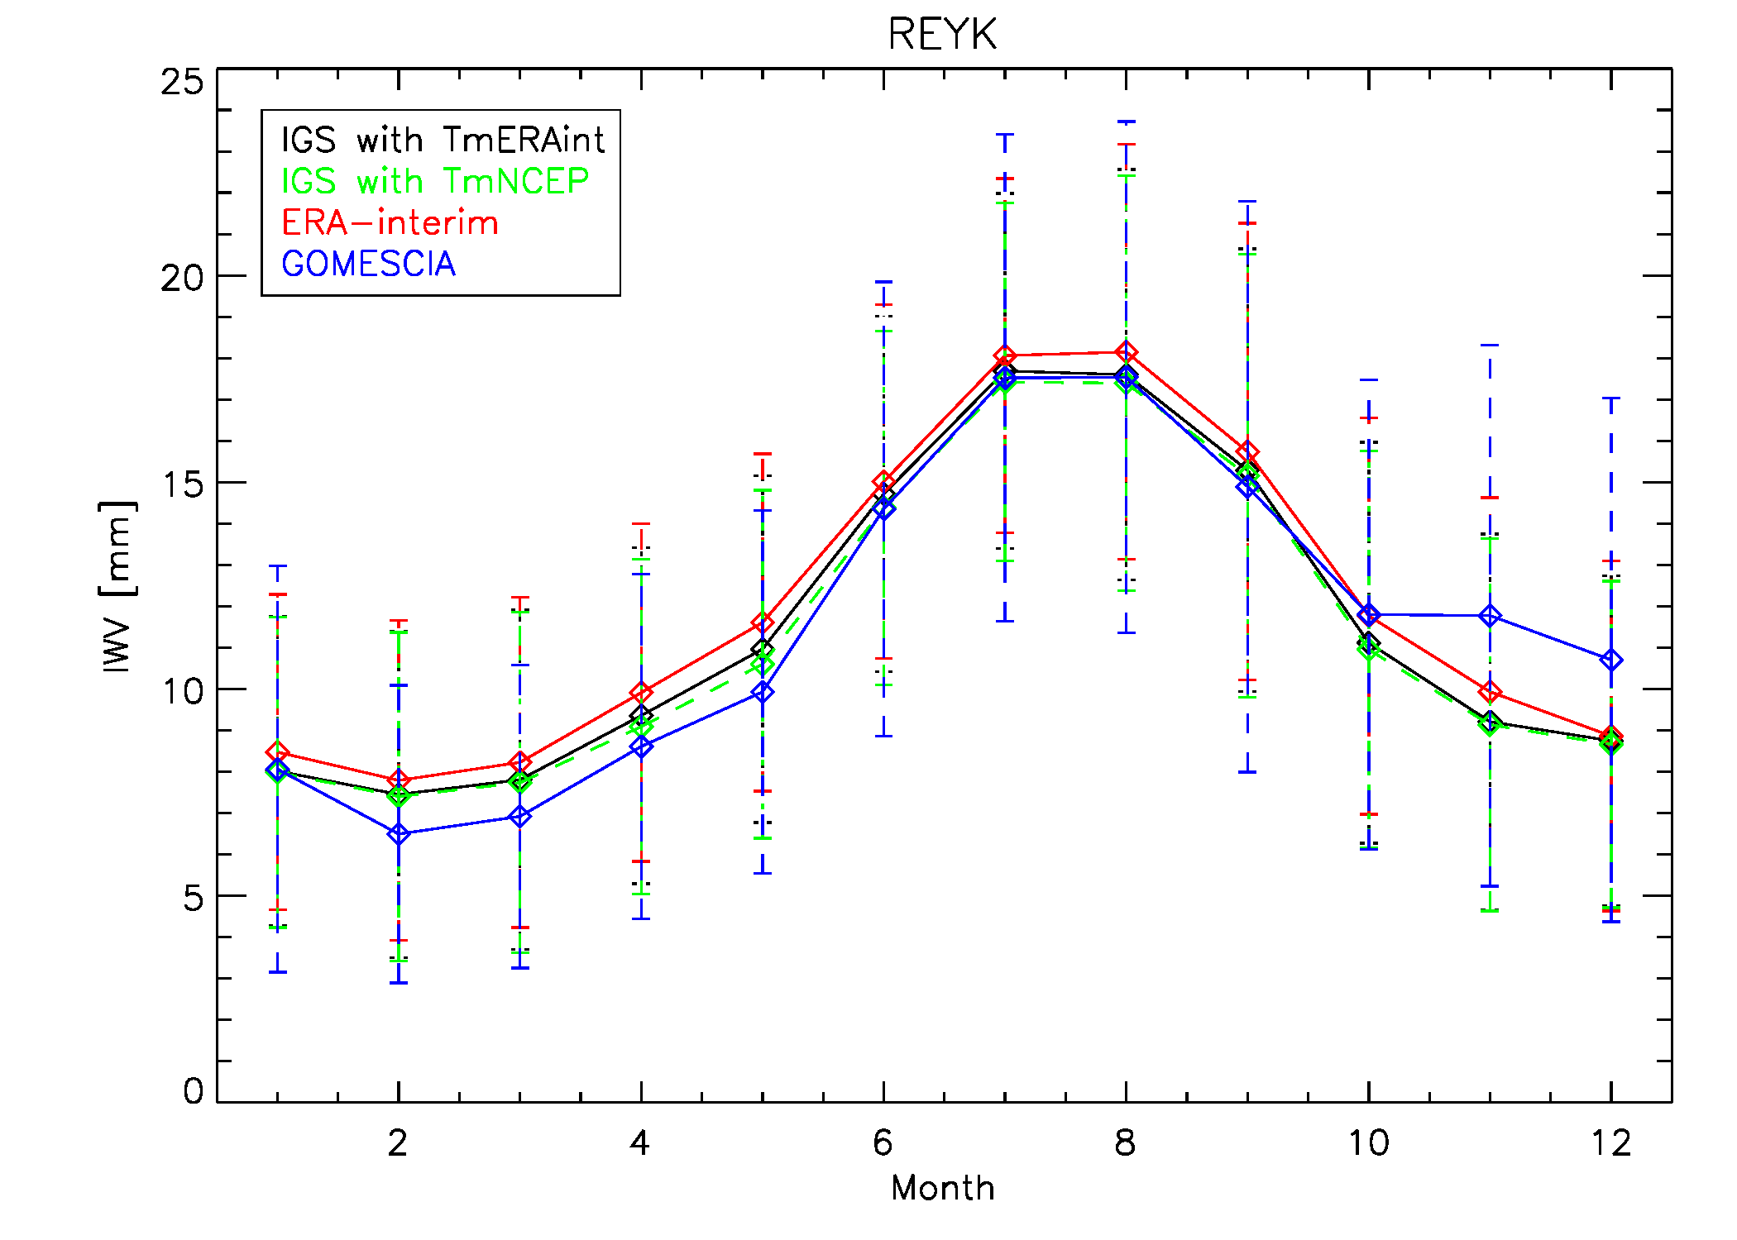
Introduction
Diurnal variation
Seasonal cycle
Frequency distribution
ROB
Seasonal cycle: Reykjavik example
the global shape of the seasonal cycle is very similarly captured by all techniques/datasets
GOMESCIA differs most from other devices w.r.t. seasonal cycle, especially at lower IWV values
Overestimation by ERA-interim?
Impact of chosen reanalysis for meteo data needed for conversion is small
GNSS4SWEC workshop
Reykjavik, Iceland 8-10 March 2016

Slide 14
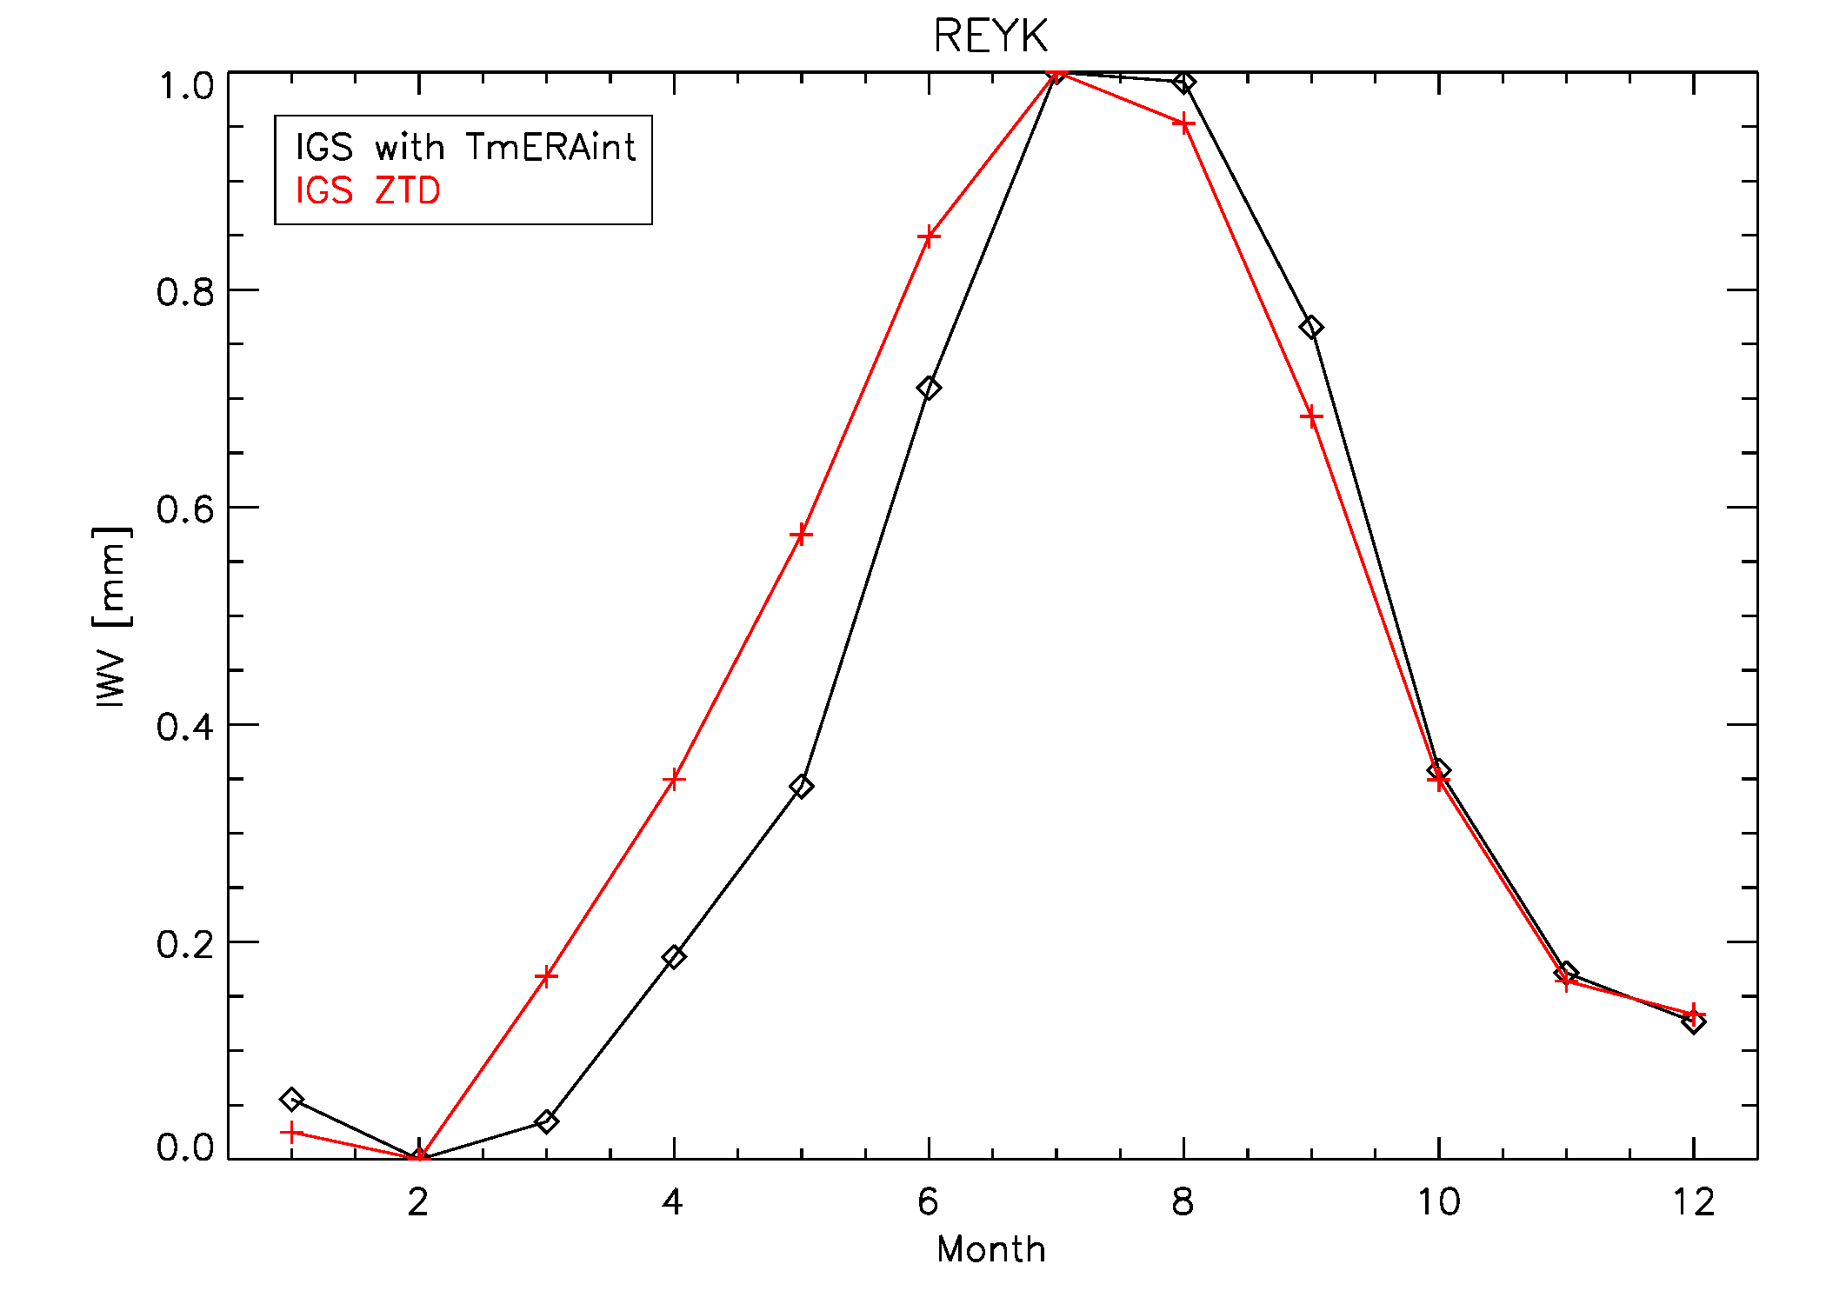
Introduction
Diurnal variation
Seasonal cycle
Frequency distribution
ROB
Seasonal cycle: Reykjavik example
Auxiliary meteo data needed for the ZTD→IWV conversion alter the ZTD seasonal cycle slightly
Normalized seasonal cycle
GNSS4SWEC workshop
Reykjavik, Iceland 8-10 March 2016

Slide 15
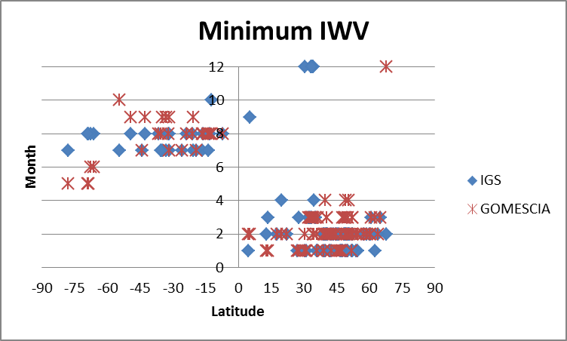
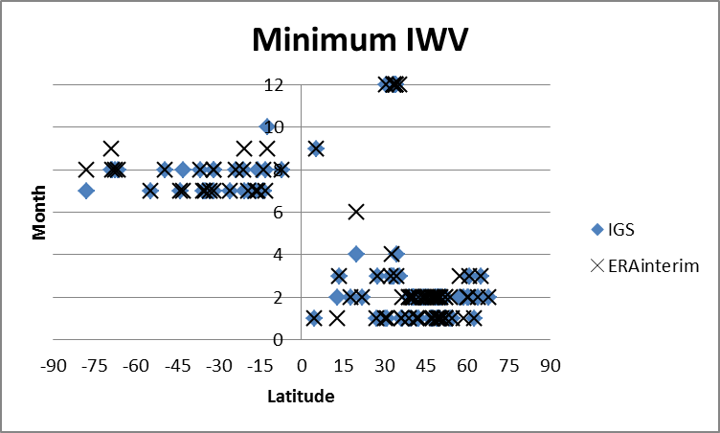
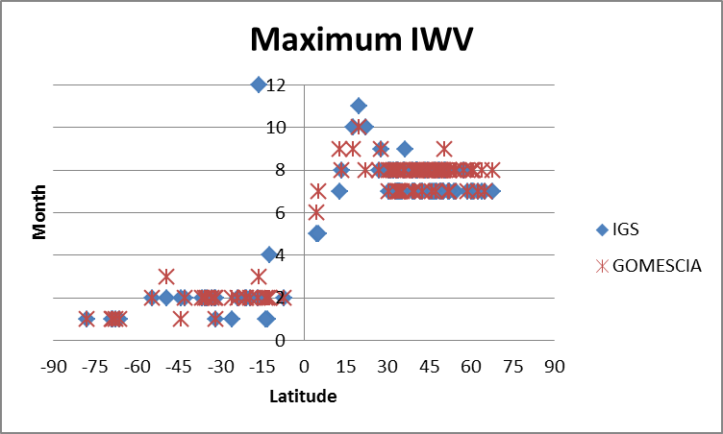
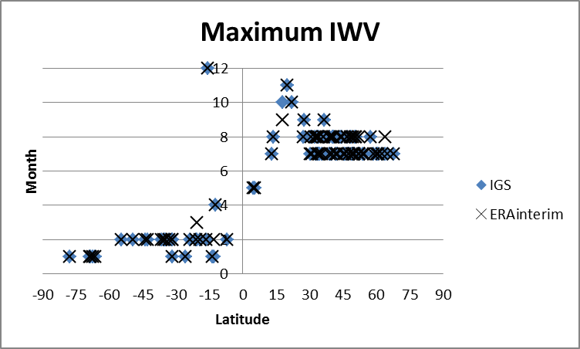
Introduction
Diurnal variation
Seasonal cycle
Frequency distribution
ROB
Seasonal cycle: phase analysis
earlier
later

Slide 16
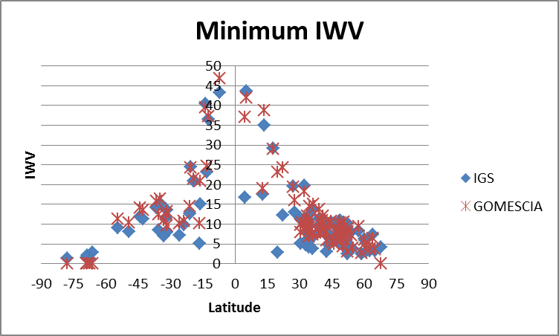
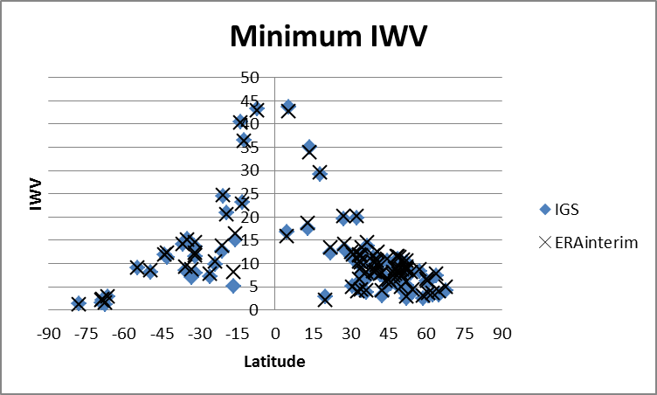
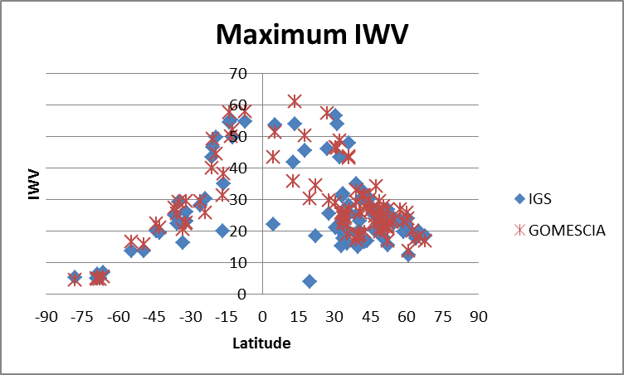
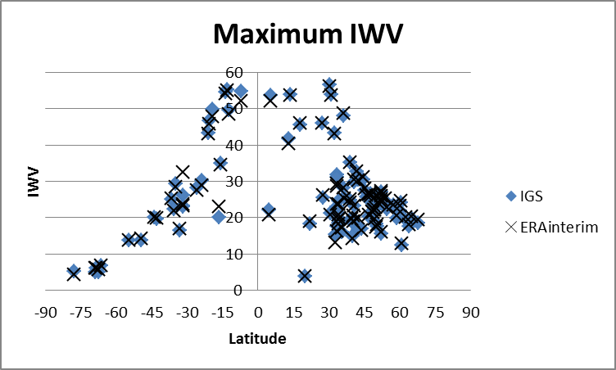
Introduction
Diurnal variation
Seasonal cycle
Frequency distribution
ROB
Seasonal cycle: amplitude analysis
higher
higher

Slide 17
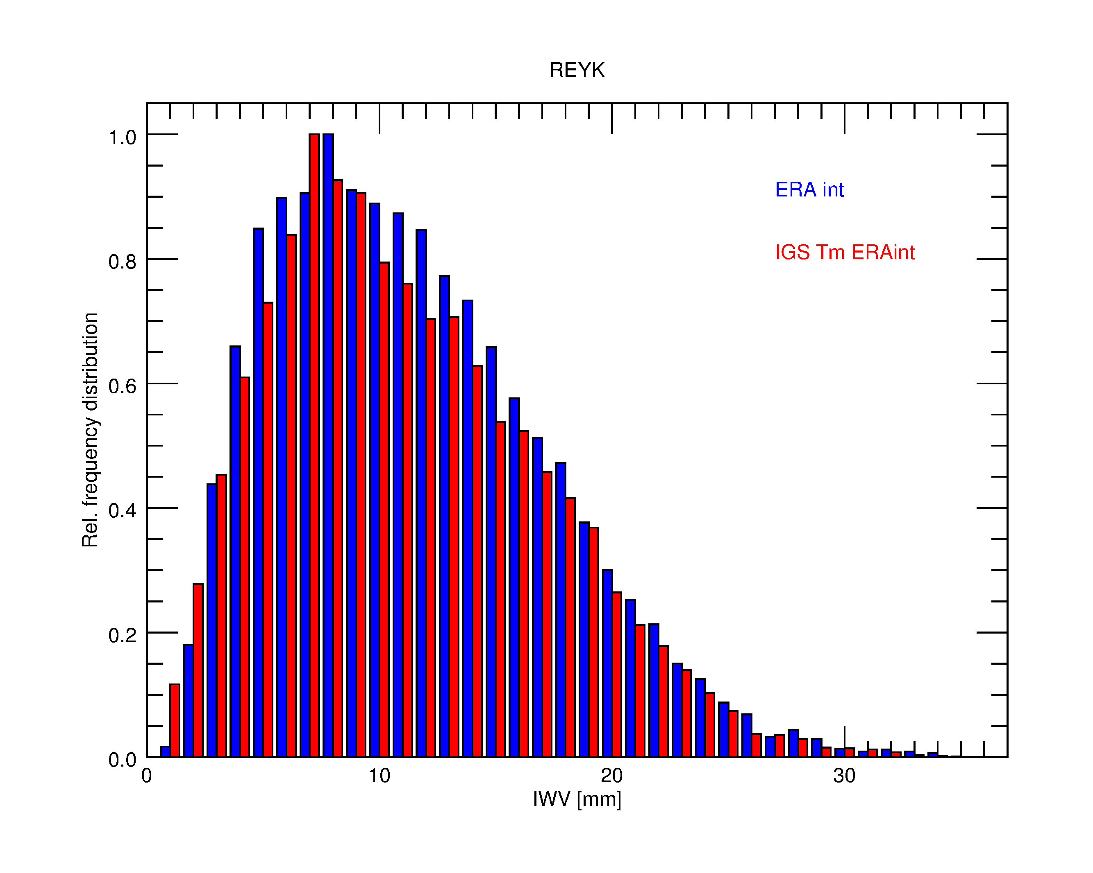
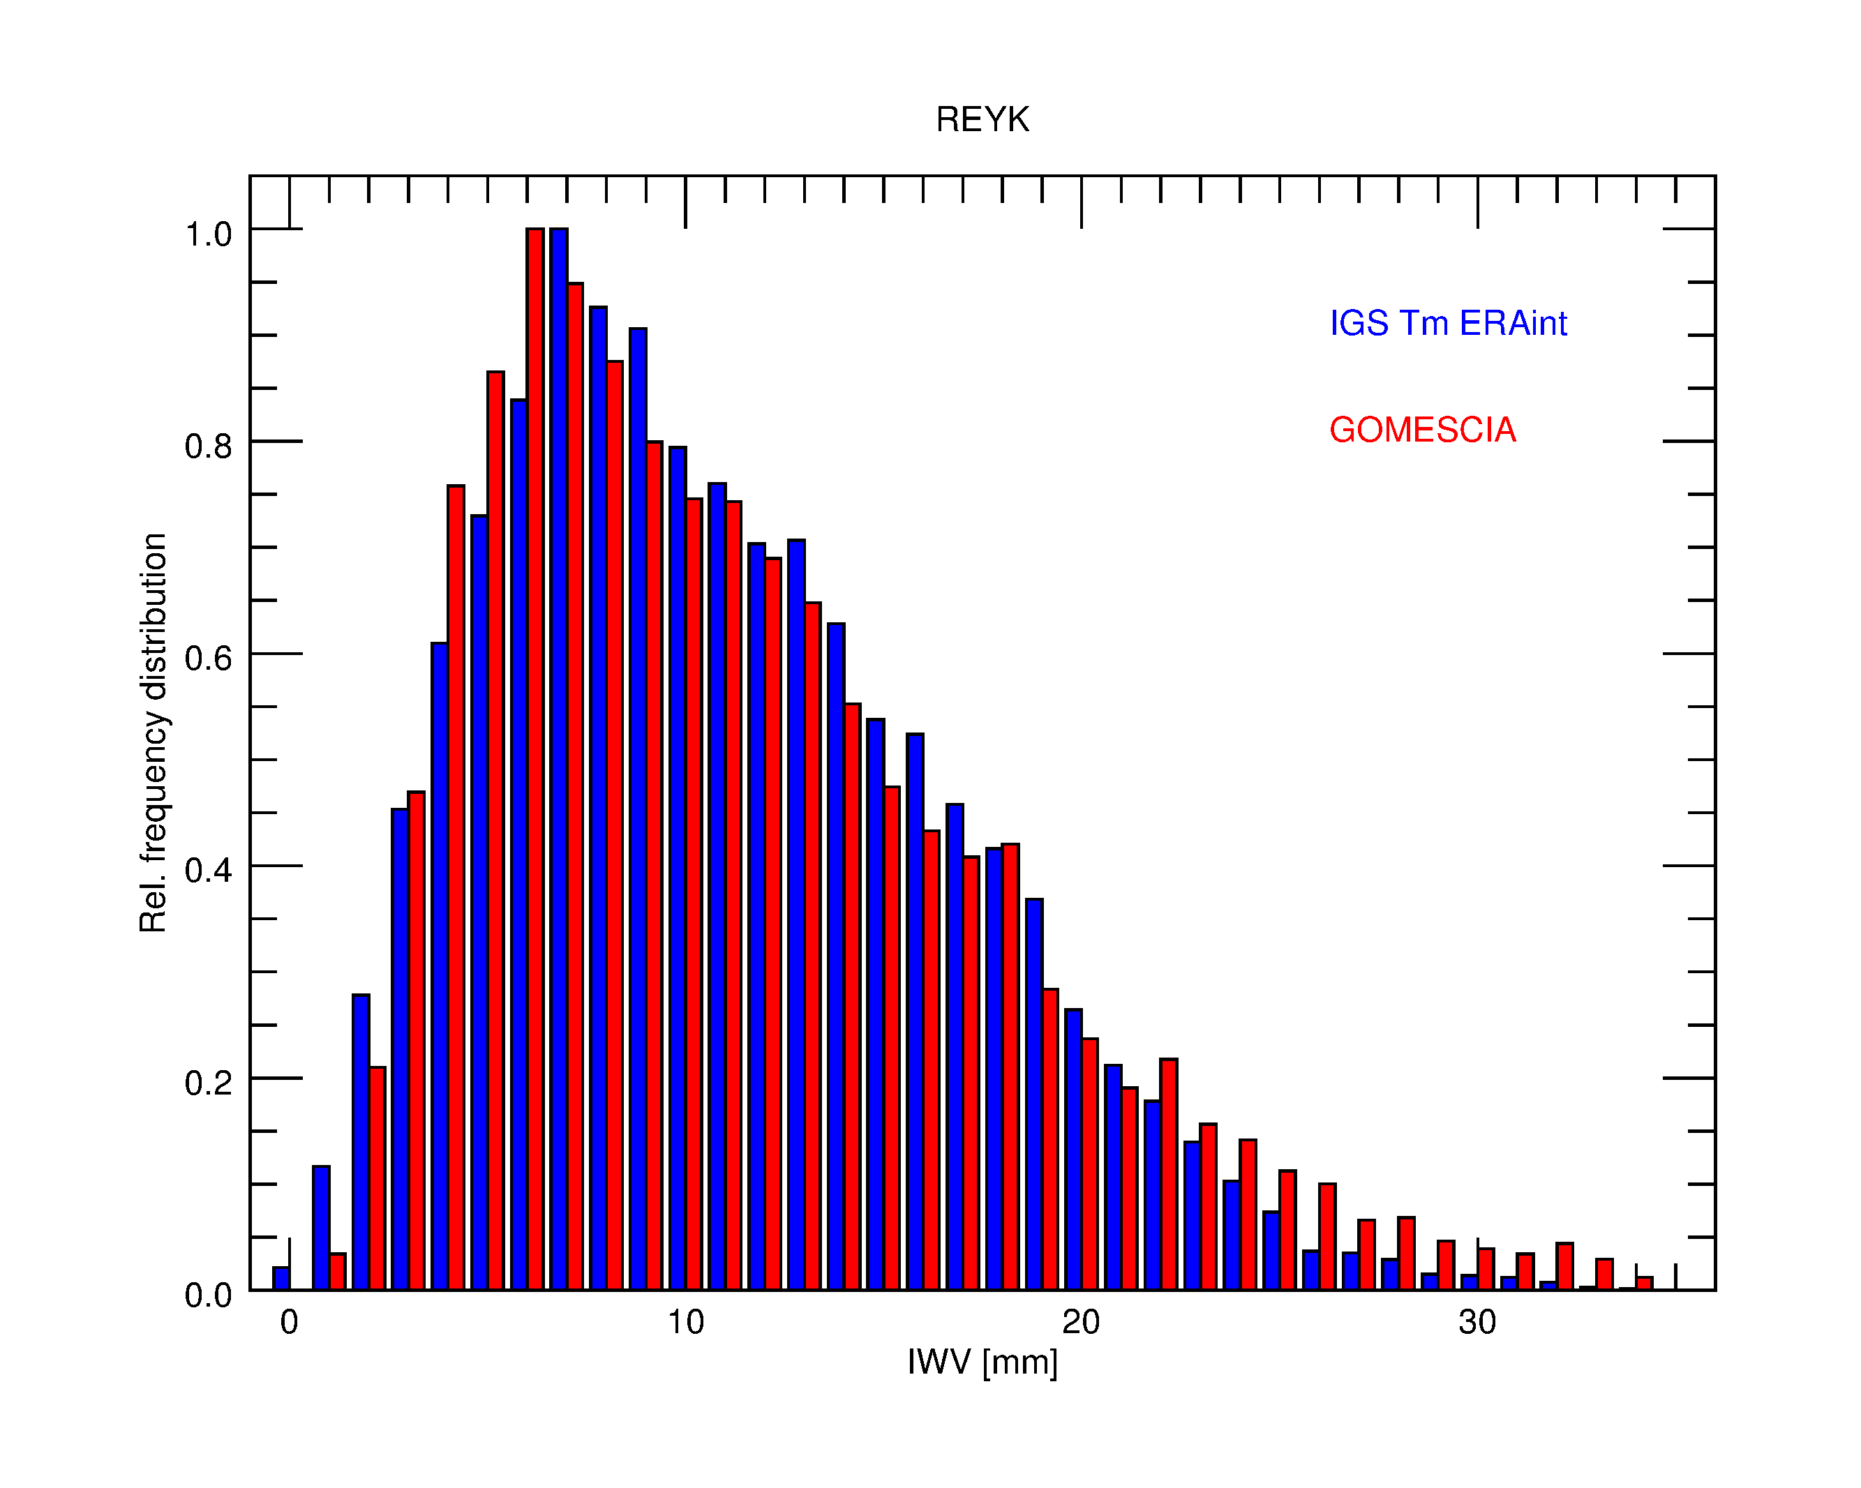
Introduction
Diurnal variation
Seasonal cycle
Frequency distribution
ROB
Histograms: (normalized) frequency distribution
REYK
Normalized frequency distributions are very similar.
GOMESCIA has a larger tail for the high-range IWV values (positive skew).
GNSS4SWEC workshop
Reykjavik, Iceland 8-10 March 2016

Slide 18
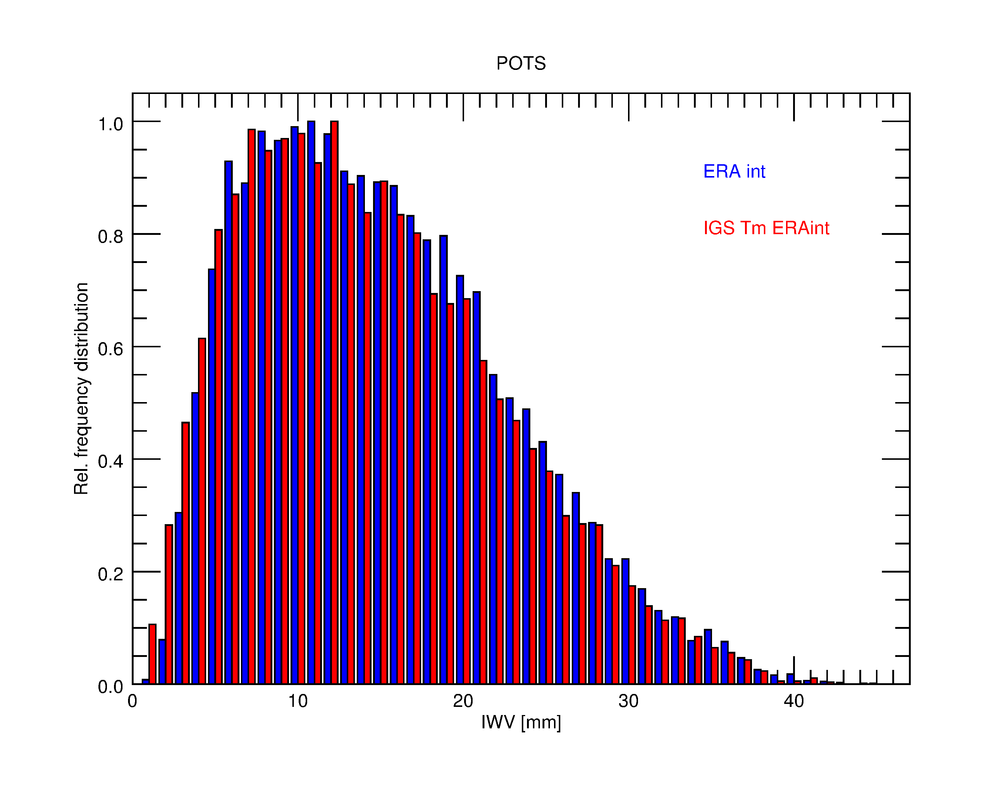
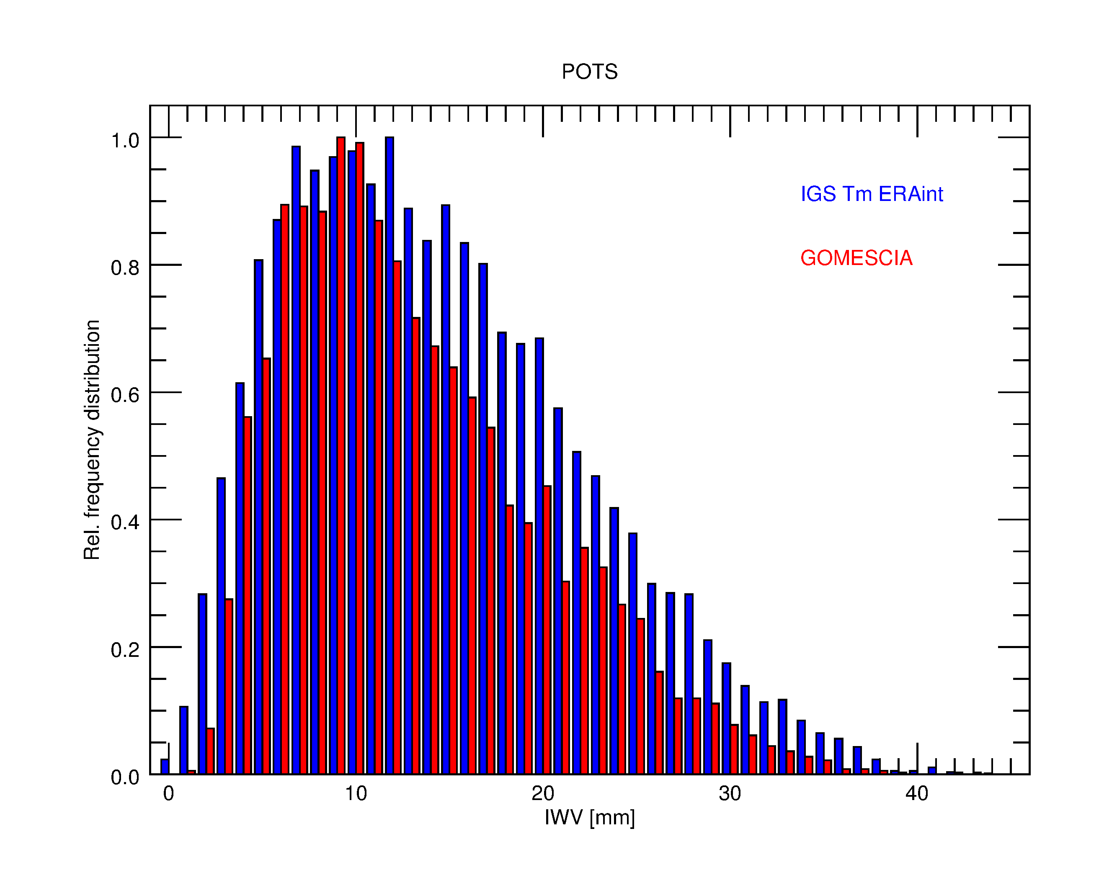
Introduction
Diurnal variation
Seasonal cycle
Frequency distribution
ROB
Histograms: (normalized) frequency distribution
POTS
GOMESCIA has sharper (normalized) frequency distribution.
Are these differences related to retrieval strategy, geographical site properties, etc.?
GNSS4SWEC workshop
Reykjavik, Iceland 8-10 March 2016

Slide 19
ROB
Conclusions & Perspectives
Preliminary results of the analysis on the short-term behaviour of the IWV field, retrieved by different techniques (GPS, satellite, reanalysis)
  >< long-term trends.
No clear, consistent bias between the measurements/calculations taken at 0h/12h UTC.
→ Time difference between GOMESCIA and IGS/ERA-interim not ----------significant for the agreement.
IGS and ERA-Interim IWV capture similarly the IWV seasonal cycle, both in phase and amplitude, but the IGS ZTD time series show a slightly different seasonal cycle.
GOMESCIA gives a slightly different seasonal cycle as IGS/ERA-interim.
The geographical analysis of the IWV histograms at different sites needs further investigation.
Homogenisation issues: sub-WG (splinter session at 14h)
GNSS4SWEC workshop
Reykjavik, Iceland 8-10 March 2016

Slide 20
painting by Jess Sutton
Thank you!
GNSS4SWEC workshop
Reykjavik, Iceland 8-10 March 2016

